Slide 1
Chapter 6 Arrays
C How to Program, 8/e, GE

Slide 2
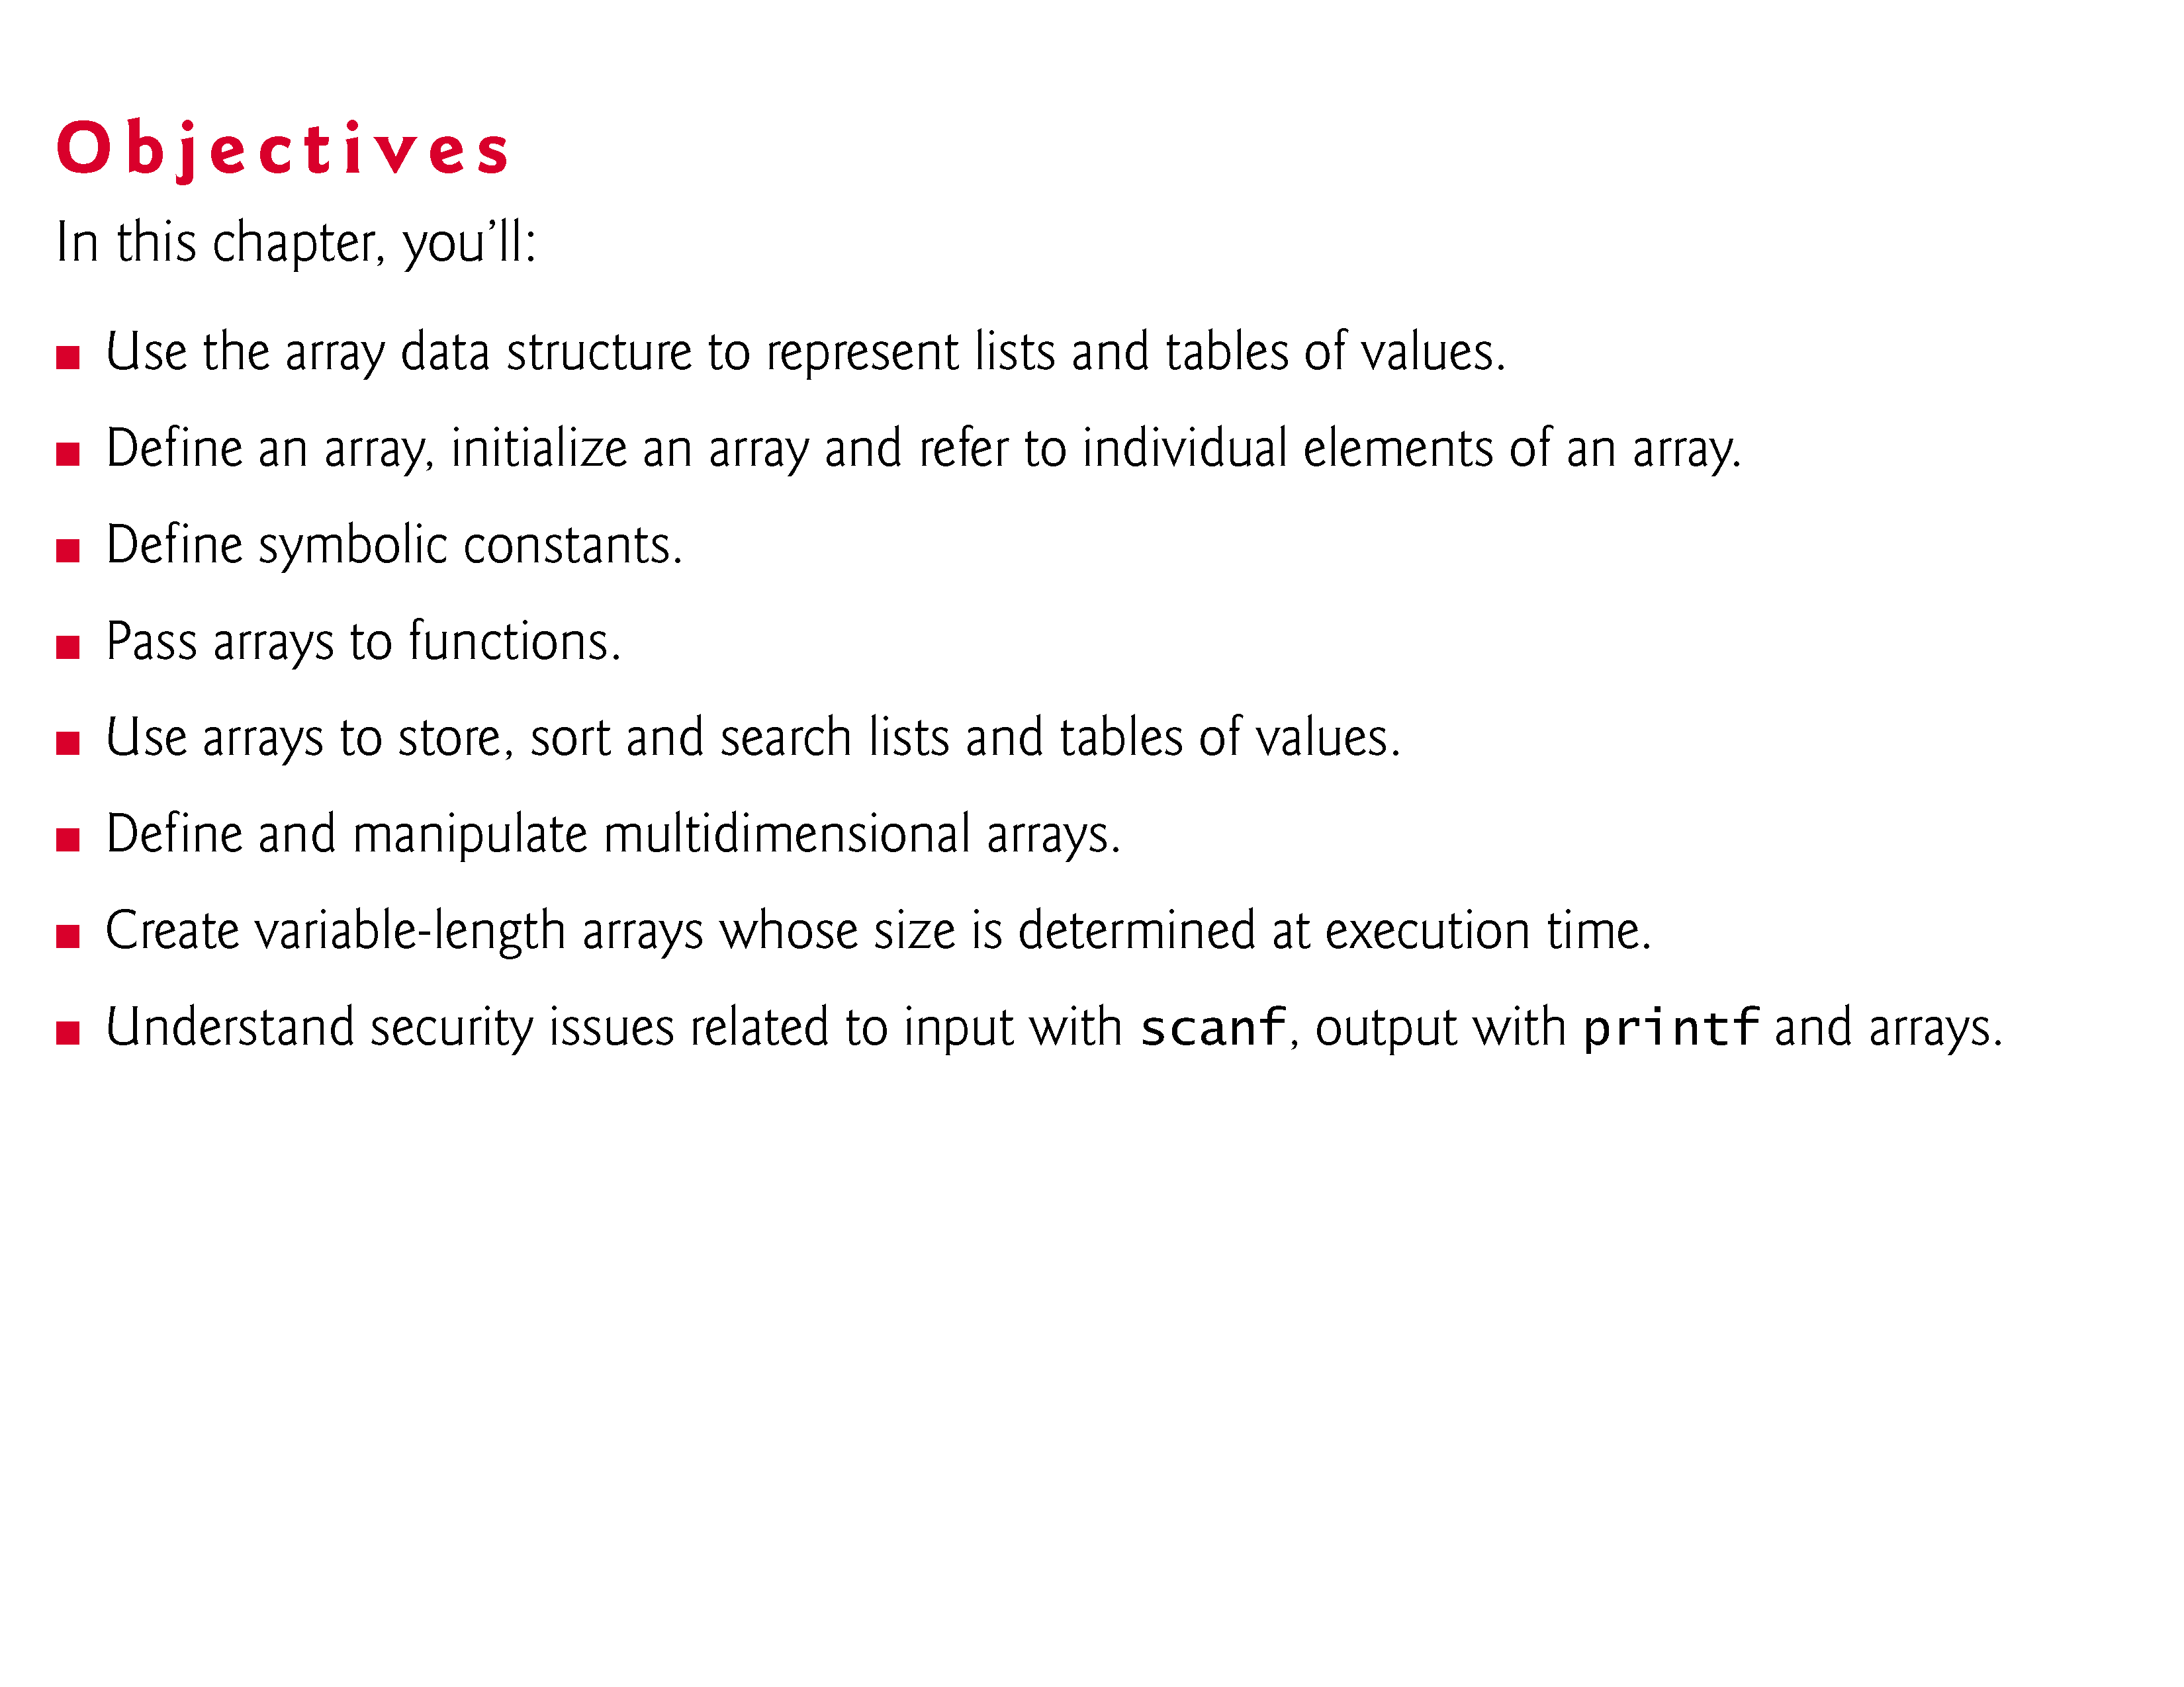

Slide 3
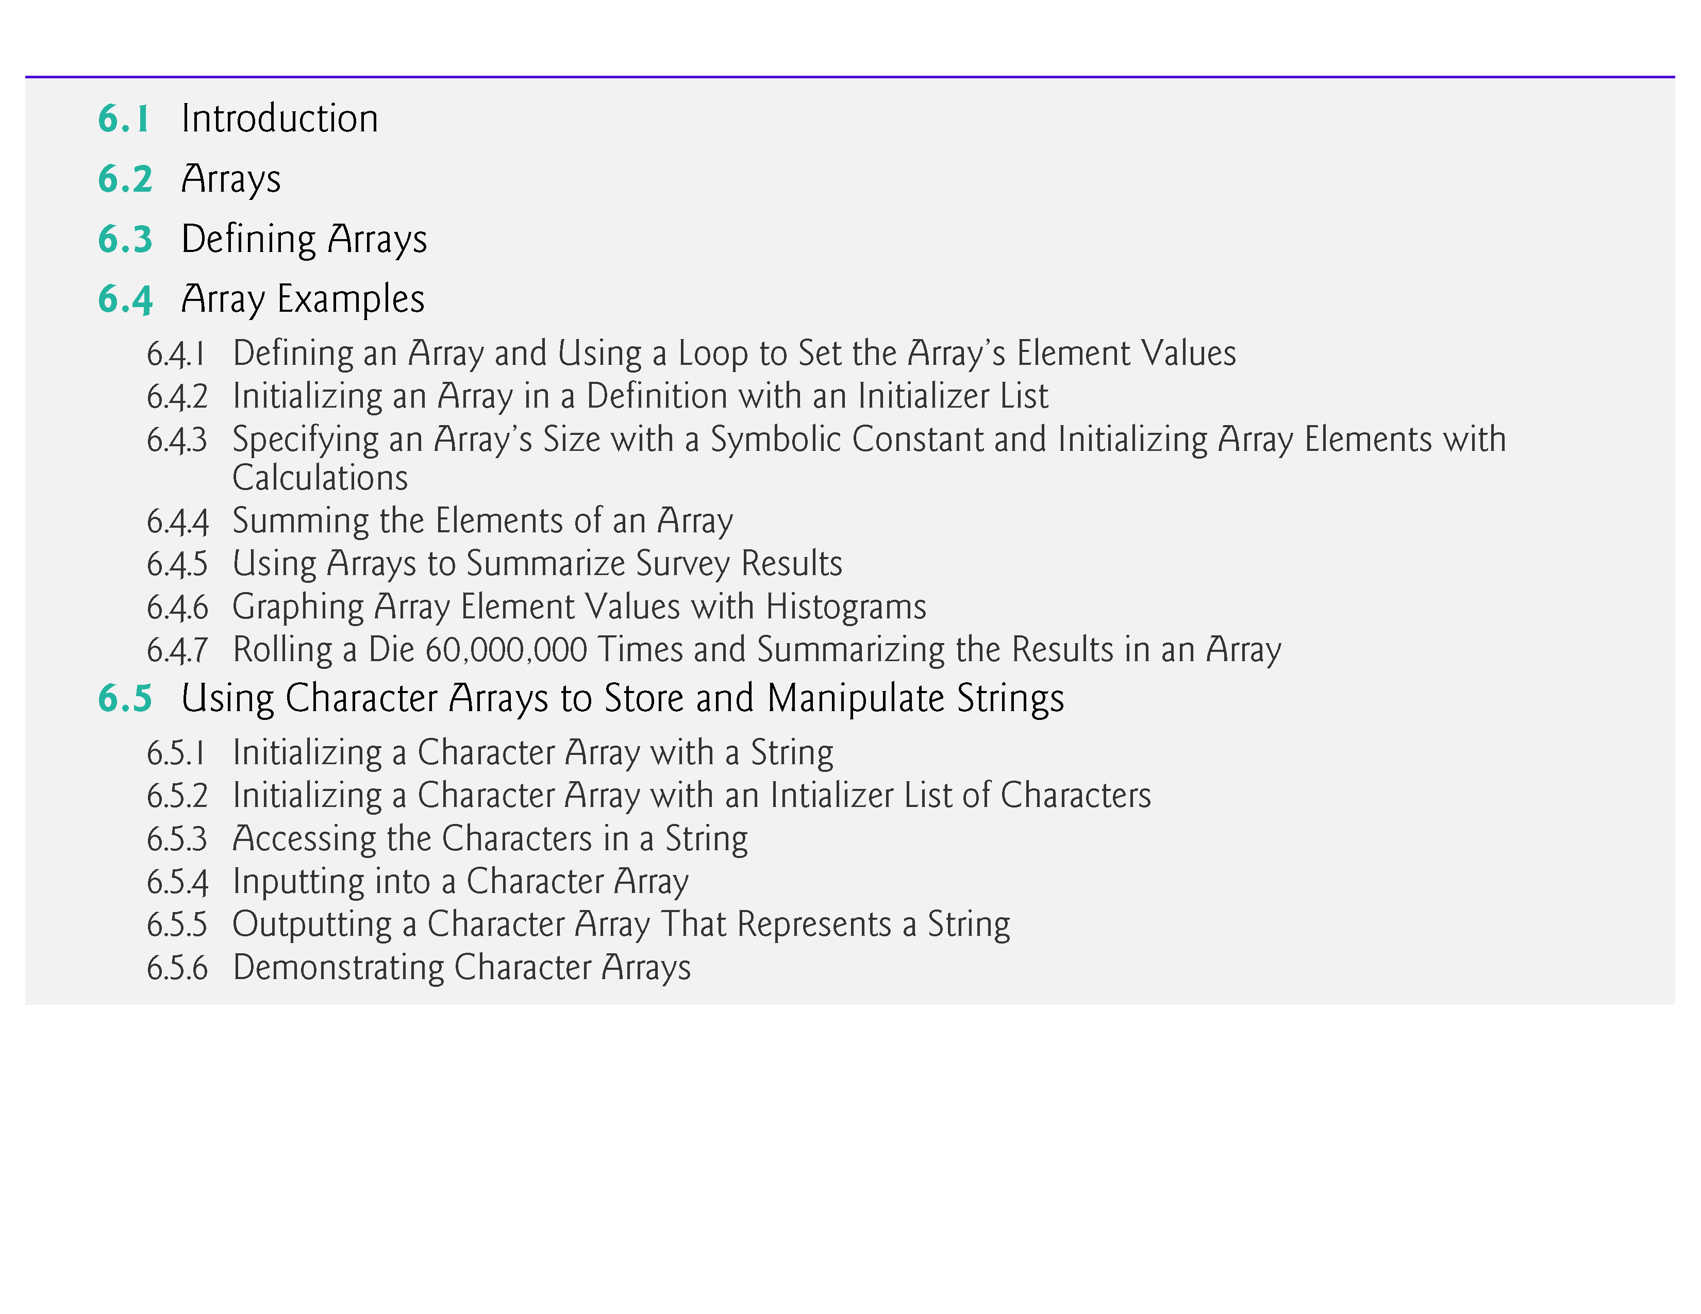

Slide 4
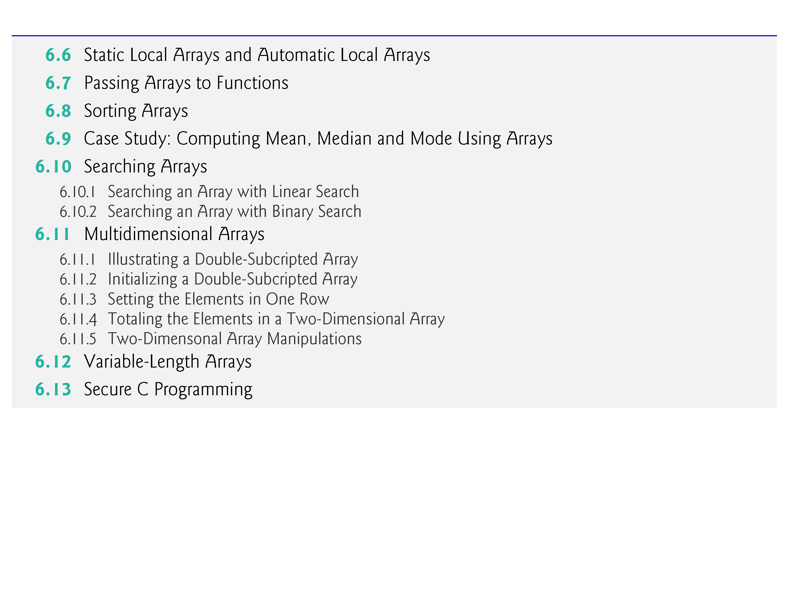

Slide 5
6.1 Introduction
This chapter serves as an introduction to data structures.
Arrays are data structures consisting of related data items of the same type.
In Chapter 10, we discuss C’s notion of struct (structure)—a data structure consisting of related data items of possibly different types.
Arrays and structures are “static” entities in that they remain the same size throughout program execution.

Slide 6
6.2 Arrays
An array is a group of contiguous memory locations that all have the same type.
To refer to a particular location or element in the array, we specify the array’s name and the position number of the particular element in the array.
Figure 6.1 shows an integer array called c, containing 12 elements.
Any one of these elements may be referred to by giving the array’s name followed by the position number of the particular element in square brackets ([]).

Slide 7
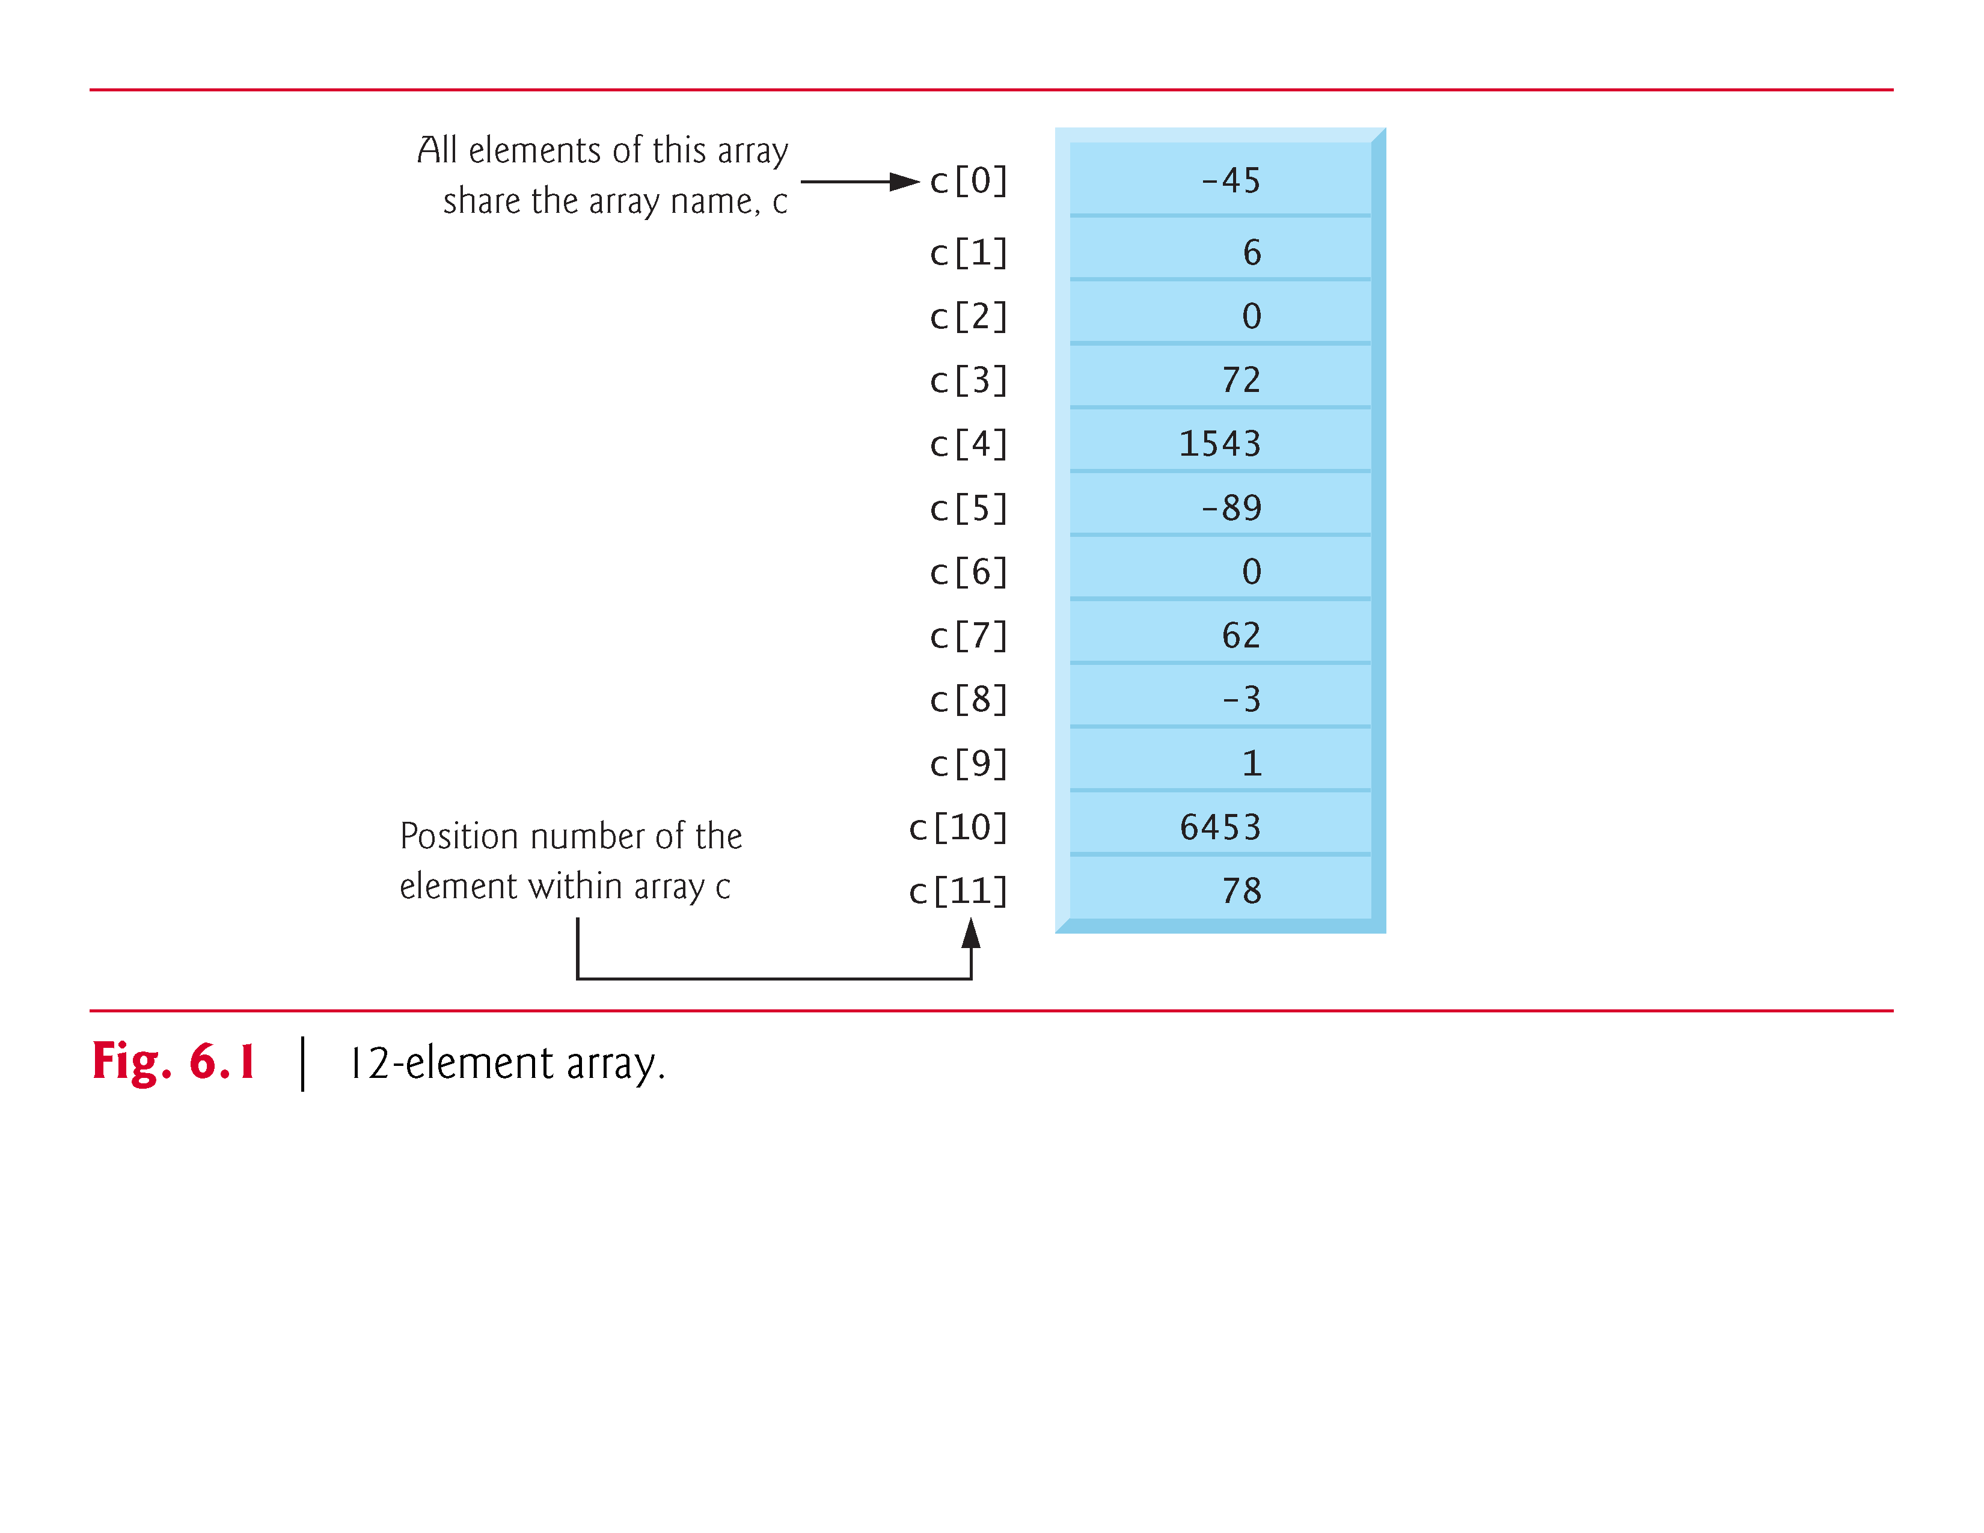

Slide 8
6.2 Arrays (Cont.)
The first element in every array is the zeroth element.
An array name, like other identifiers, can contain only letters, digits and underscores and cannot begin with a digit.
The position number within square brackets is called an index or subscript.
An index must be an integer or an integer expression.

Slide 9
6.2 Arrays (Cont.)
For example, if a = 5 and b = 6, then the statement
c[a + b] += 2;
adds 2 to array element c[11].
An indexed array name is an lvalue—it can be used on the left side of an assignment.

Slide 10
6.2 Arrays (Cont.)
Let’s examine array c (Fig. 6.1) more closely.
The array’s name is c.
Its 12 elements are referred to as c[0], c[1], c[2], …, c[10] and c[11].
The value stored in c[0] is –45, the value of c[1] is 6, c[2] is 0, c[7] is 62 and c[11] is 78.
To print the sum of the values contained in the first three elements of array c, we’d write
printf("%d", c[0] + c[1] + c[2]);
To divide the value of element 7 of array c by 2 and assign the result to the variable x, write

Slide 11
6.2 Arrays (Cont.)
The brackets used to enclose the index of an array are actually considered to be an operator in C.
They have the same level of precedence as the function call operator (i.e., the parentheses that are placed after a function name to call that function).
Figure 6.2 shows the precedence and associativity of the operators introduced to this point in the text.

Slide 12
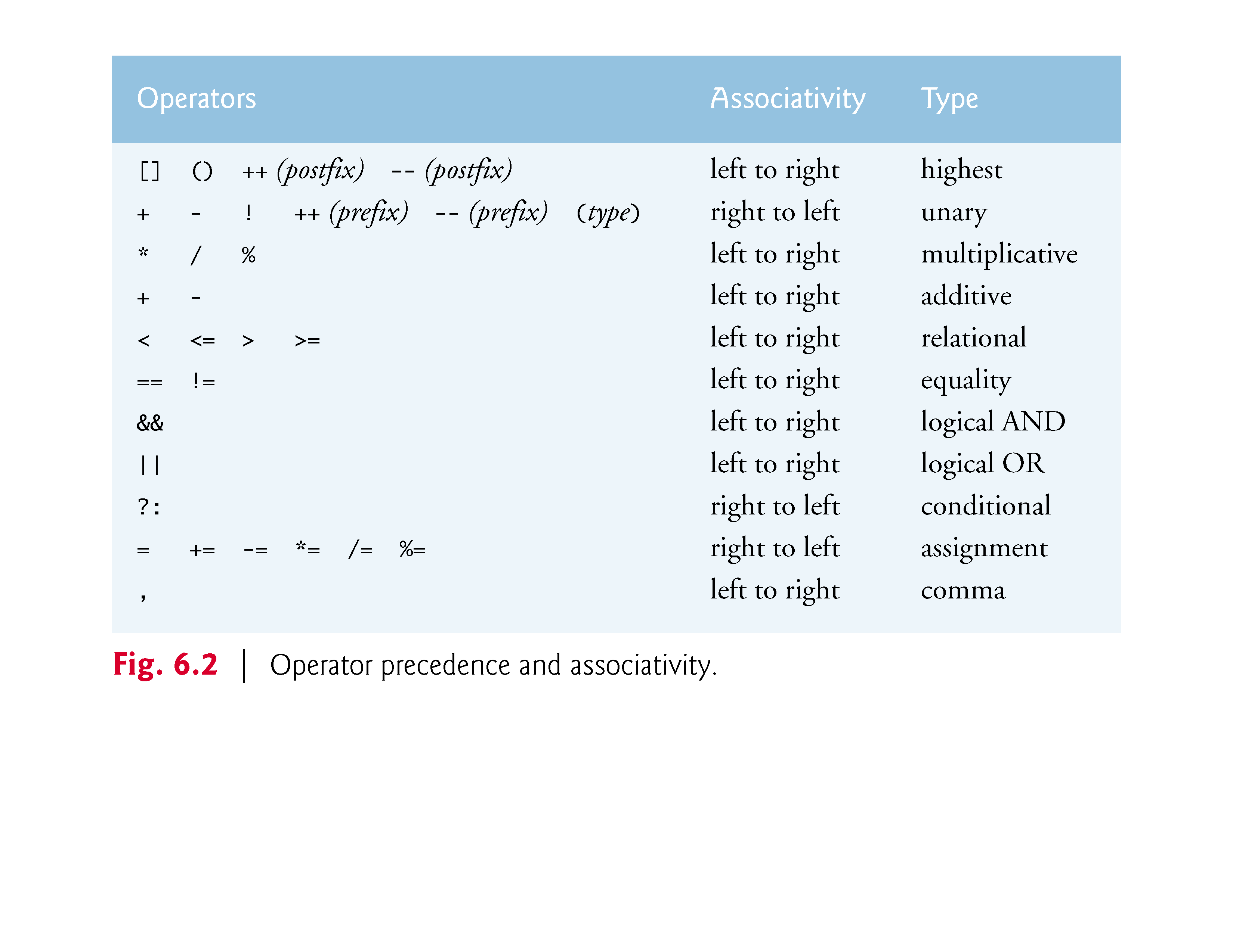

Slide 13
6.3 Defining Arrays
Arrays occupy space in memory.
You specify the type of each element and the number of elements each array requires so that the computer may reserve the appropriate amount of memory.
The following definition reserves 12 elements for integer array c, which has indices in the range 0-11.
int c[12];

Slide 14
6.3 Defining Arrays (Cont.)
The definition
int b[100], x[27];
reserves 100 elements for integer array b and 27 elements for integer array x.
These arrays have indices in the ranges 0–99 and 0–26, respectively.
Arrays may contain other data types.
Character strings and their similarity to arrays are discussed in Chapter 8. The relationship between pointers and arrays is discussed in Chapter 7.

Slide 15
6.4 Array Examples
6.4.1 Defining an Array and Using a Loop to Set the Array’s Element Values
Like any other variables, uninitialized array elements contain garbage values.
Figure 6.3 uses for statements to initialize the elements of a five integer array n to zeros and print the array in tabular format.
The first printf statement displays the column heads for the two columns printed in the subsequent for statement.

Slide 16
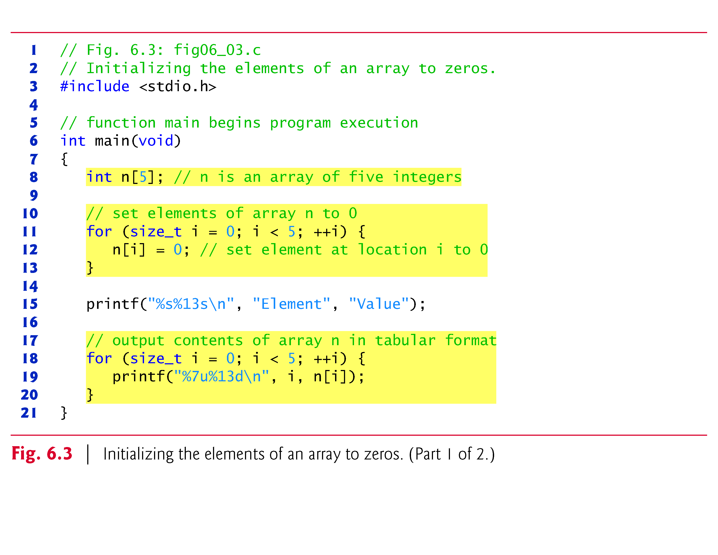

Slide 17
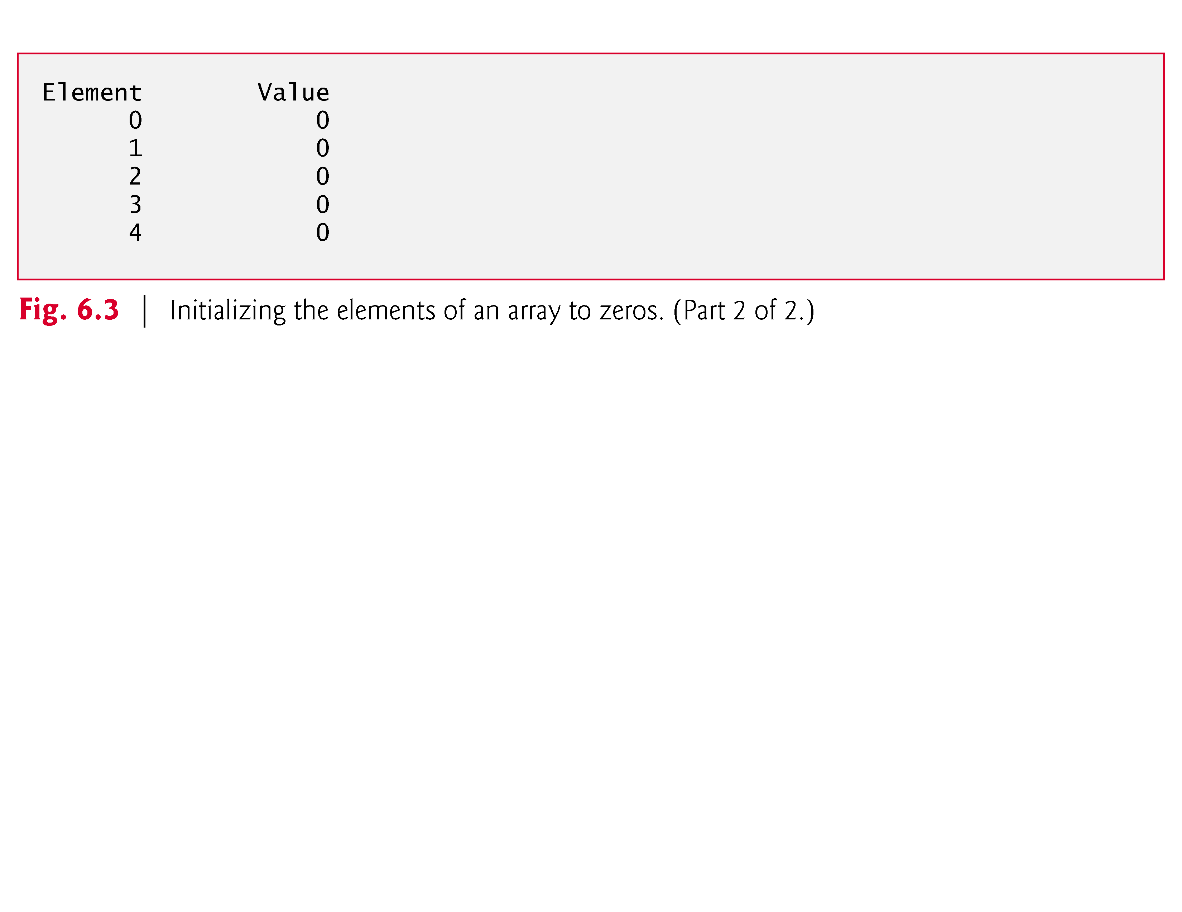

Slide 18
6.4 Array Examples (Cont.)
Notice that the variable i is declared to be of type size_t, which according to the C standard represents an unsigned integral type.
This type is recommended for any variable that represents an array’s size or an array’s indices.
Type size_t is defined in header <stddef.h>, which is often included by other headers (such as <stdio.h>).
[Note: If you attempt to compile Fig. 6.3 and receive errors, simply include <stddef.h> in your program.]

Slide 19
6.4 Array Examples (Cont.)
Initializing an Array in a Definition with an Initializer List
The elements of an array can also be initialized when the array is defined by following the definition with an equals sign and braces, {}, containing a comma-separated list of array initializers.
Figure 6.4 initializes an integer array with five values and prints the array in tabular format.

Slide 20
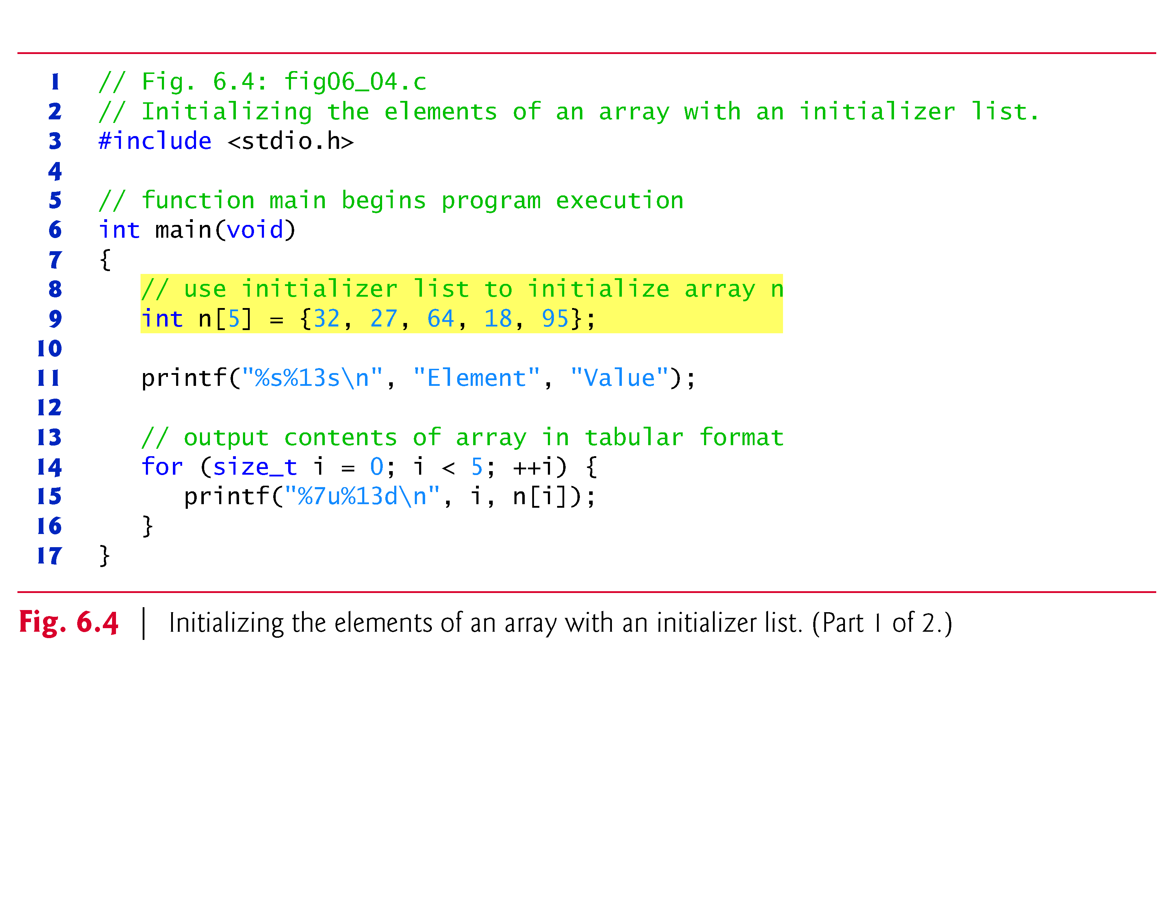

Slide 21
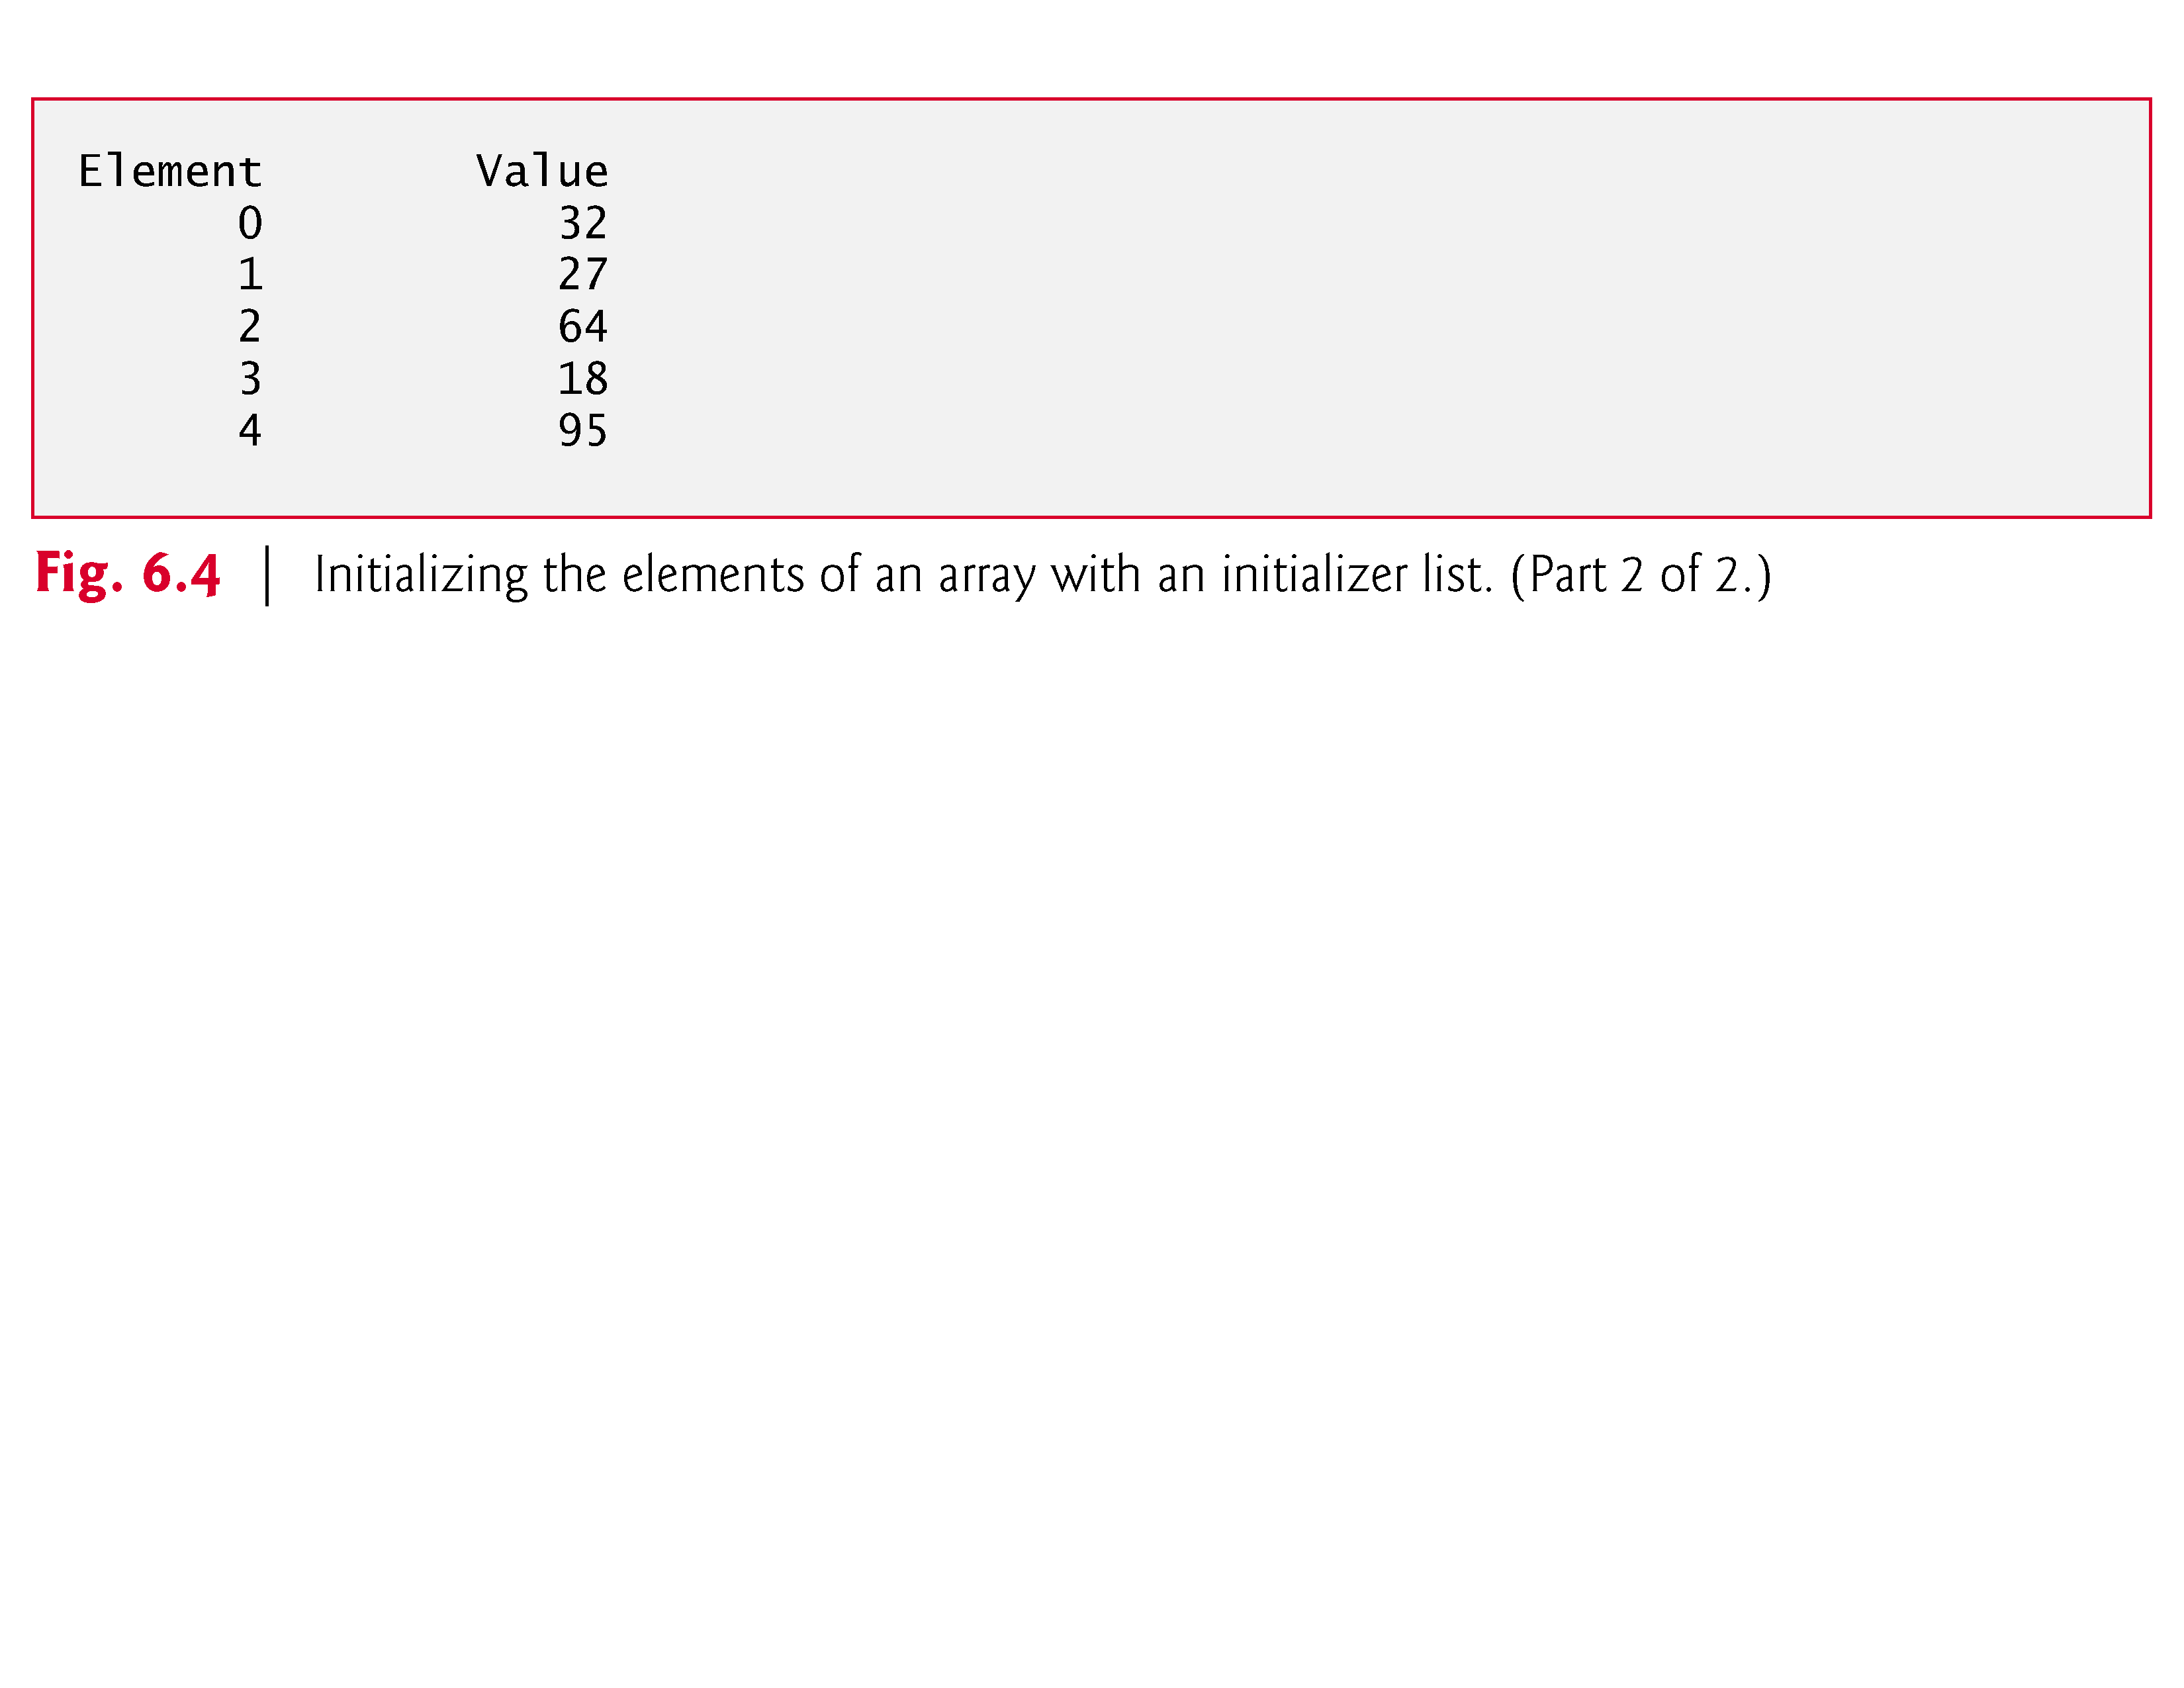

Slide 22
6.4 Array Examples (Cont.)
If there are fewer initializers than elements in the array, the remaining elements are initialized to zero.
For example, the elements of the array n in Fig. 6.3 could have been initialized to zero as follows:
// initializes entire array to zeros
int n[10] = {0};
This explicitly initializes the first element to zero and initializes the remaining nine elements to zero because there are fewer initializers than there are elements in the array.

Slide 23
6.4 Array Examples (Cont.)
It’s important to remember that arrays are not automatically initialized to zero.
You must at least initialize the first element to zero for the remaining elements to be automatically zeroed.
Array elements are initialized before program startup for static arrays and at runtime for automatic arrays.

Slide 24
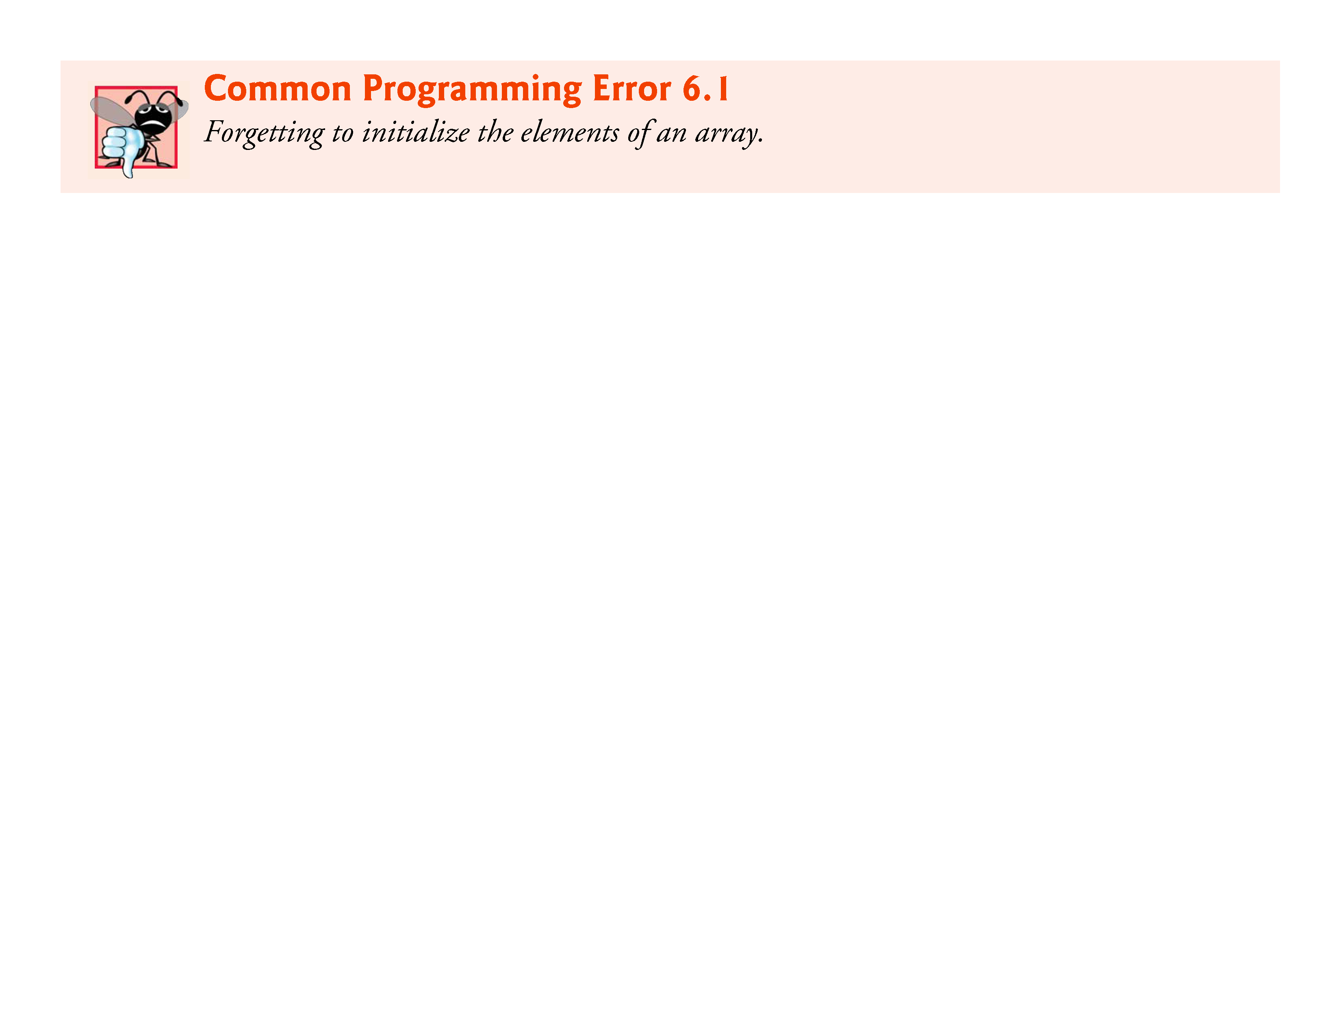

Slide 25
6.4 Array Examples (Cont.)
The array definition
int n[5] = {32, 27, 64, 18, 95, 14};
causes a syntax error because there are six initializers and only five array elements.

Slide 26
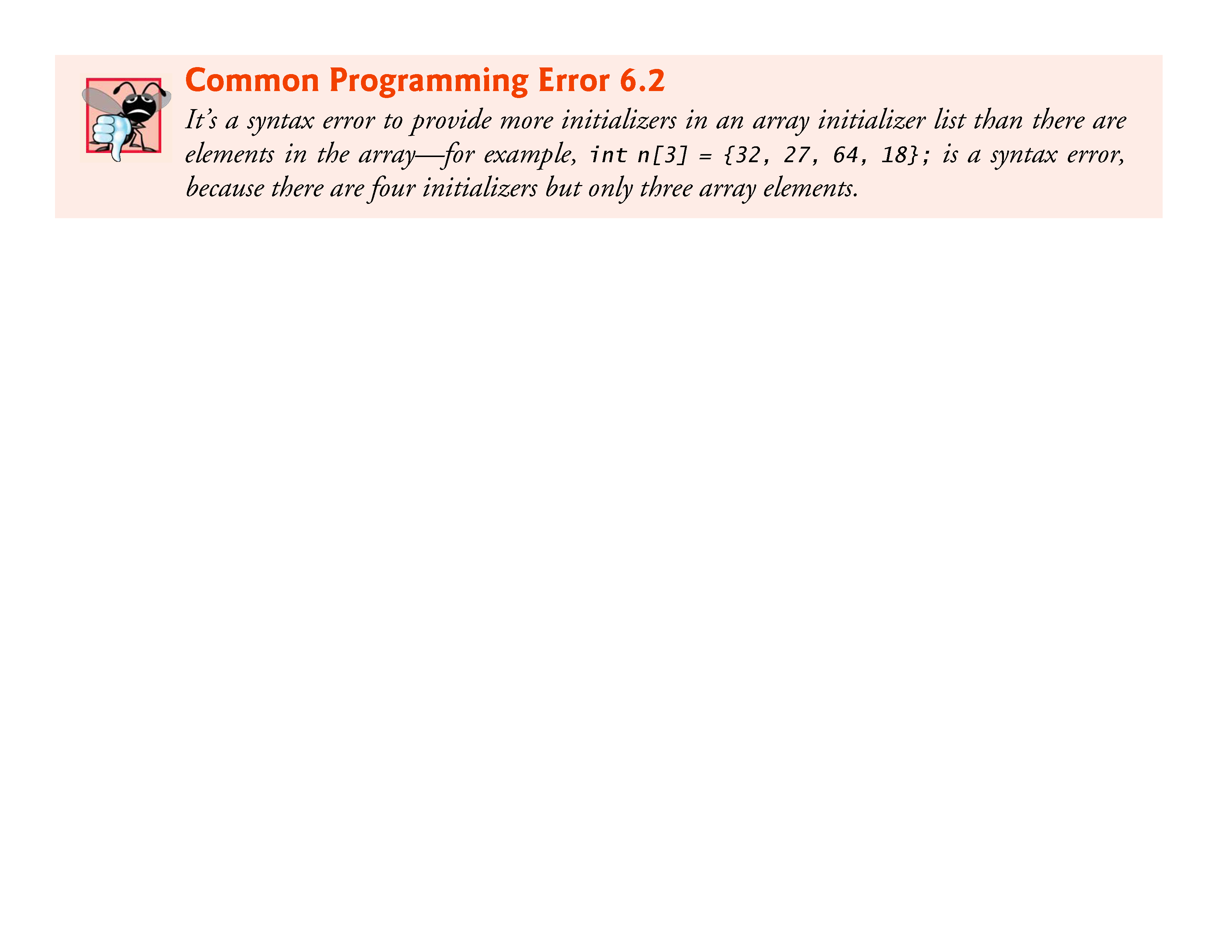

Slide 27
6.4 Array Examples (Cont.)
If the array size is omitted from a definition with an initializer list, the number of elements in the array will be the number of elements in the initializer list.
For example,
int n[] = {1, 2, 3, 4, 5};
would create a five-element array initialized with the indicated values.

Slide 28
6.4 Array Examples (Cont.)
Specifying an Array’s Size with a Symbolic Constant and Initializing Array Elements with Calculations
Figure 6.5 initializes the elements of a 10-element array s to the values 2, 4, 6, …, 20 and prints the array in tabular format.
The values are generated by multiplying the loop counter by 2 and adding 2.

Slide 29
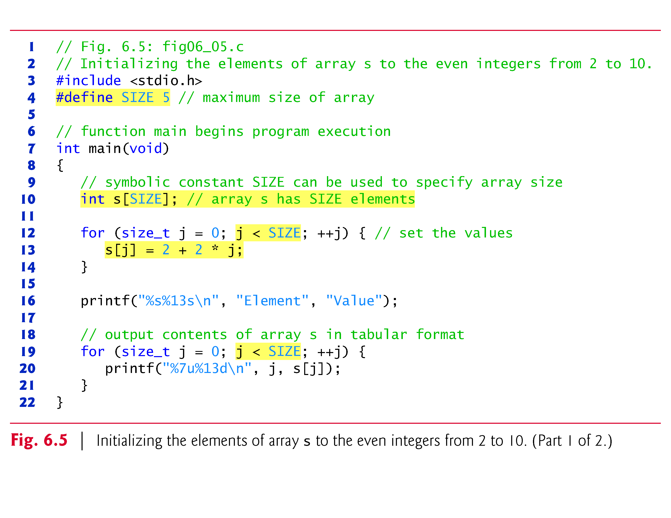

Slide 30
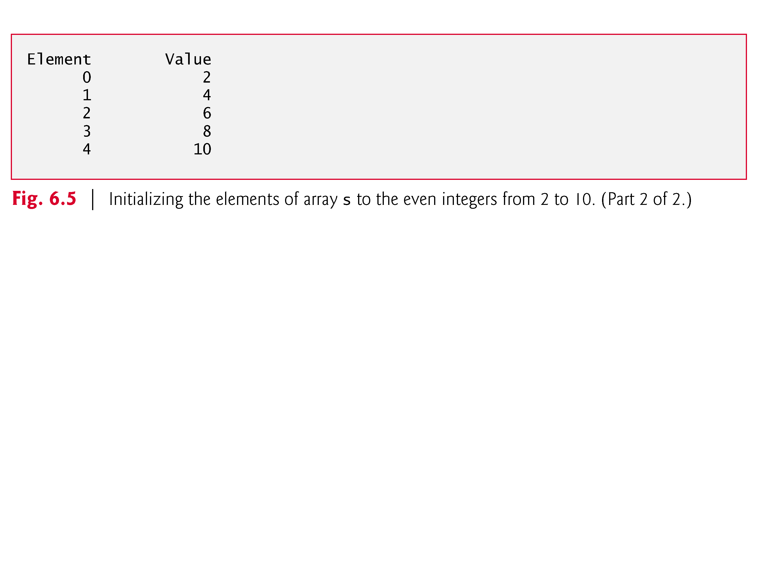

Slide 31
6.4 Array Examples (Cont.)
The #define preprocessor directive is introduced in this program.
#define SIZE 5
defines a symbolic constant SIZE whose value is 5.
A symbolic constant is an identifier that’s replaced with replacement text by the C preprocessor before the program is compiled.

Slide 32
6.4 Array Examples (Cont.)
When the program is preprocessed, all occurrences of the symbolic constant SIZE are replaced with the replacement text 5.
Using symbolic constants to specify array sizes makes programs more modifiable.
In Fig. 6.5, we could have the first for loop fill a 1000-element array by simply changing the value of SIZE in the #define directive from 5 to 1000.
If the symbolic constant SIZE had not been used, we’d have to change the program in three separate places.

Slide 33
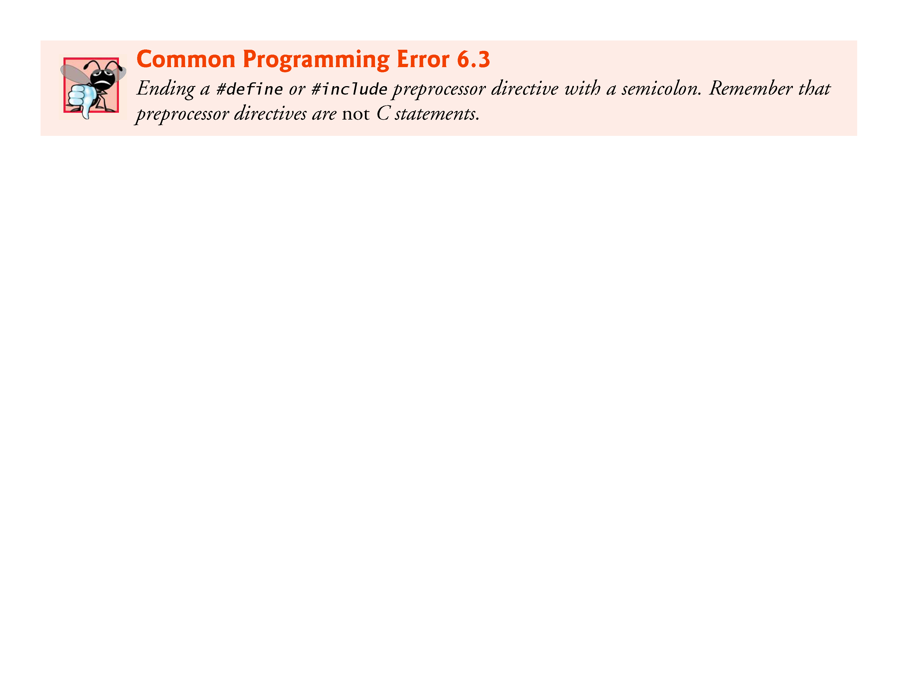

Slide 34
6.4 Array Examples (Cont.)
If the #define preprocessor directive is terminated with a semicolon, the preprocessor replaces all occurrences of the symbolic constant SIZE in the program with the text 5;.

Slide 35
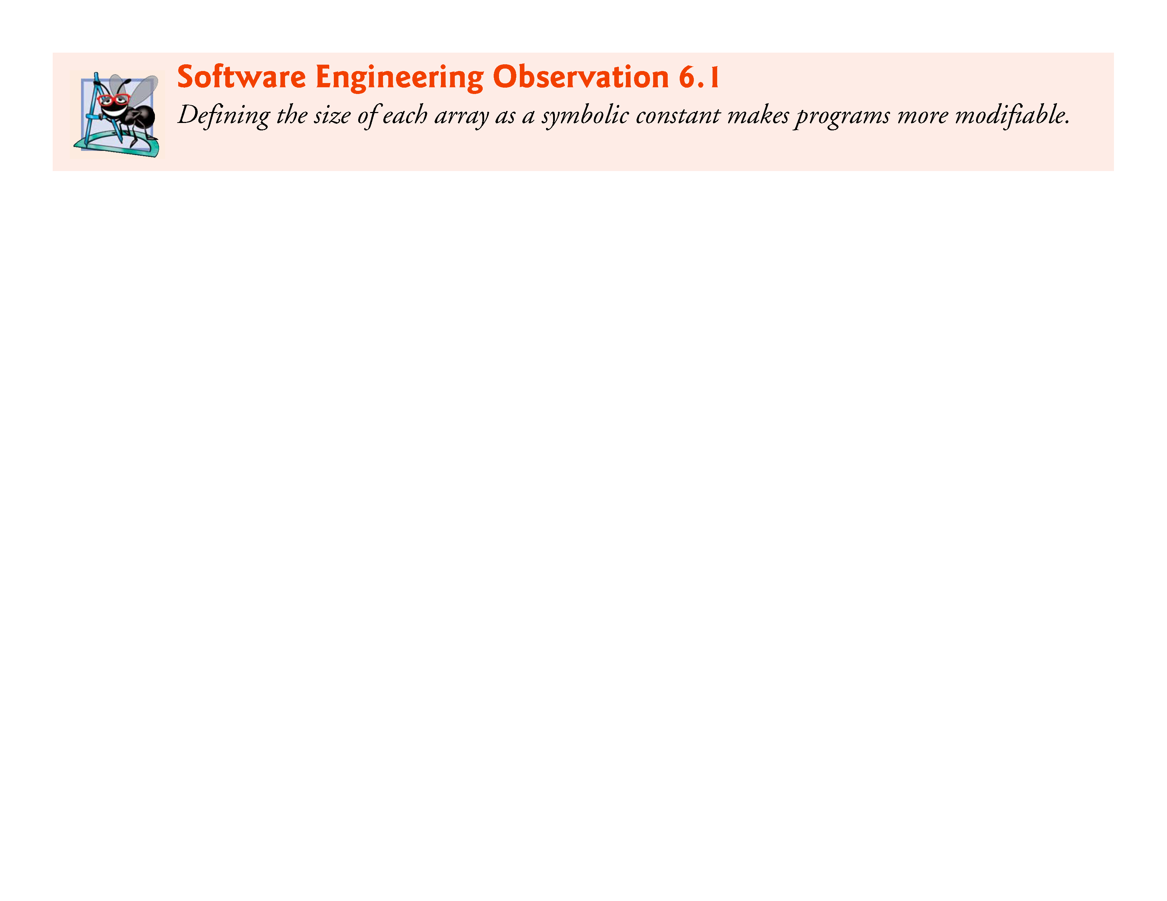

Slide 36
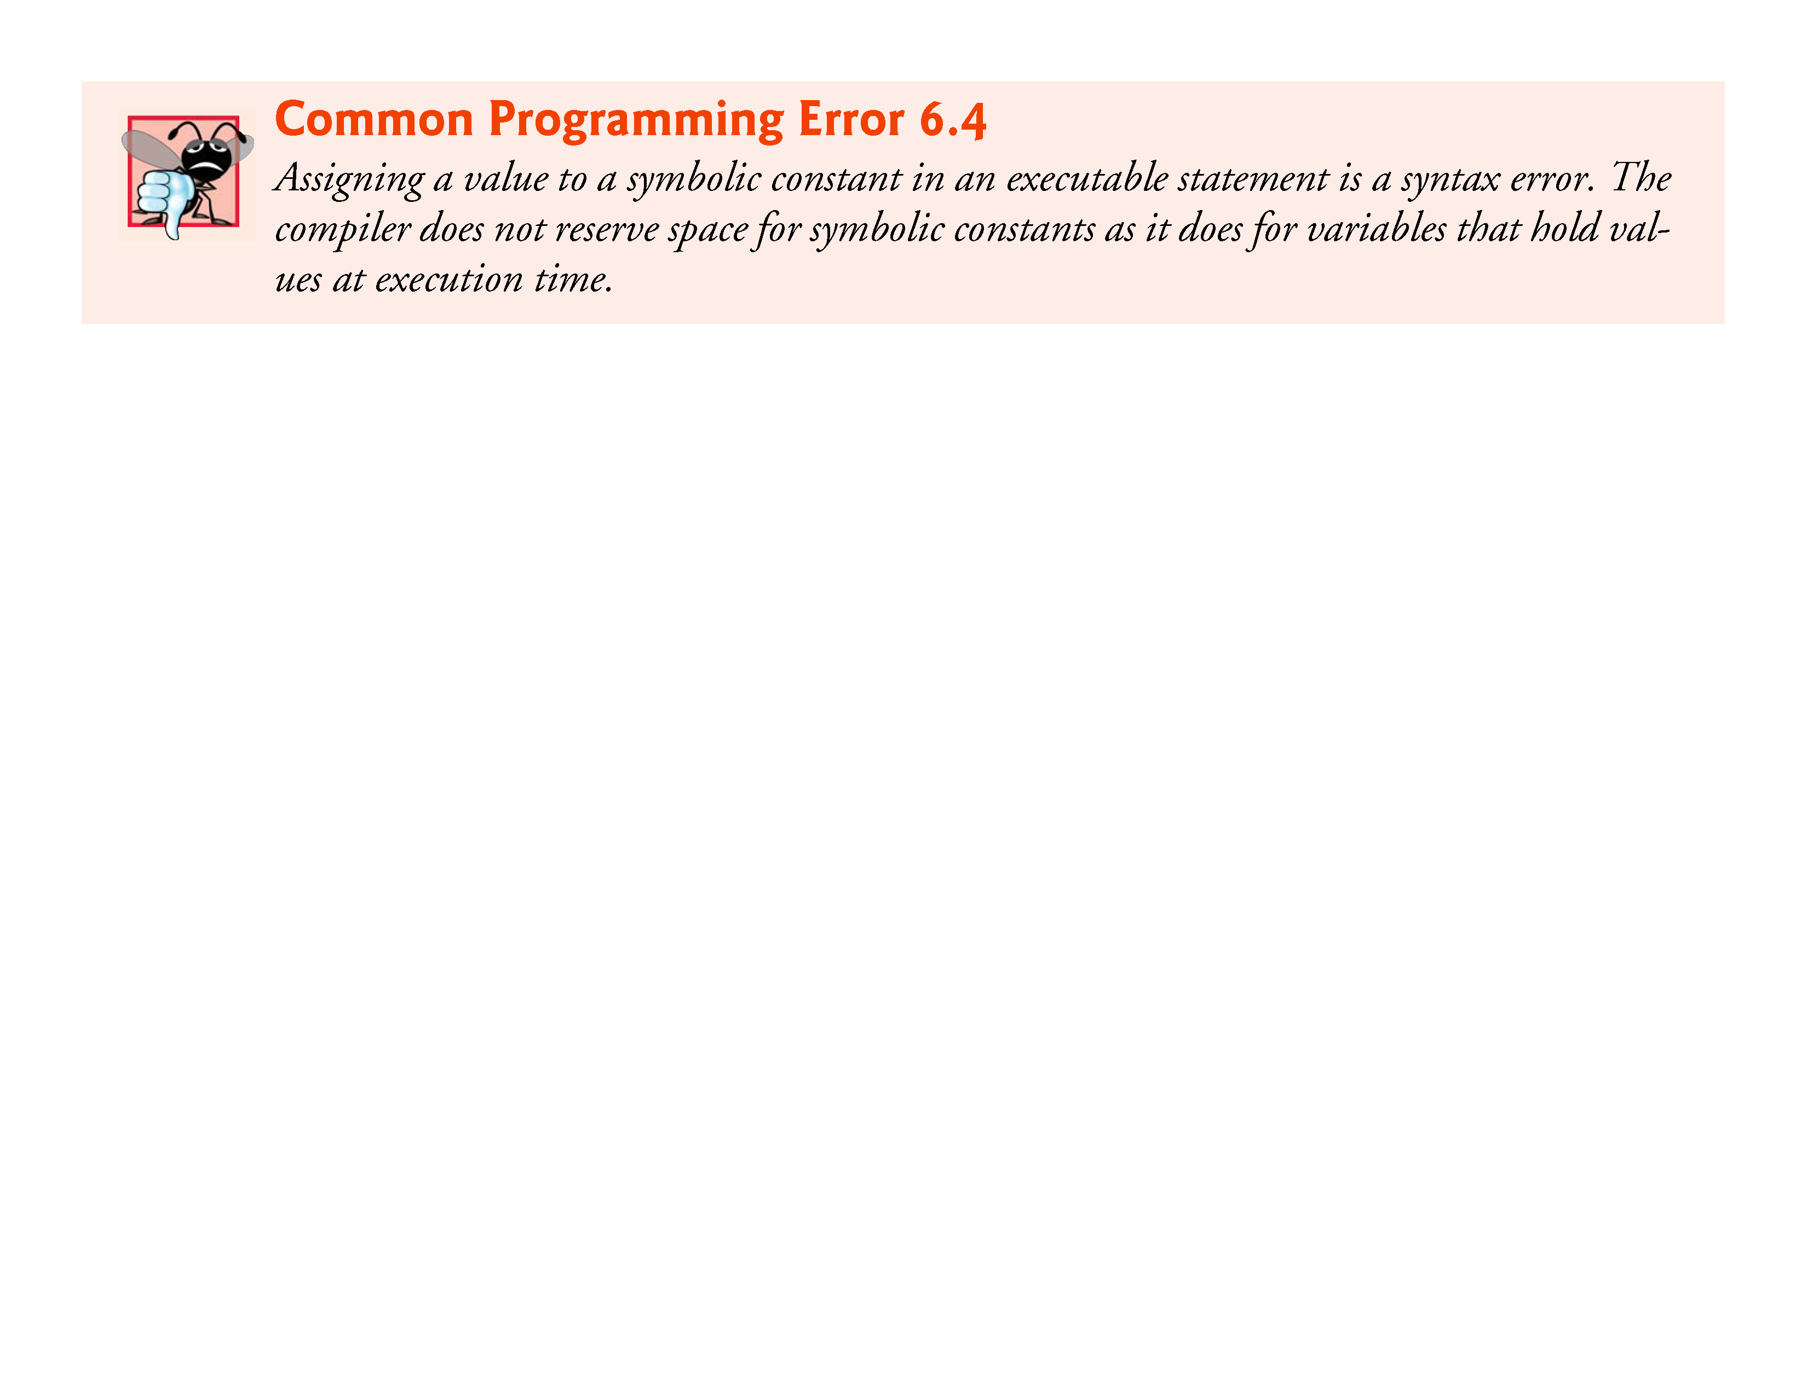

Slide 37
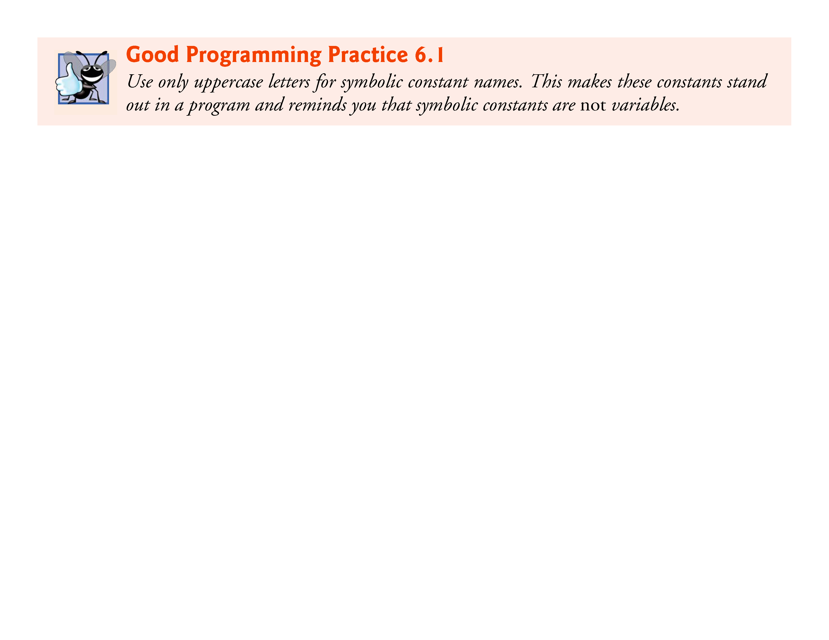

Slide 38
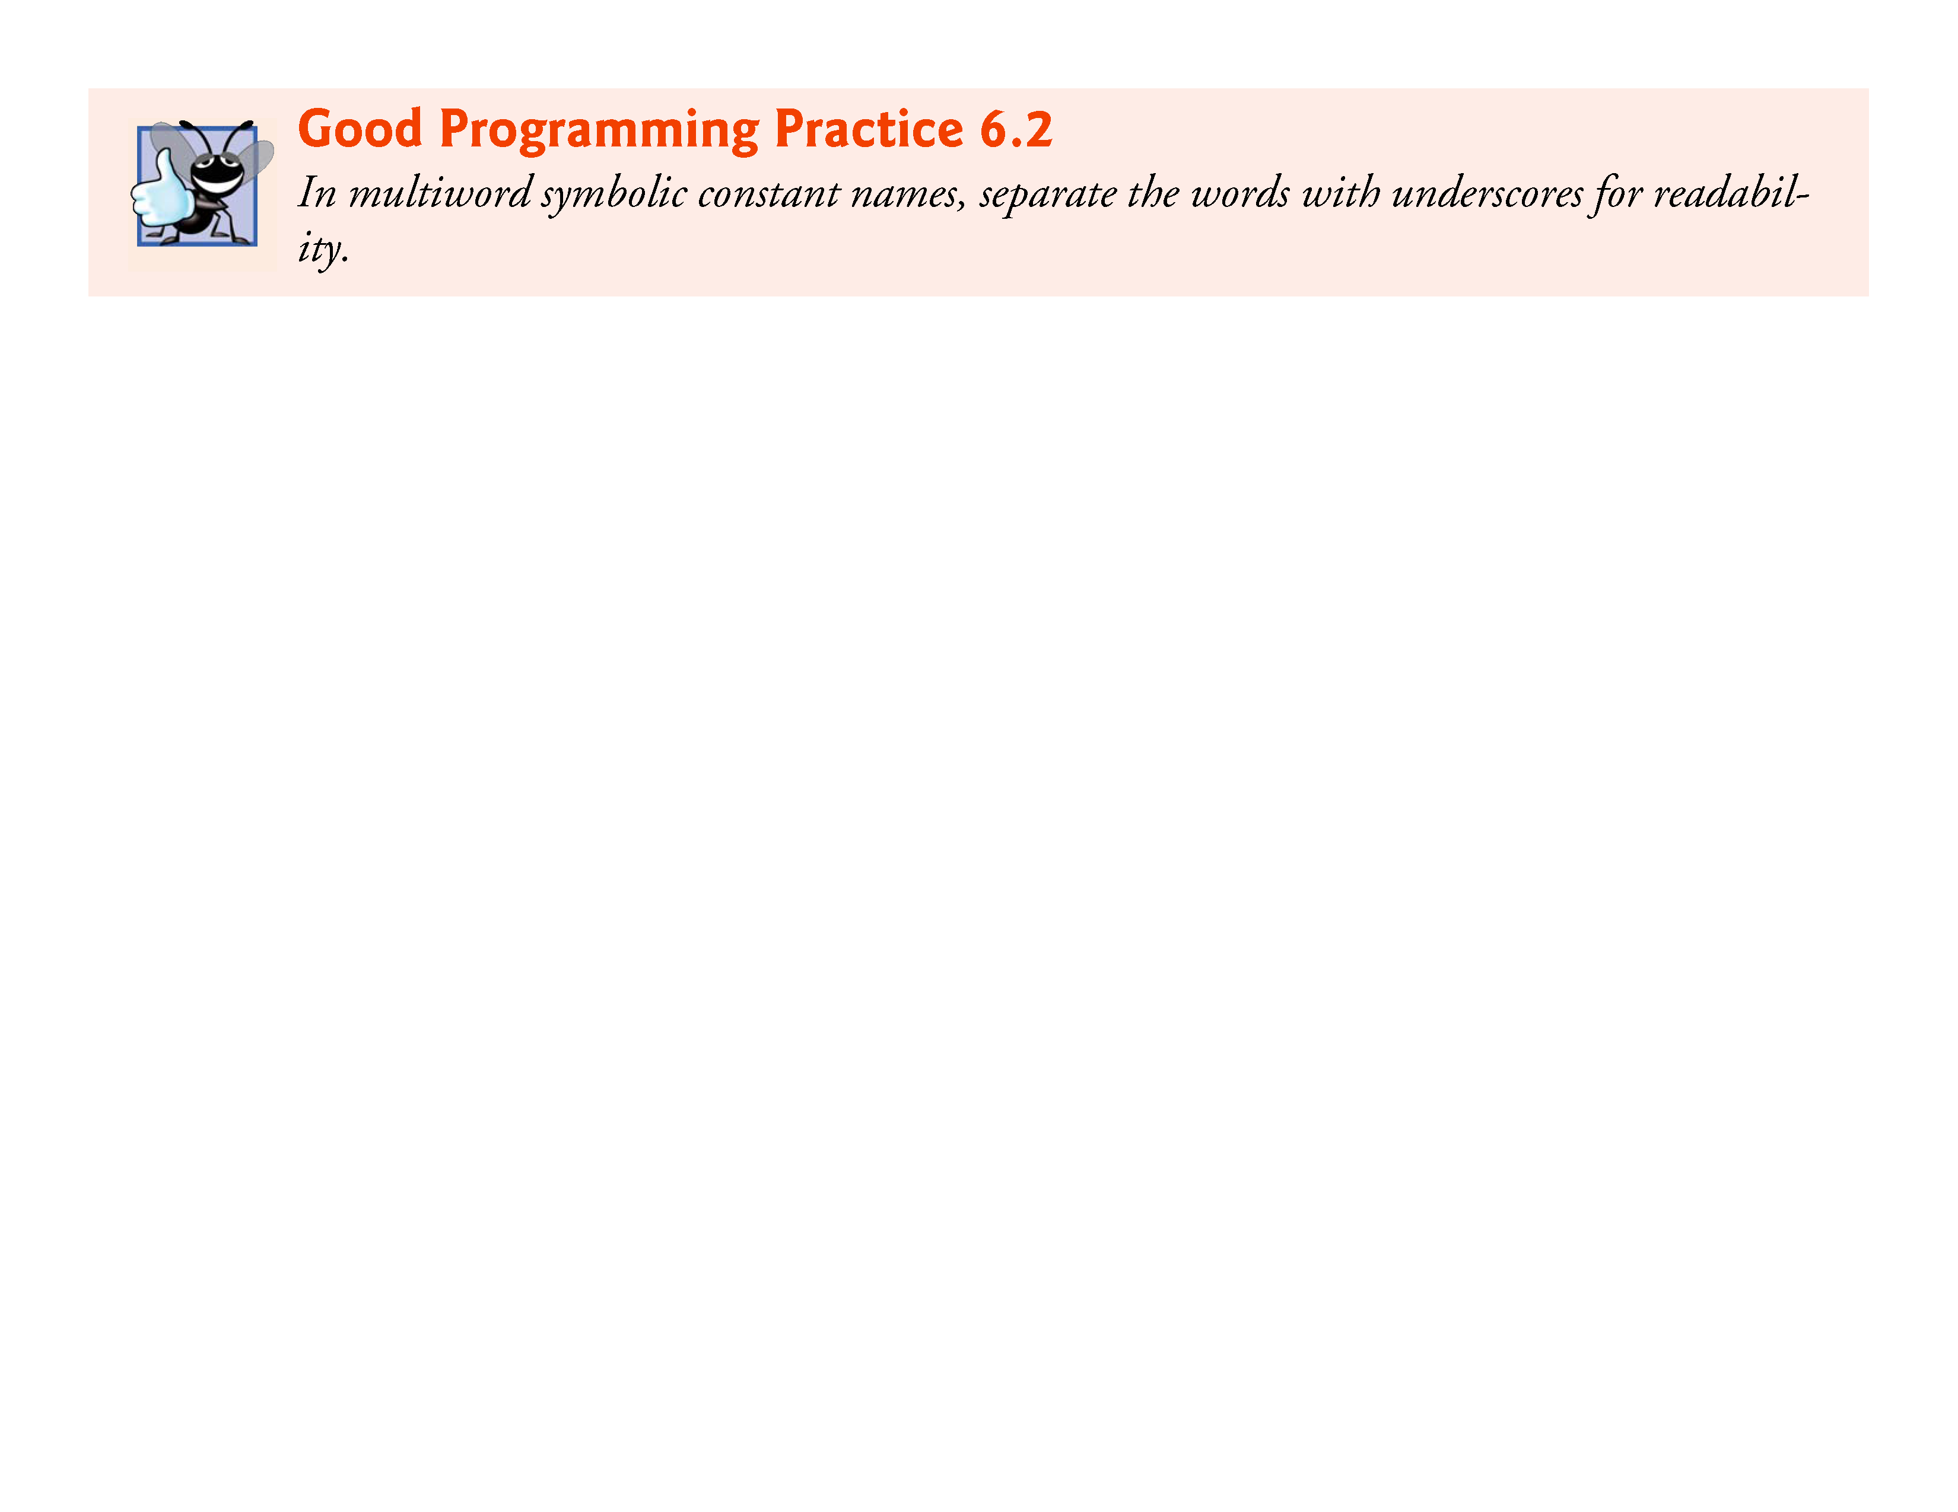

Slide 39
6.4 Array Examples (Cont.)
Summing the Elements of an Array
Figure 6.6 sums the values contained in the 12-element integer array a.
The for statement’s body does the totaling.

Slide 40
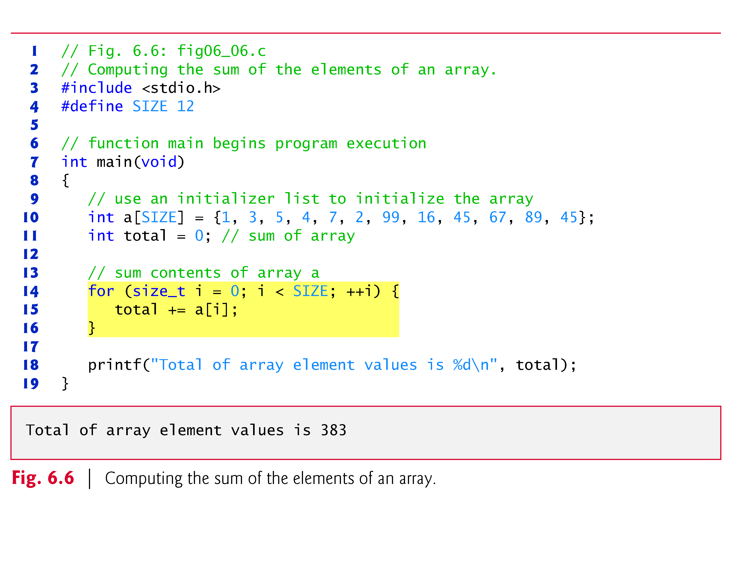

Slide 41
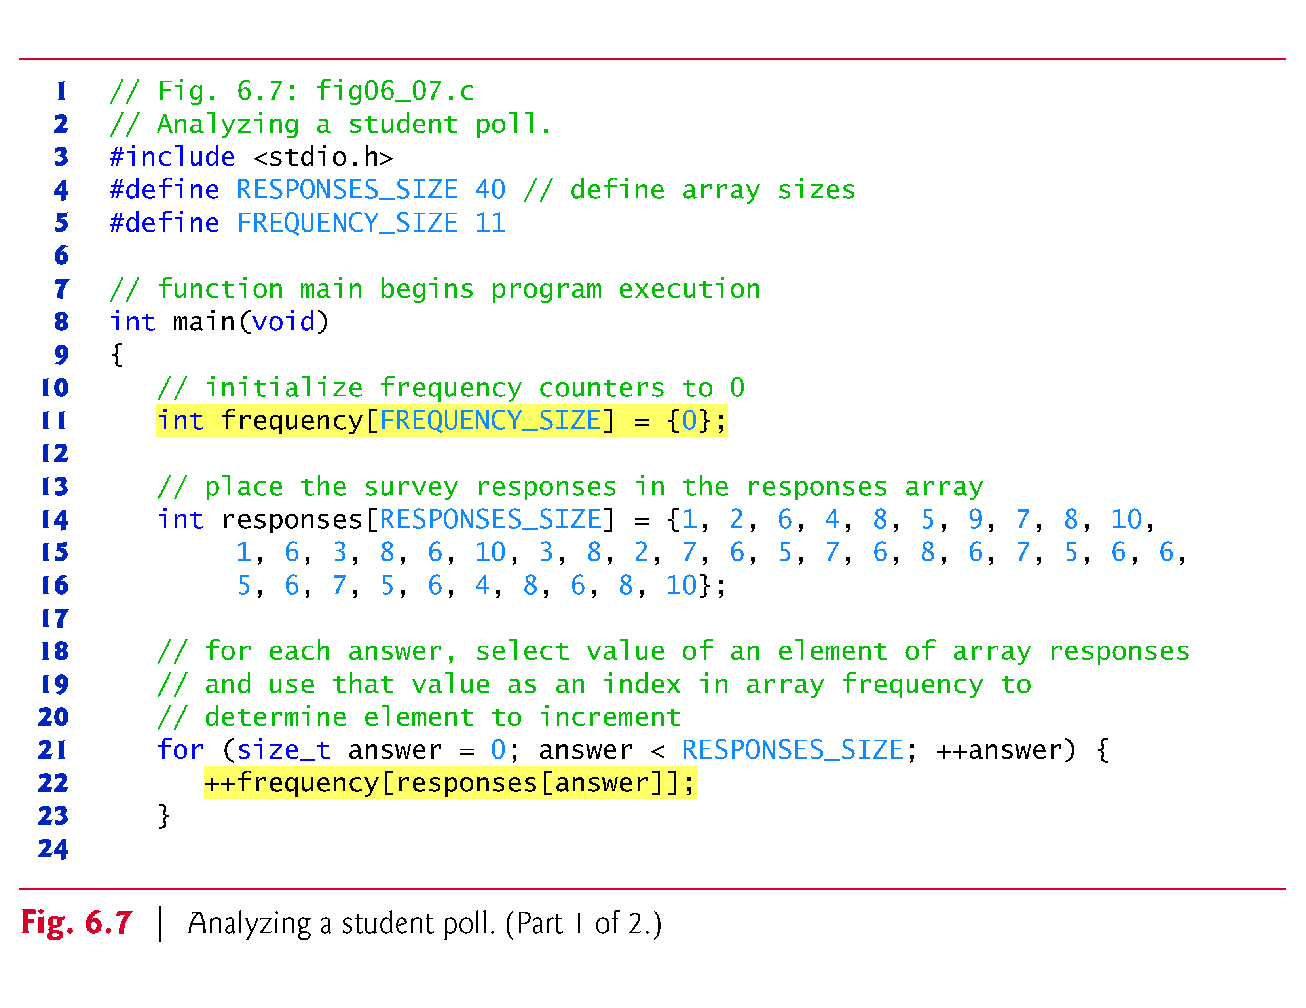

Slide 42
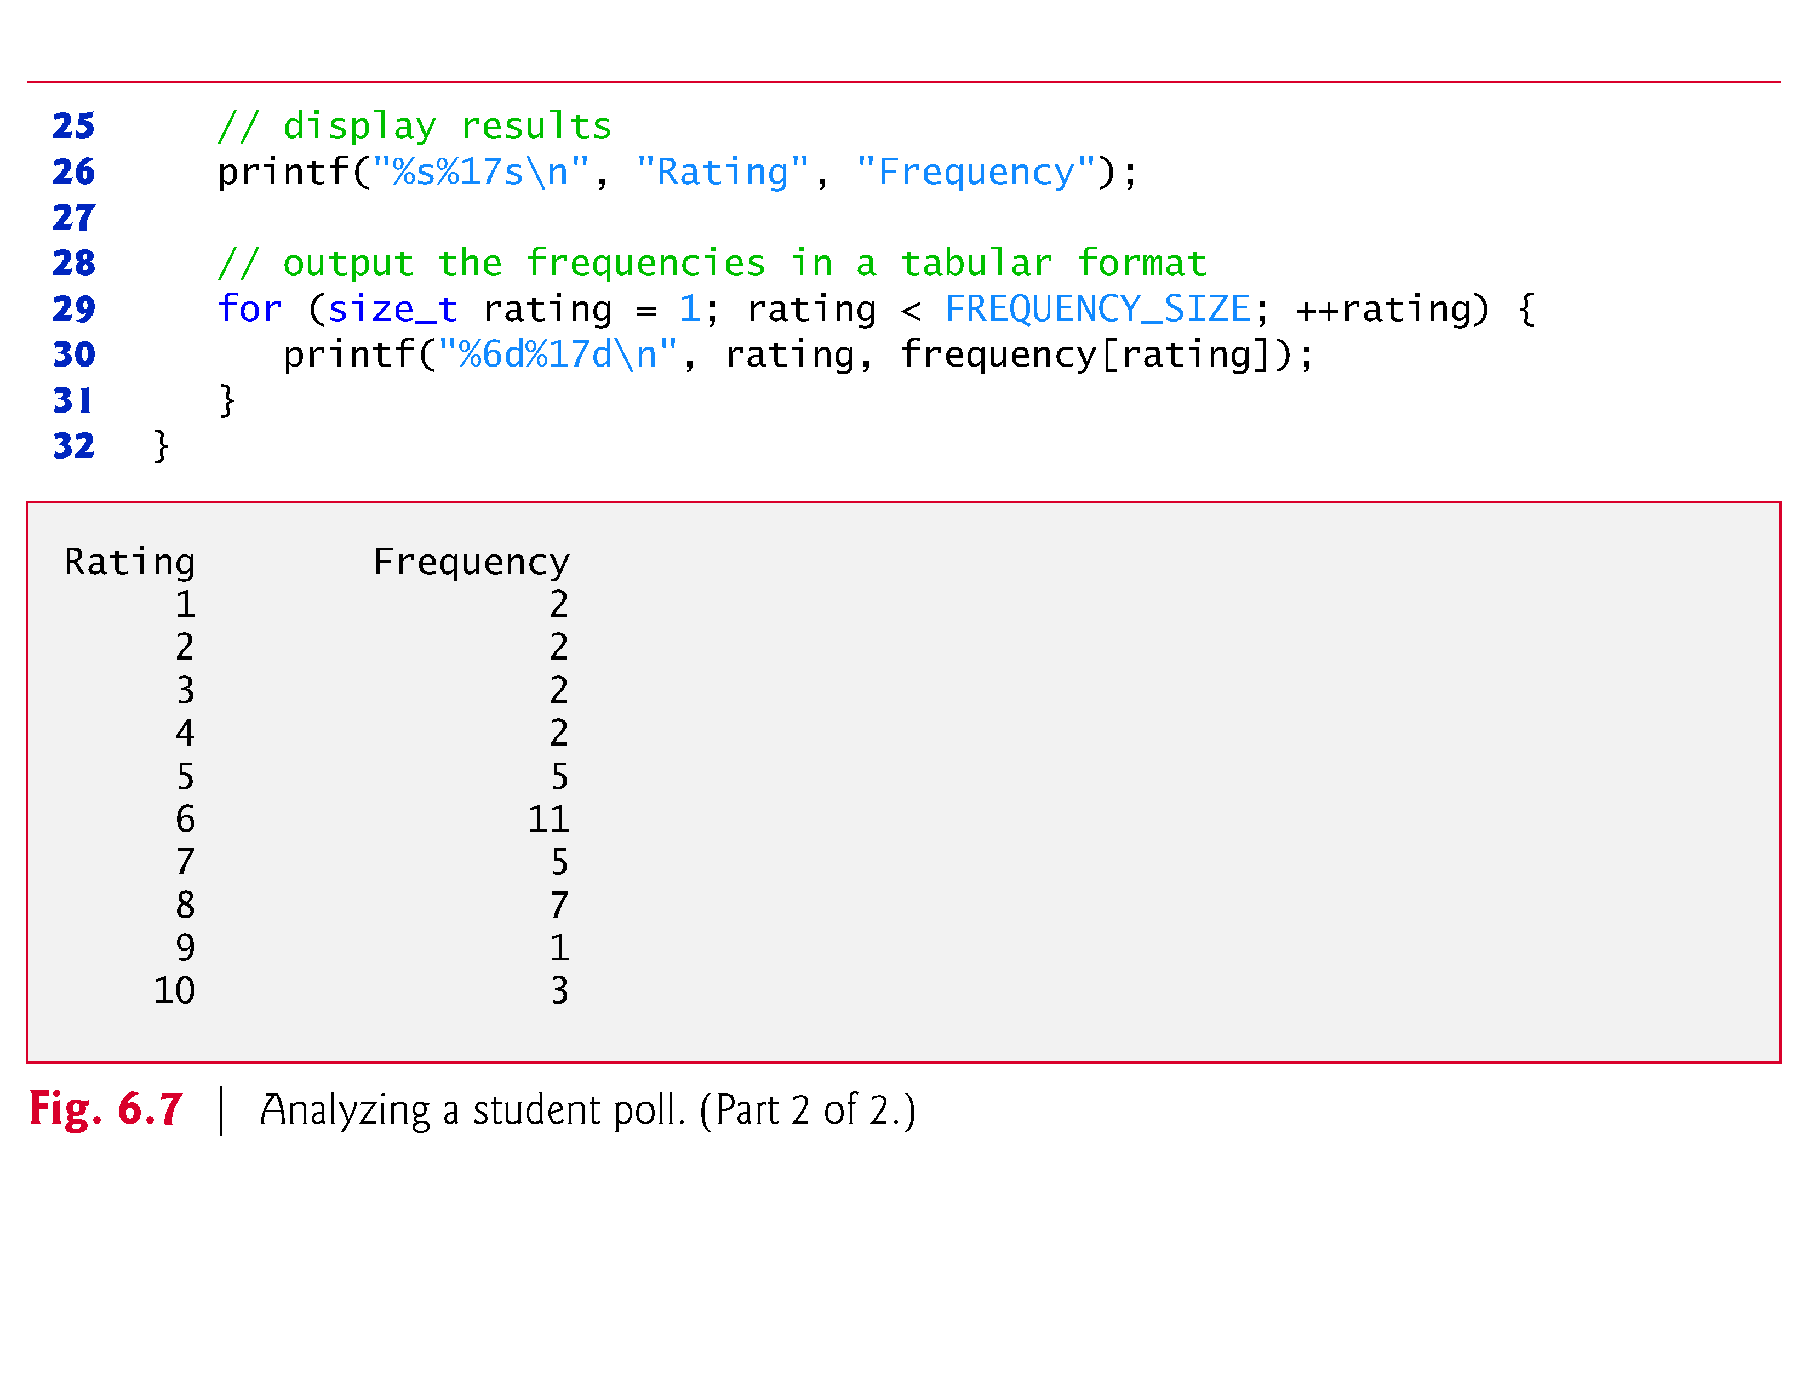

Slide 43
6.4 Array Examples (Cont.)
Using Arrays to Summarize Survey Results
Our next example uses arrays to summarize the results of data collected in a survey.
Consider the problem statement.
Forty students were asked to rate the quality of the food in the student cafeteria on a scale of 1 to 10 (1 means awful and 10 means excellent). Place the 40 responses in an integer array and summarize the results of the poll.
This is a typical array application (see Fig. 6.7).
We wish to summarize the number of responses of each type (i.e., 1 through 10).

Slide 44
6.4 Array Examples (Cont.)
The array responses is a 40-element array of the students’ responses.
We use an 11-element array frequency to count the number of occurrences of each response.
We ignore frequency[0] because it’s logical to have response 1 increment frequency[1] rather than frequency[0].
This allows us to use each response directly as the index in the frequency array.

Slide 45
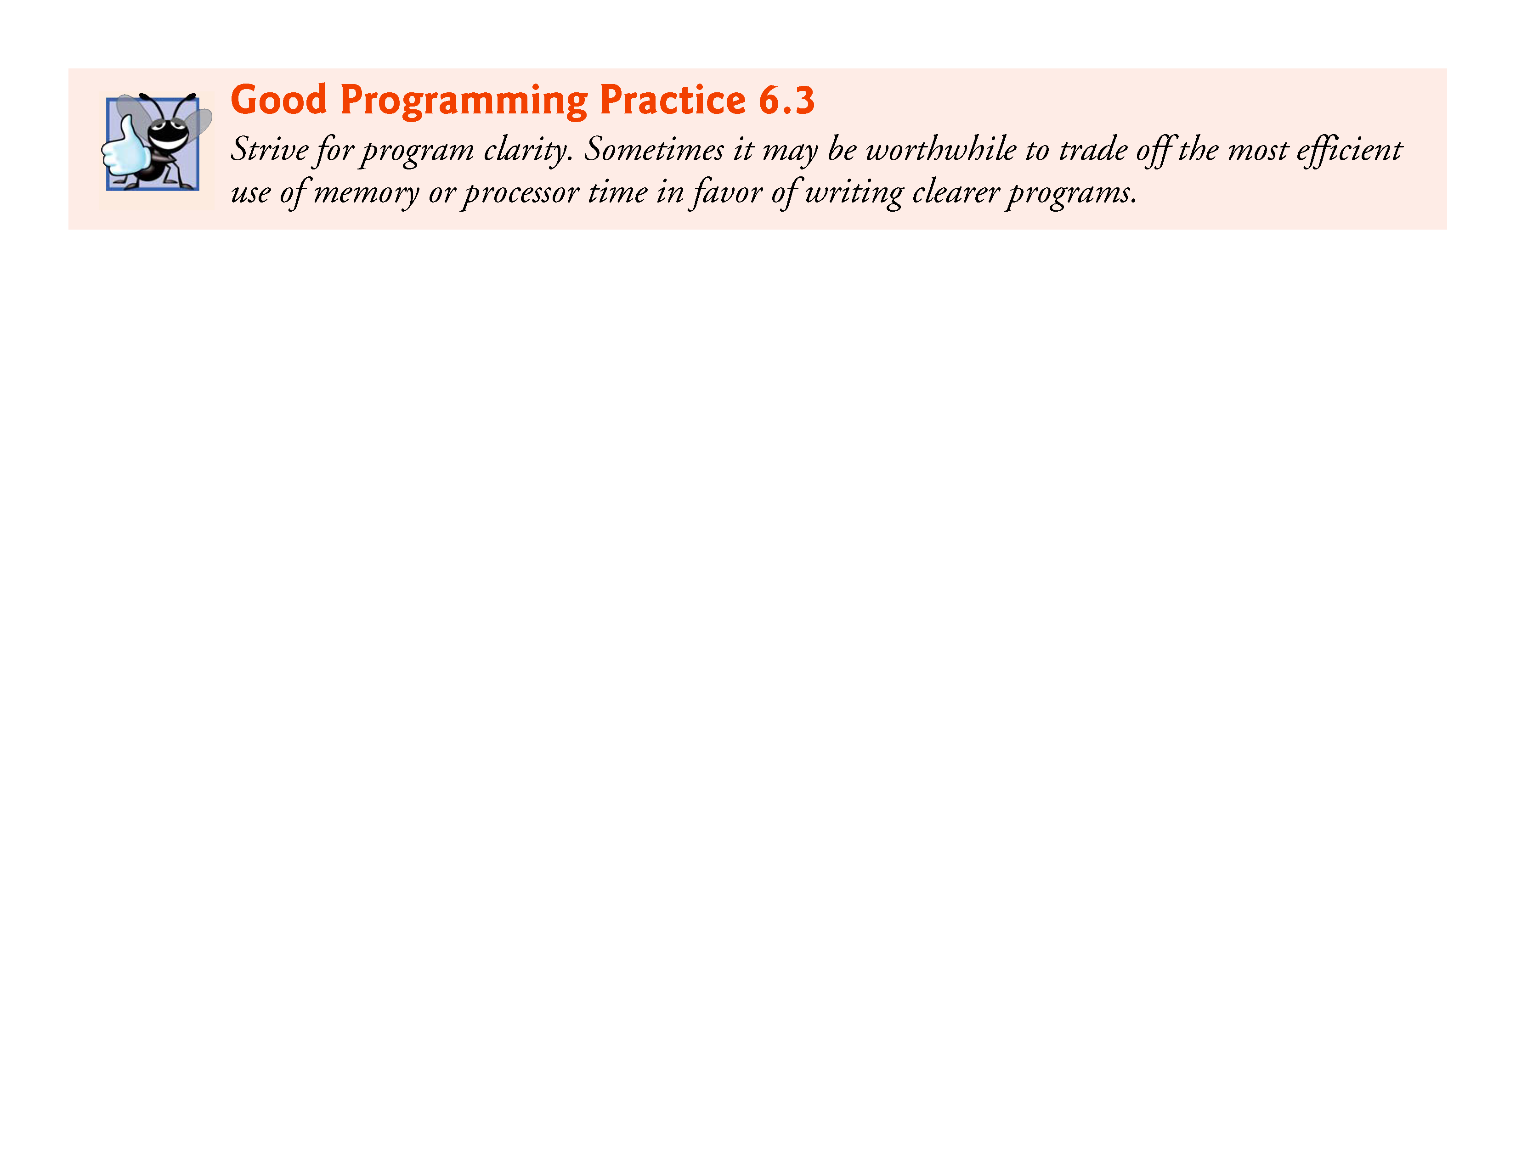

Slide 46
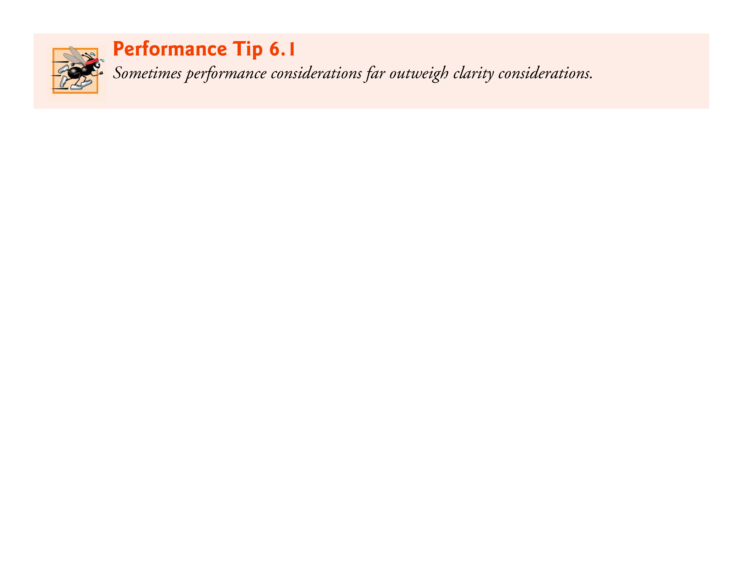

Slide 47
6.4 Array Examples (Cont.)
The for loop takes the responses one at a time from the array responses and increments one of the 10 counters (frequency[1] to frequency[10]) in the frequency array.
The key statement in the loop is
++frequency[responses[answer]];
which increments the appropriate frequency counter depending on the value of responses[answer].

Slide 48
6.4 Array Examples (Cont.)
When the counter variable answer is 0, responses[answer] is 1, so ++frequency[responses[answer]]; is interpreted as
++frequency[1];
which increments array element one.
When answer is 1, responses[answer] is 2, so ++frequency[responses[answer]]; is interpreted as
++frequency[2];
which increments array element two.

Slide 49
6.4 Array Examples (Cont.)
When answer is 2, responses[answer] is 6, so ++frequency[responses[answer]]; is interpreted as
++frequency[6];
which increments array element six, and so on.
Regardless of the number of responses processed in the survey, only an 11-element array is required (ignoring element zero) to summarize the results.
If the data contained invalid values such as 13, the program would attempt to add 1 to frequency[13].
This would be outside the bounds of the array.

Slide 50
6.4 Array Examples (Cont.)
C has no array bounds checking to prevent the program from referring to an element that does not exist.
Thus, an executing program can “walk off” either end of an array without warning—a security problem that we discuss in Section 6.11.
You should ensure that all array references remain within the bounds of the array.

Slide 51


Slide 52
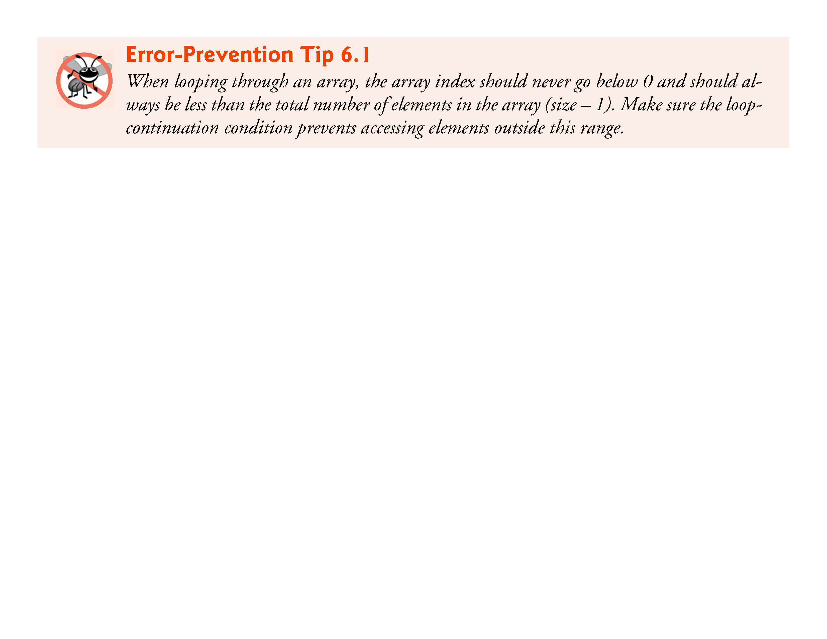

Slide 53
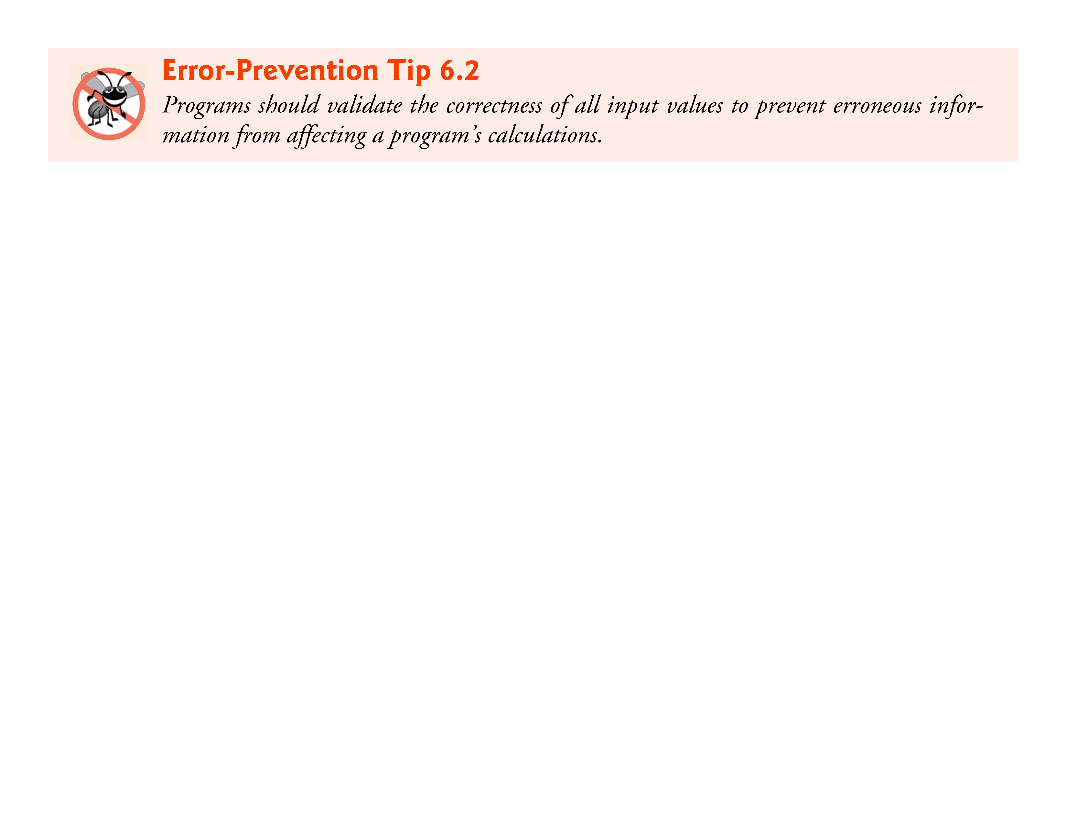

Slide 54
6.4 Array Examples (Cont.)
Graphing Array Element Values with Histograms
Our next example (Fig. 6.8) reads numbers from an array and graphs the information in the form of a bar chart or histogram—each number is printed, then a bar consisting of that many asterisks is printed beside the number.
The nested for statement draws the bars.
Note the use of puts("") to end each histogram bar.

Slide 55
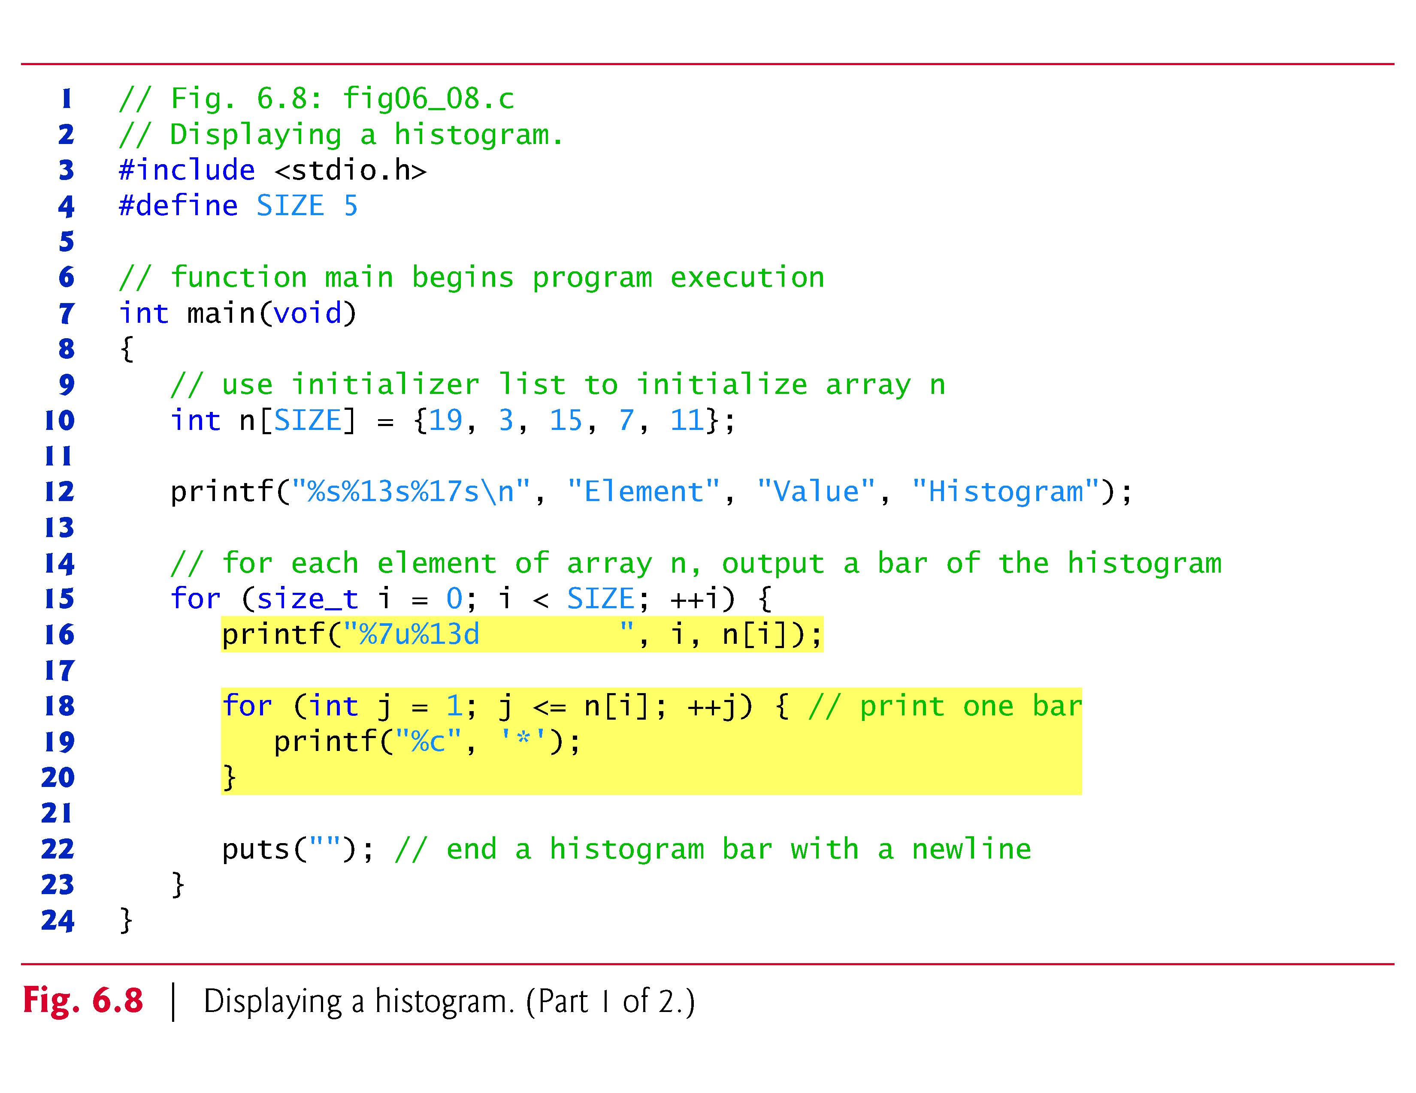

Slide 56
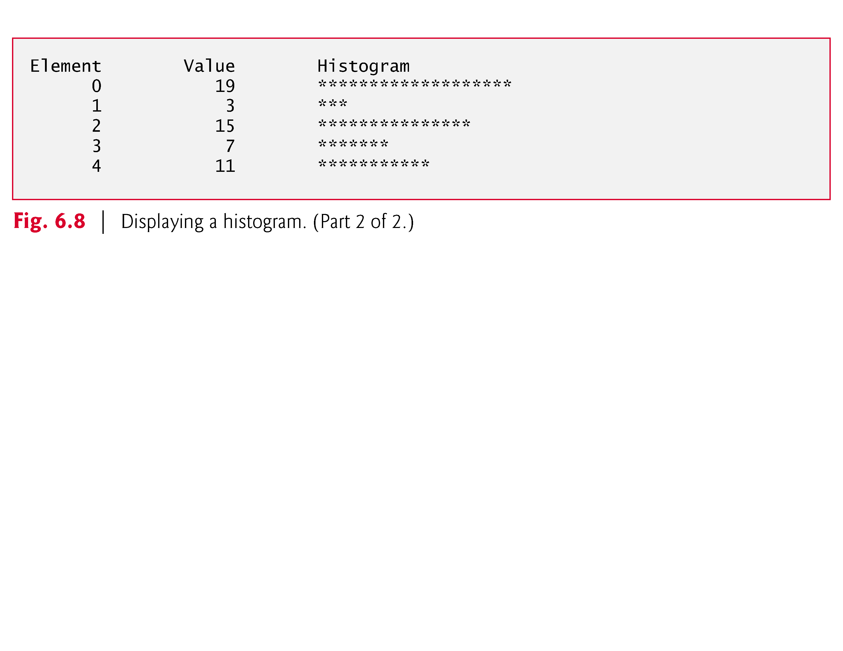

Slide 57
6.4 Array Examples (Cont.)
Rolling a Die 60,000,000 Times and Summarizing the Results in an Array
Roll a single six-sided die 60,000,000 times to test whether the random number generator actually produces random numbers.
An array version of this program is shown in Fig. 6.9.

Slide 58
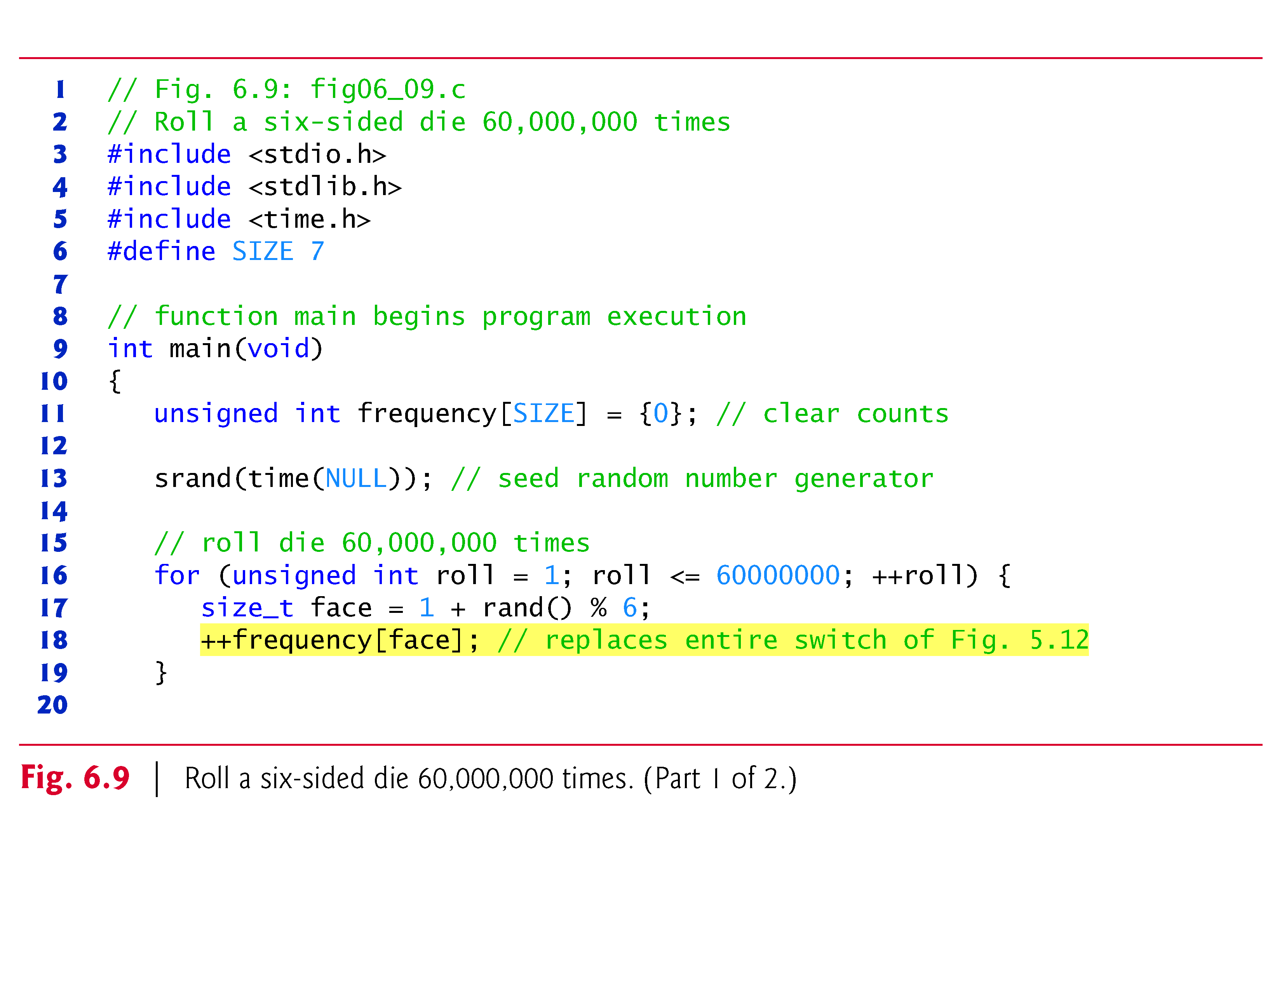

Slide 59
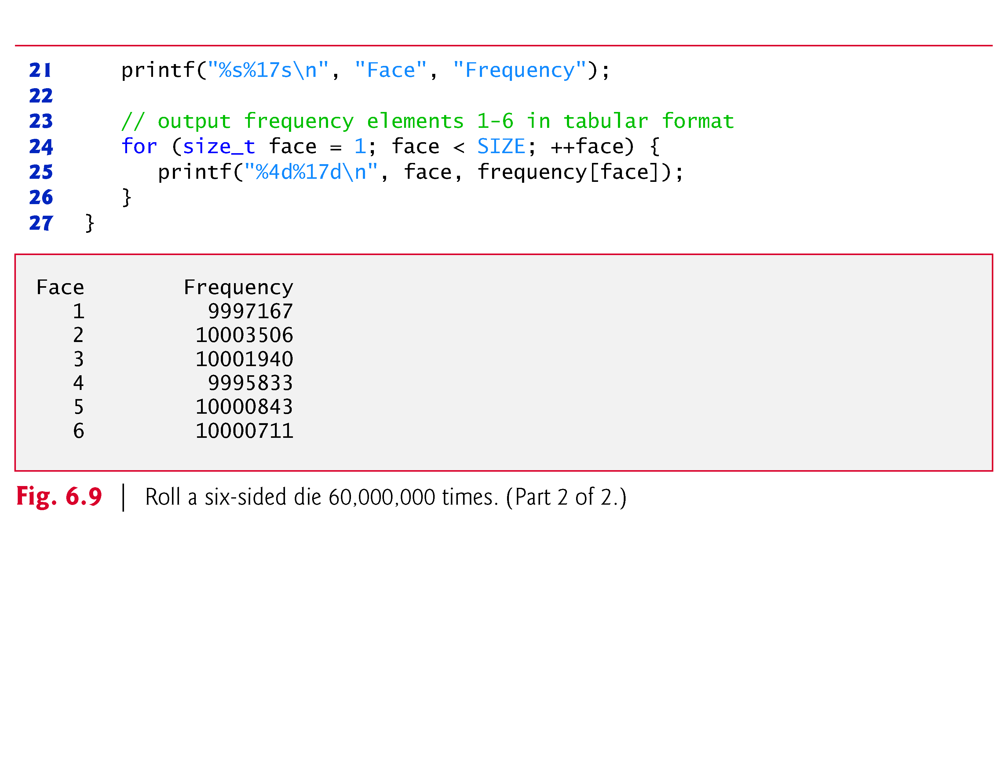

Slide 60
6.5 Using Character Arrays to Store and Manipulate Strings
We now discuss storing strings in character arrays.
So far, the only string-processing capability we have is outputting a string with printf.
A string such as "hello" is really an array of individual characters in C.
A character array can be initialized using a string literal.
For example,
char string1[] = "first";
initializes the elements of array string1 to the individual characters in the string literal "first".

Slide 61
6.5 Using Character Arrays to Store and Manipulate Strings
In this case, the size of array string1 is determined by the compiler based on the length of the string.
The string "first" contains five characters plus a special string-termination character called the null character.
Thus, array string1 actually contains six elements.
The character constant representing the null character is '\0'.
All strings in C end with this character.
A character array representing a string should always be defined large enough to hold the number of characters in the string and the terminating null character.
Character arrays also can be initialized with individual character constants in an initializer list, but this can be tedious.

Slide 62
6.5 Using Character Arrays to Store and Manipulate Strings
The preceding definition is equivalent to
char string1[] = {'f', 'i', 'r', 's', 't', '\0'};
Because a string is really an array of characters, we can access individual characters in a string directly using array index notation.
For example, string1[0] is the character 'f' and string1[3] is the character 's'.
We also can input a string directly into a character array from the keyboard using scanf and the conversion specifier %s.

Slide 63
6.5 Using Character Arrays to Store and Manipulate Strings
For example,
char string2[20];
creates a character array capable of storing a string of at most 19 characters and a terminating null character.
The statement
scanf("%19s", string2);
reads a string from the keyboard into string2.
The name of the array is passed to scanf without the preceding & used with nonstring variables.
The & is normally used to provide scanf with a variable’s location in memory so that a value can be stored there.

Slide 64
6.5 Using Character Arrays to Store and Manipulate Strings
In Section 6.5, when we discuss passing arrays to functions, we’ll see that the value of an array name is the address of the start of the array; therefore, the & is not necessary.
Function scanf will read characters until a space, tab, newline or end-of-file indicator is encountered.
The string2 should be no longer than 19 characters to leave room for the terminating null character.
If the user types 20 or more characters, your program may crash or create a security vulerability.
For this reason, we used the conversion specifier %19s so that scanf reads a maximum of 19 characters and does not write characters into memory beyond the end of the array string2.

Slide 65
6.5 Using Character Arrays to Store and Manipulate Strings
It’s your responsibility to ensure that the array into which the string is read is capable of holding any string that the user types at the keyboard.
Function scanf does not check how large the array is.
Thus, scanf can write beyond the end of the array.

Slide 66
6.5 Using Character Arrays to Store and Manipulate Strings
A character array representing a string can be output with printf and the %s conversion specifier.
The array string2 is printed with the statement
printf("%s\n", string2);
Function printf, like scanf, does not check how large the character array is.
The characters of the string are printed until a terminating null character is encountered.

Slide 67
6.5 Using Character Arrays to Store and Manipulate Strings
Figure 6.10 demonstrates initializing a character array with a string literal, reading a string into a character array, printing a character array as a string and accessing individual characters of a string.

Slide 68
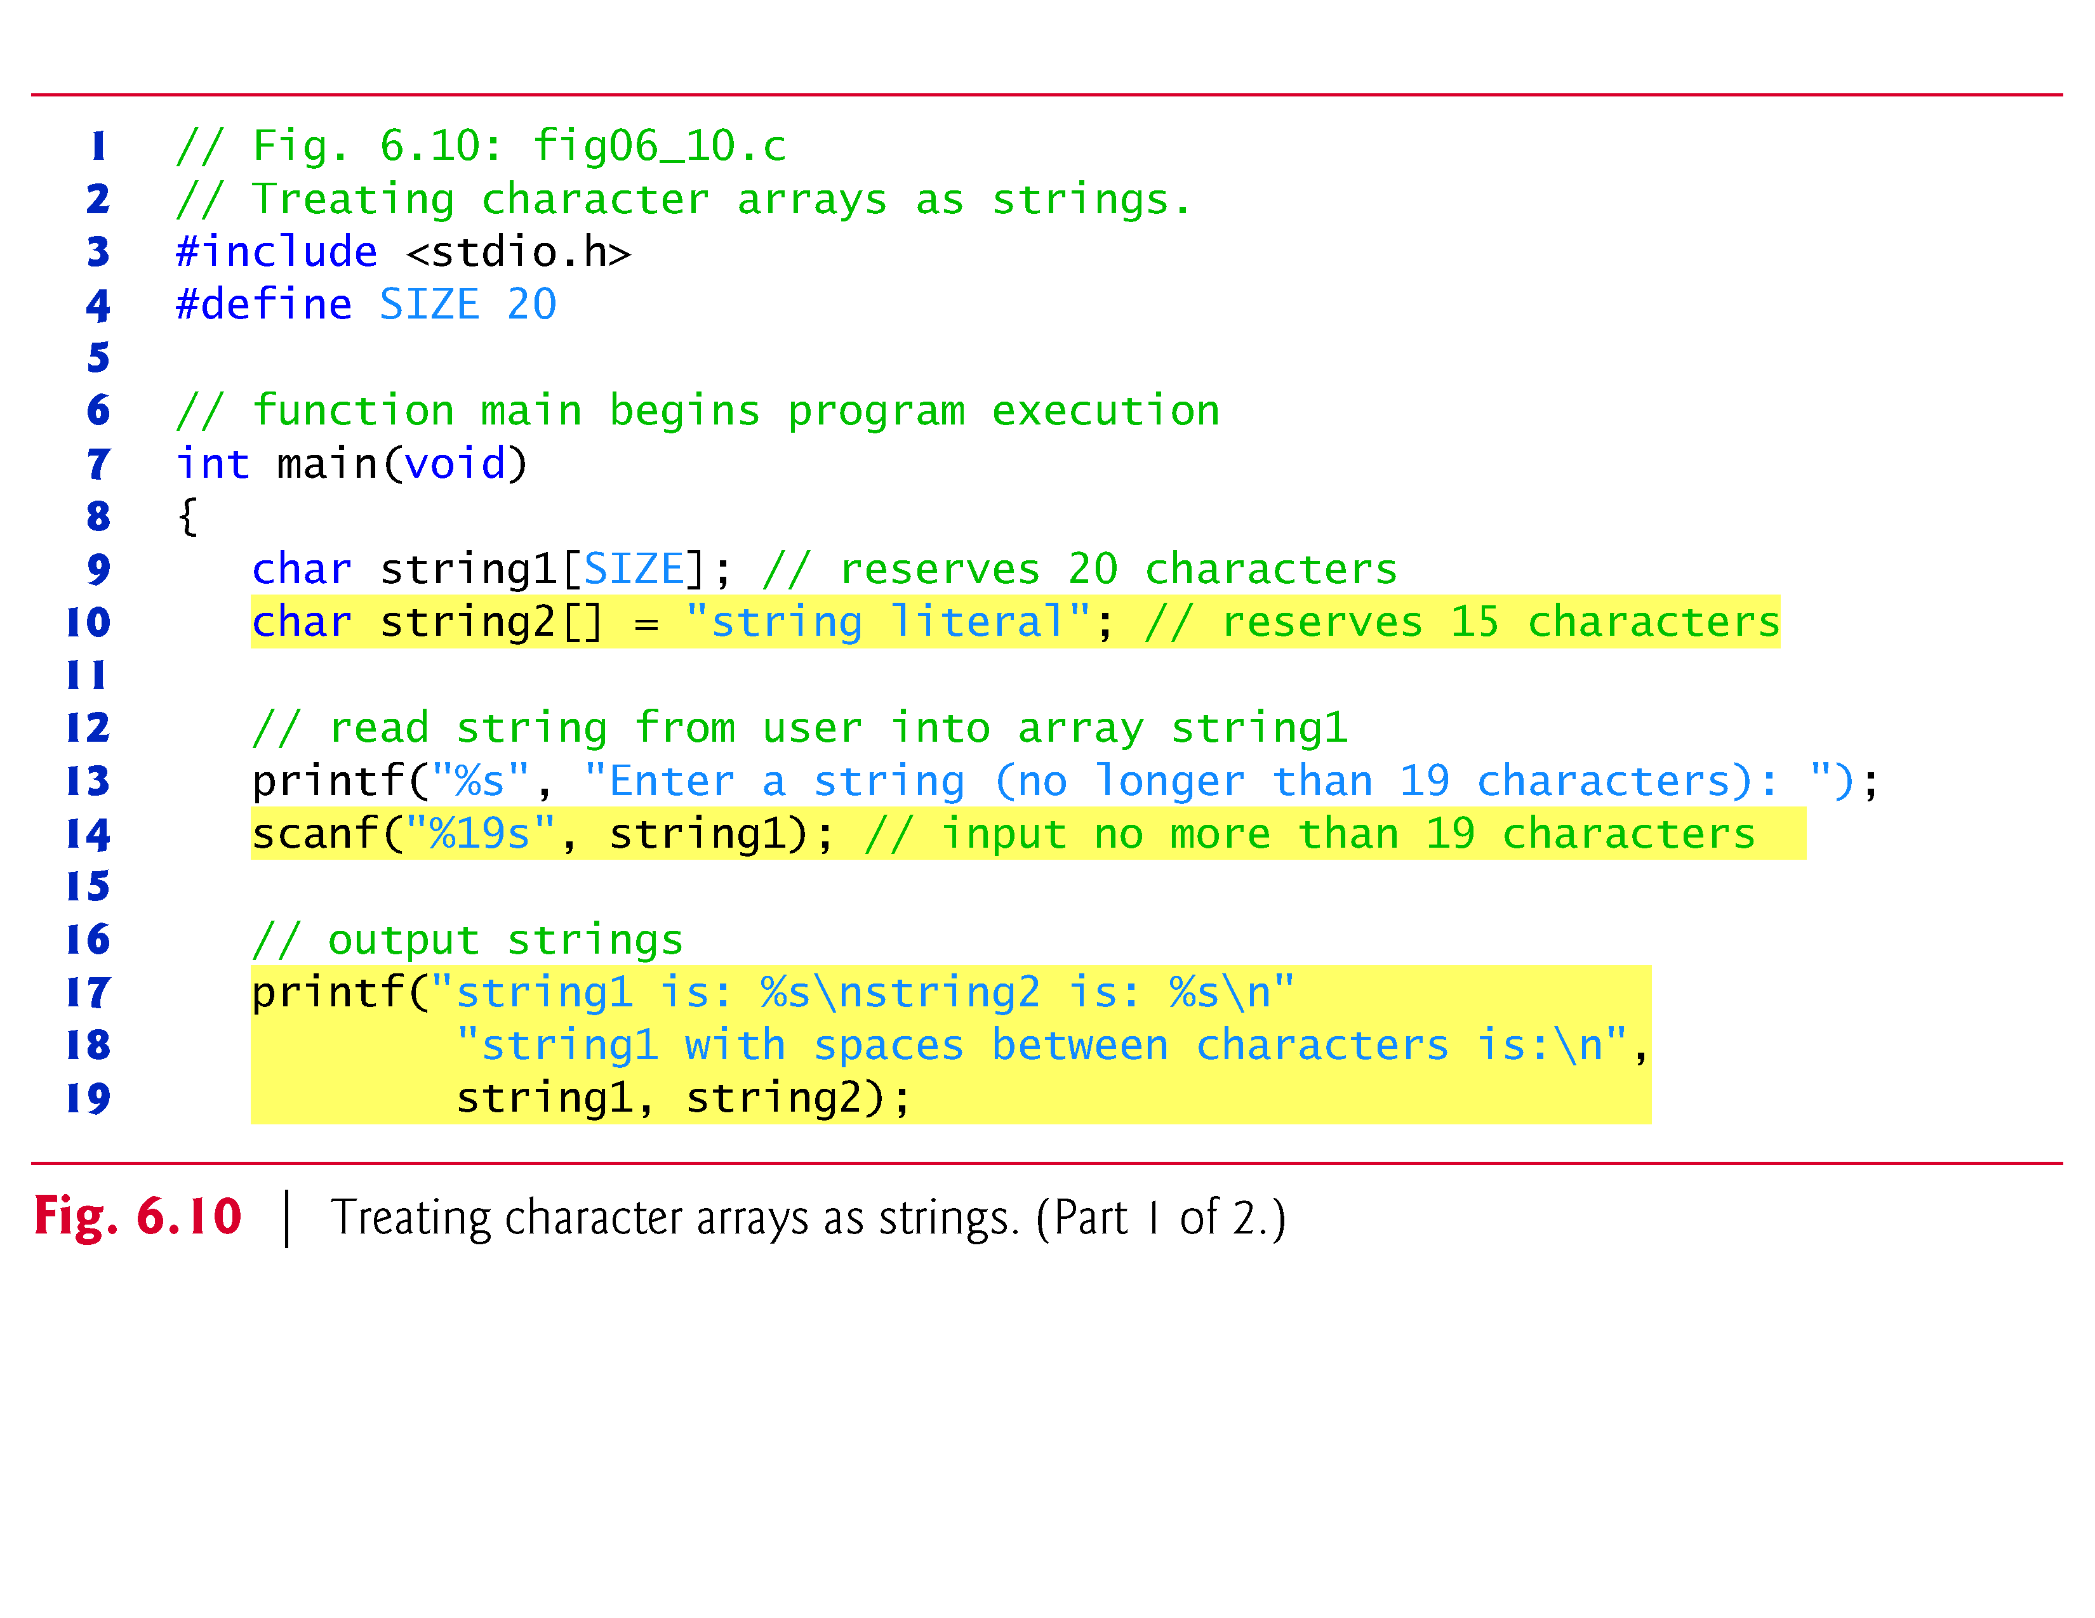

Slide 69
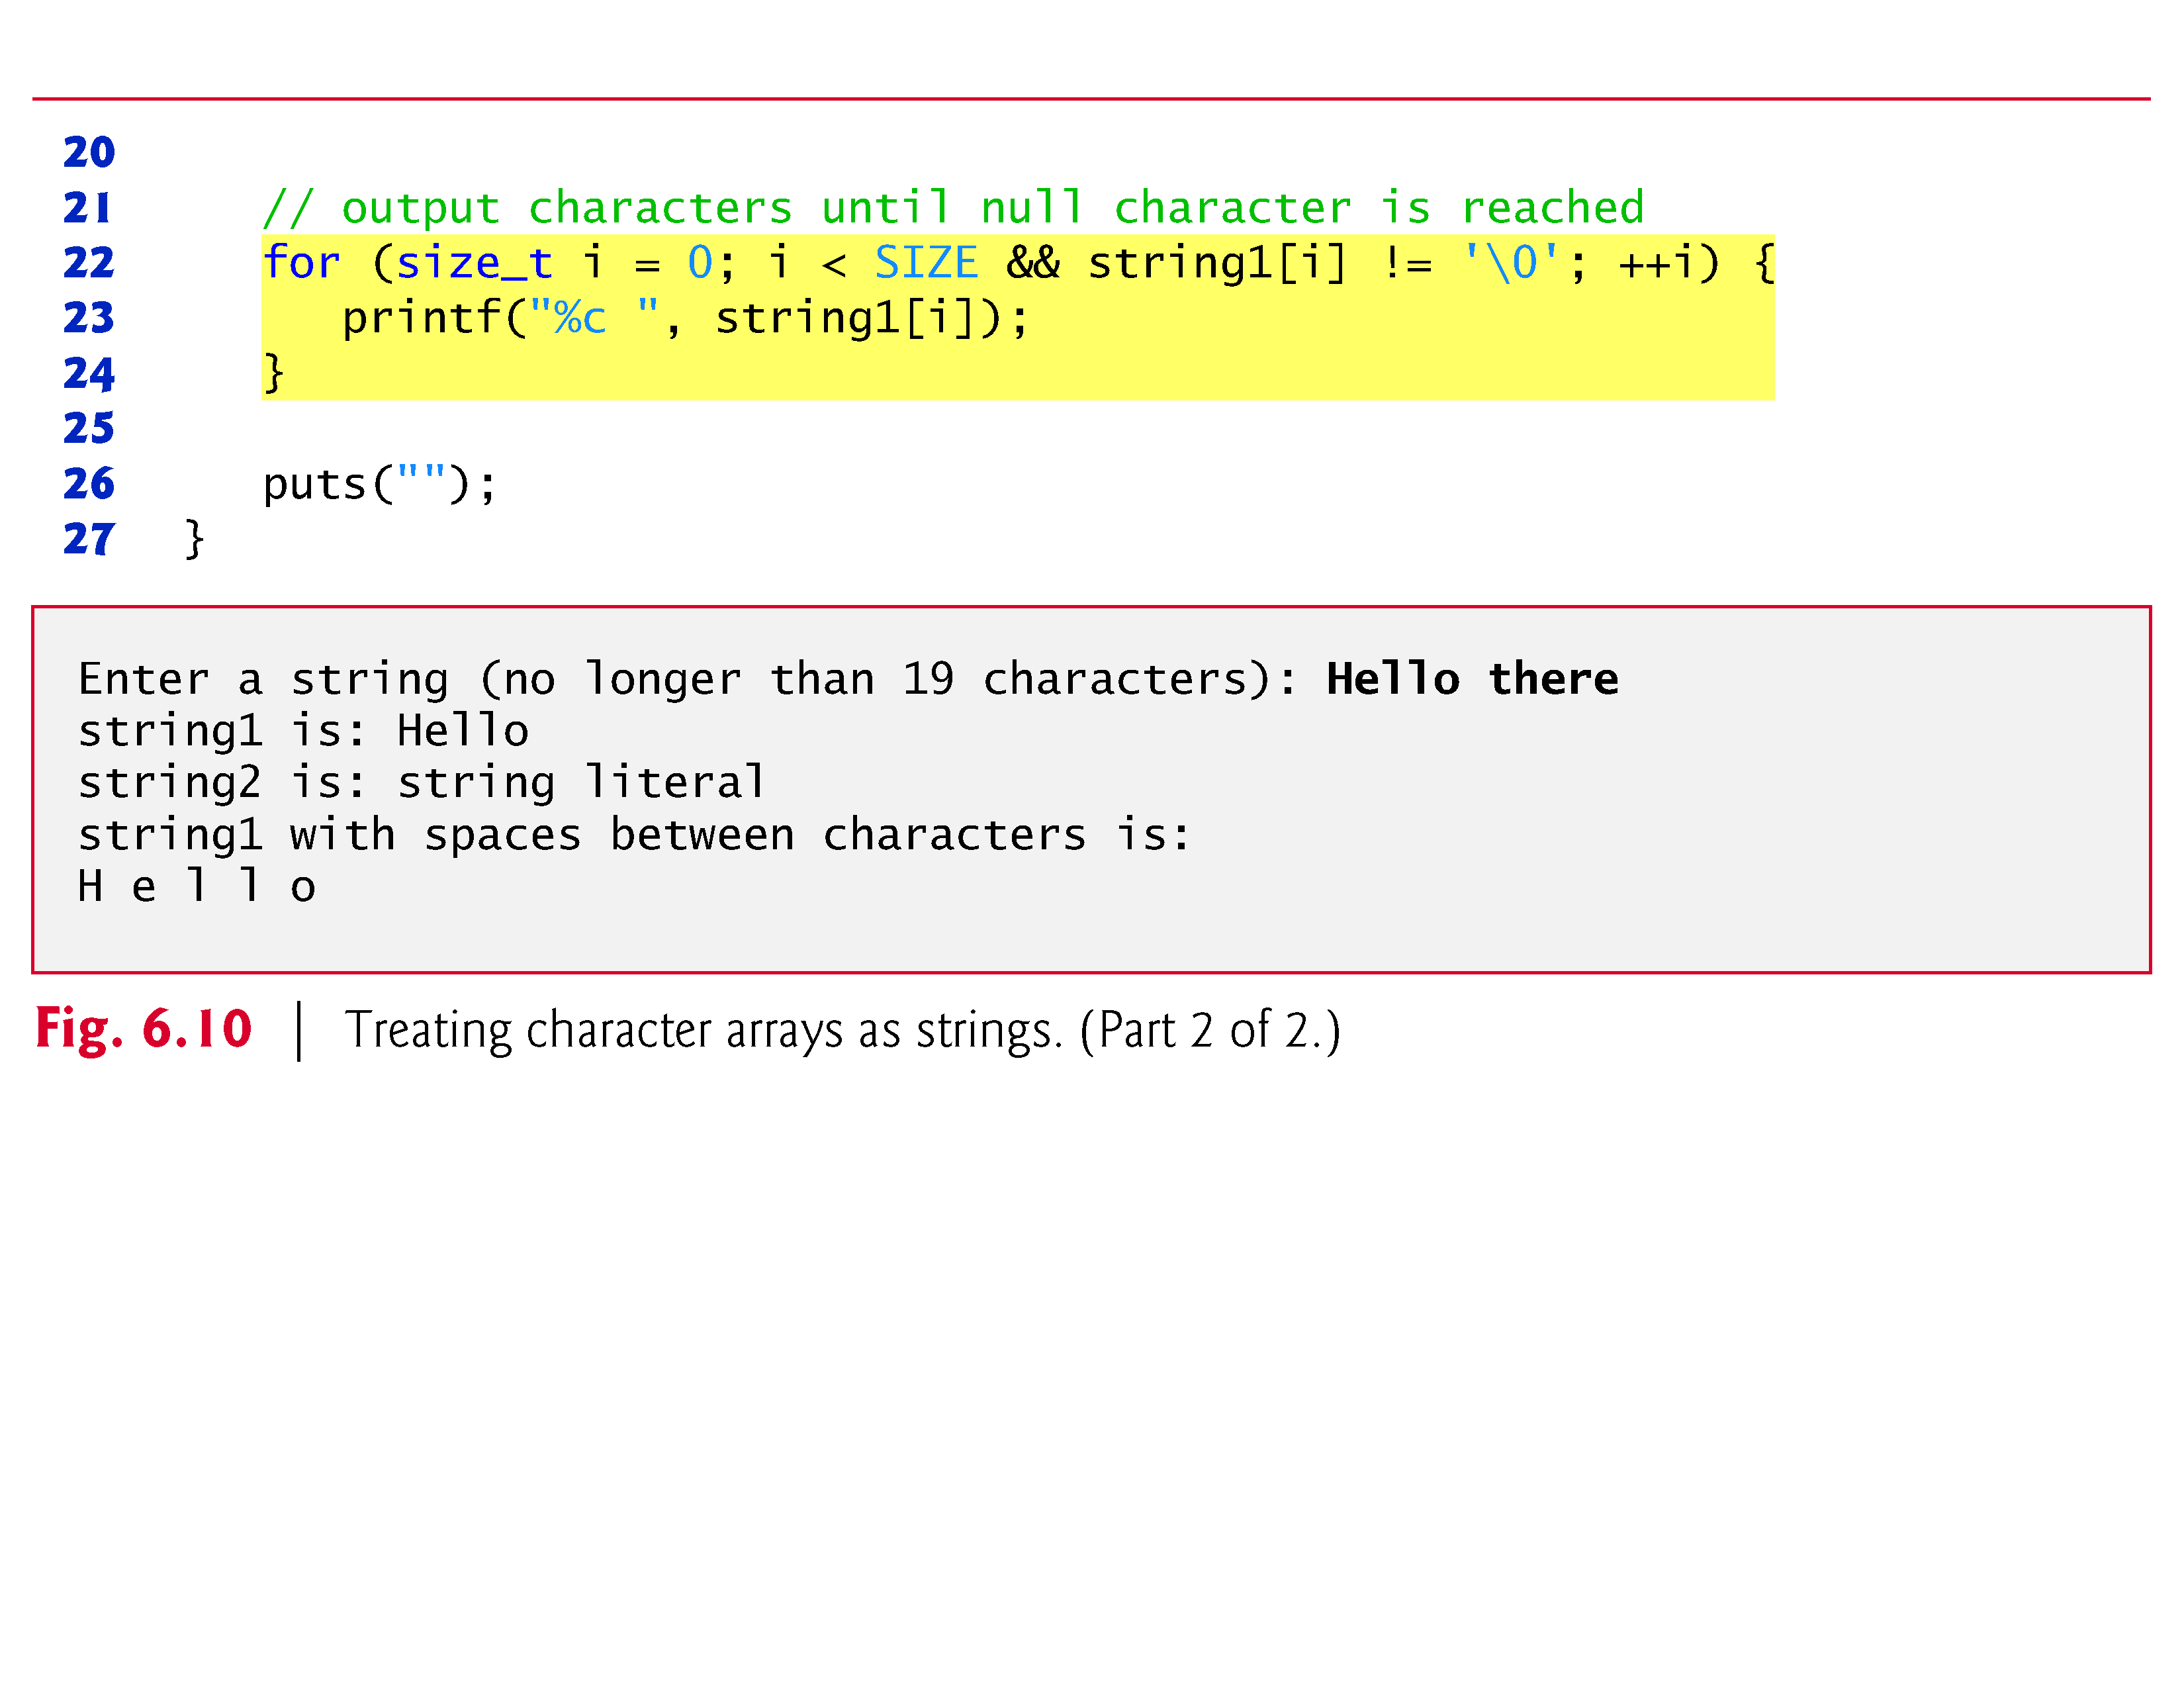

Slide 70
6.6 Static Local Arrays and Automatic Local Arrays
A static local variable exists for the duration of the program but is visible only in the function body.
We can apply static to a local array definition so the array is not created and initialized each time the function is called and the array is not destroyed each time the function is exited in the program.
This reduces program execution time, particularly for programs with frequently called functions that contain large arrays.

Slide 71
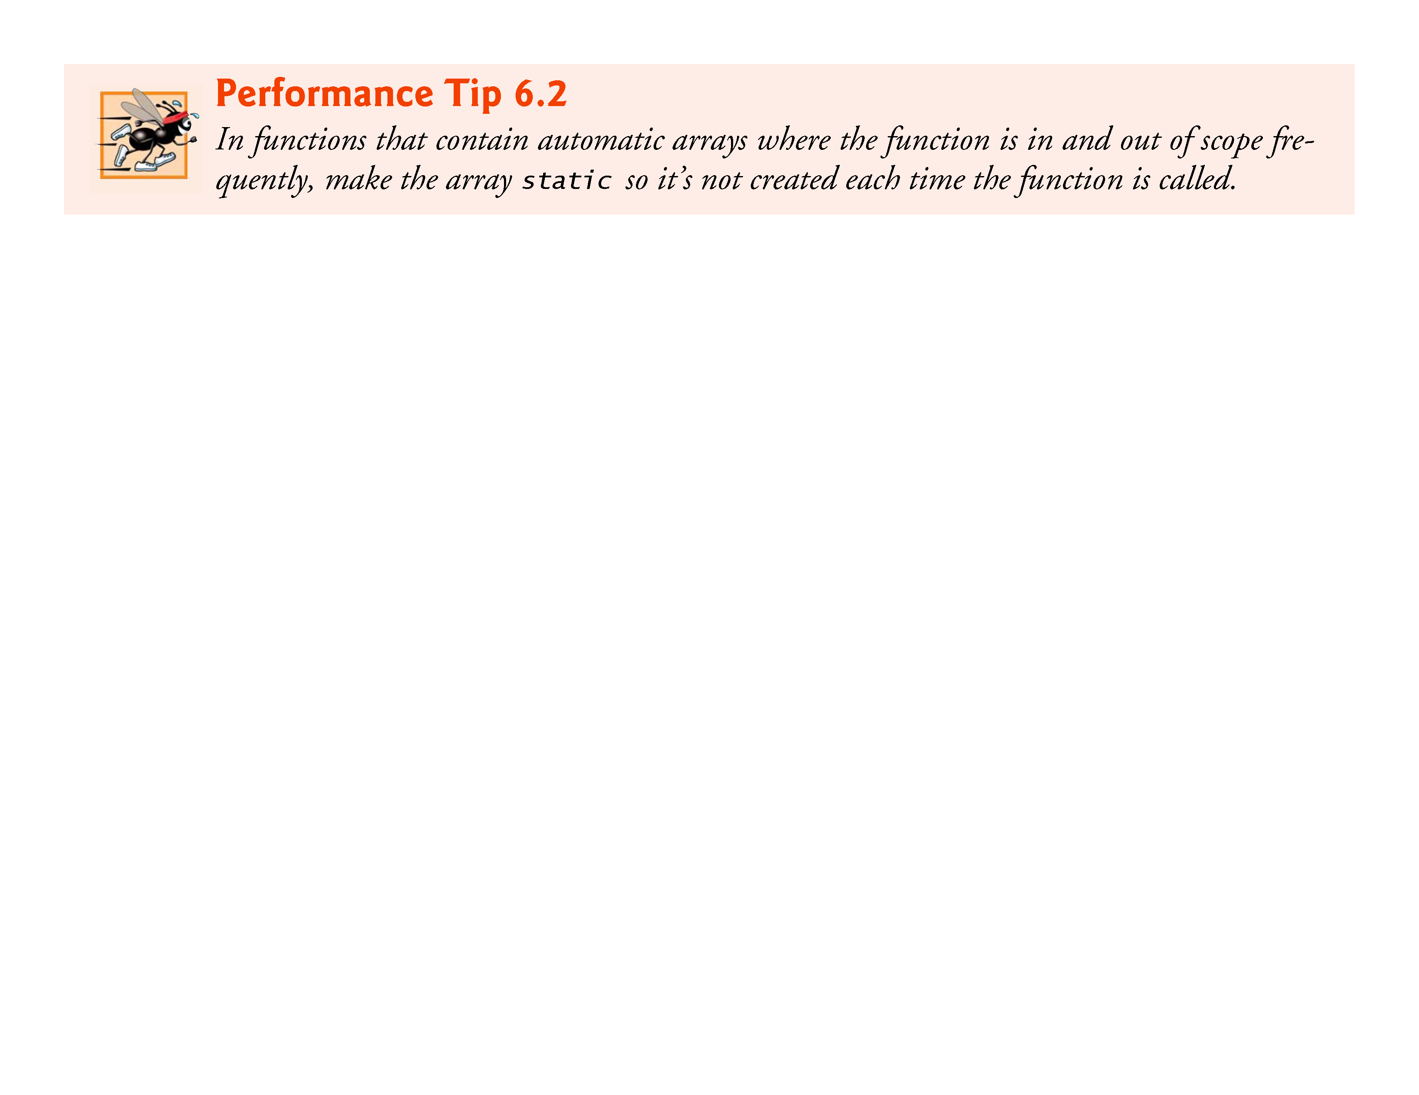

Slide 72
6.6 Static Local Arrays and Automatic Local Arrays
Arrays that are static are initialized once at program startup.
If you do not explicitly initialize a static array, that array’s elements are initialized to zero by default.
Figure 6.11 demonstrates function staticArrayInit with a local static array and function automaticArrayInit with a local automatic array.
Function staticArrayInit is called twice.
The local static array in the function is initialized to zero before program startup.
The function prints the array, adds 5 to each element and prints the array again.

Slide 73
6.6 Static Local Arrays and Automatic Local Arrays
The second time the function is called, the static array contains the values stored during the first function call.
Function automaticArrayInit is also called twice.
The elements of the automatic local array in the function are initialized with the values 1, 2 and 3.
The function prints the array, adds 5 to each element and prints the array again.
The second time the function is called, the array elements are initialized to 1, 2 and 3 again because the array has automatic storage duration.

Slide 74
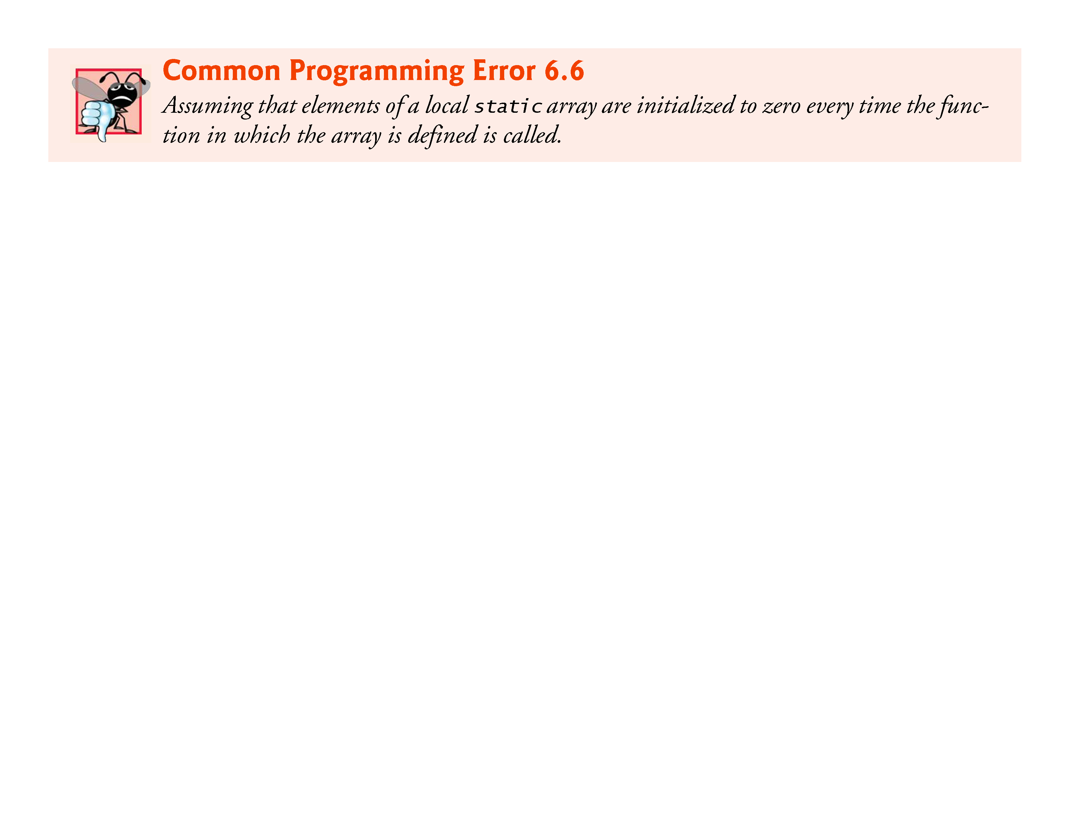

Slide 75
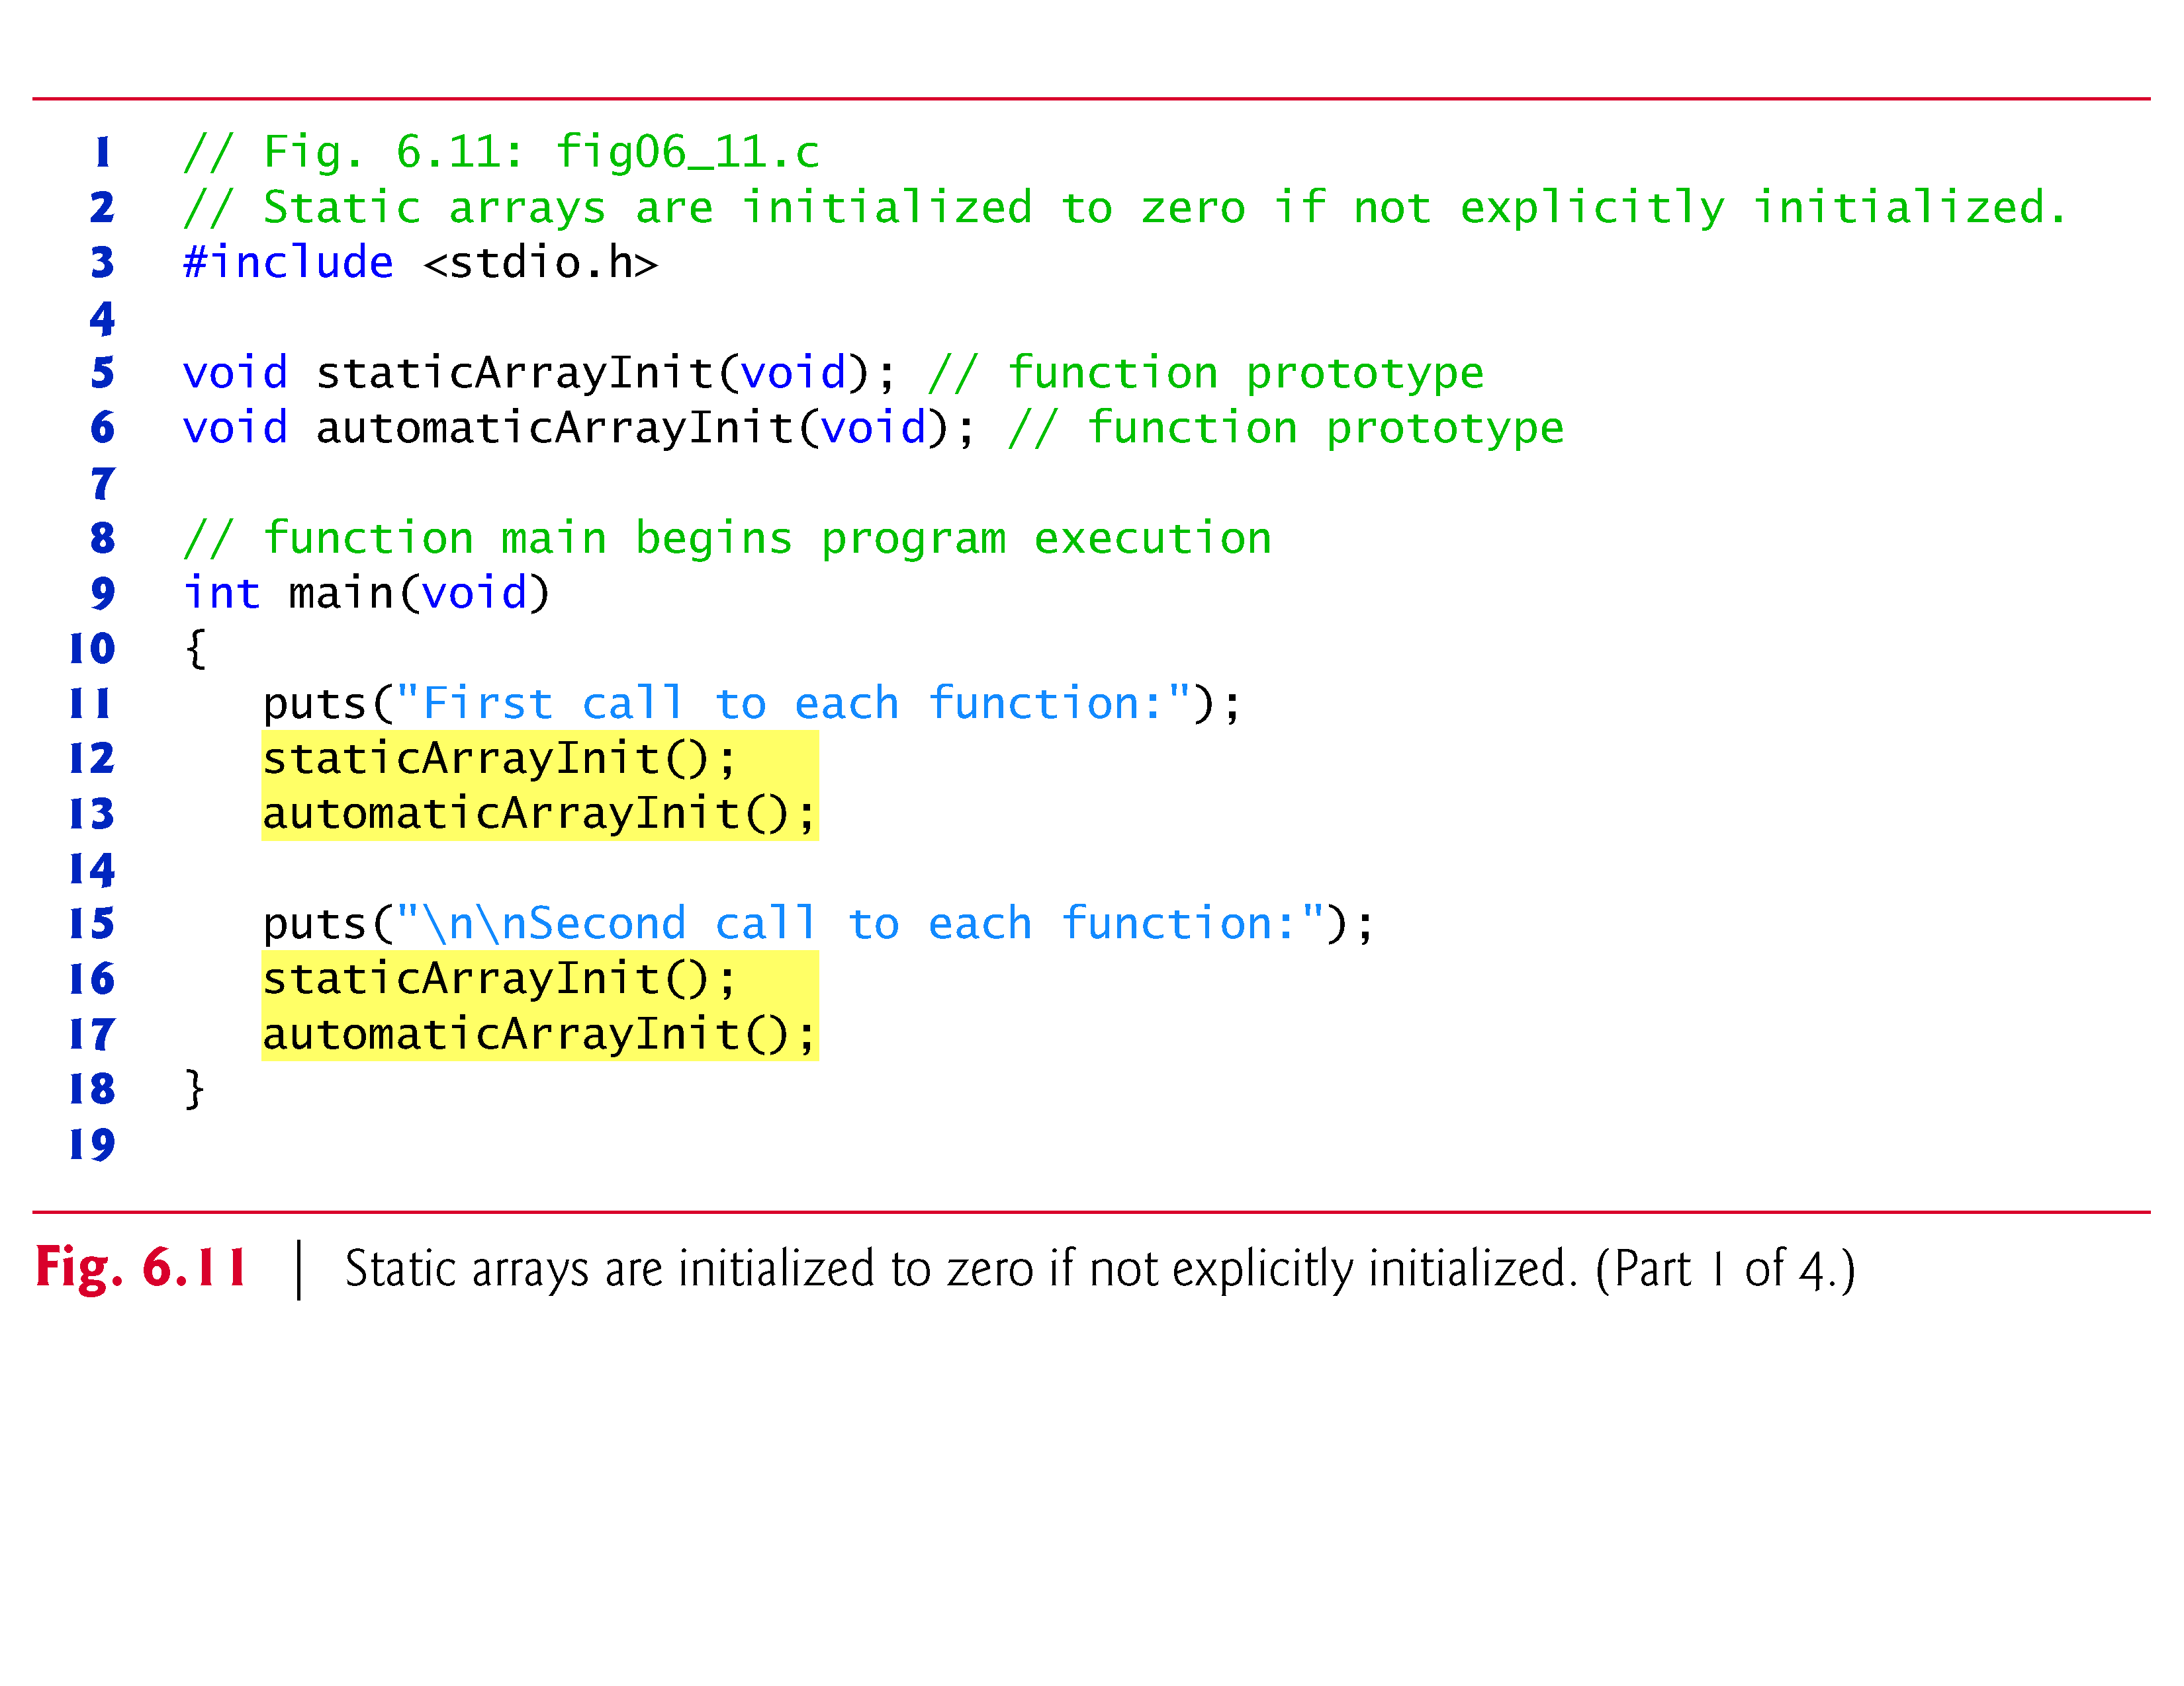

Slide 76
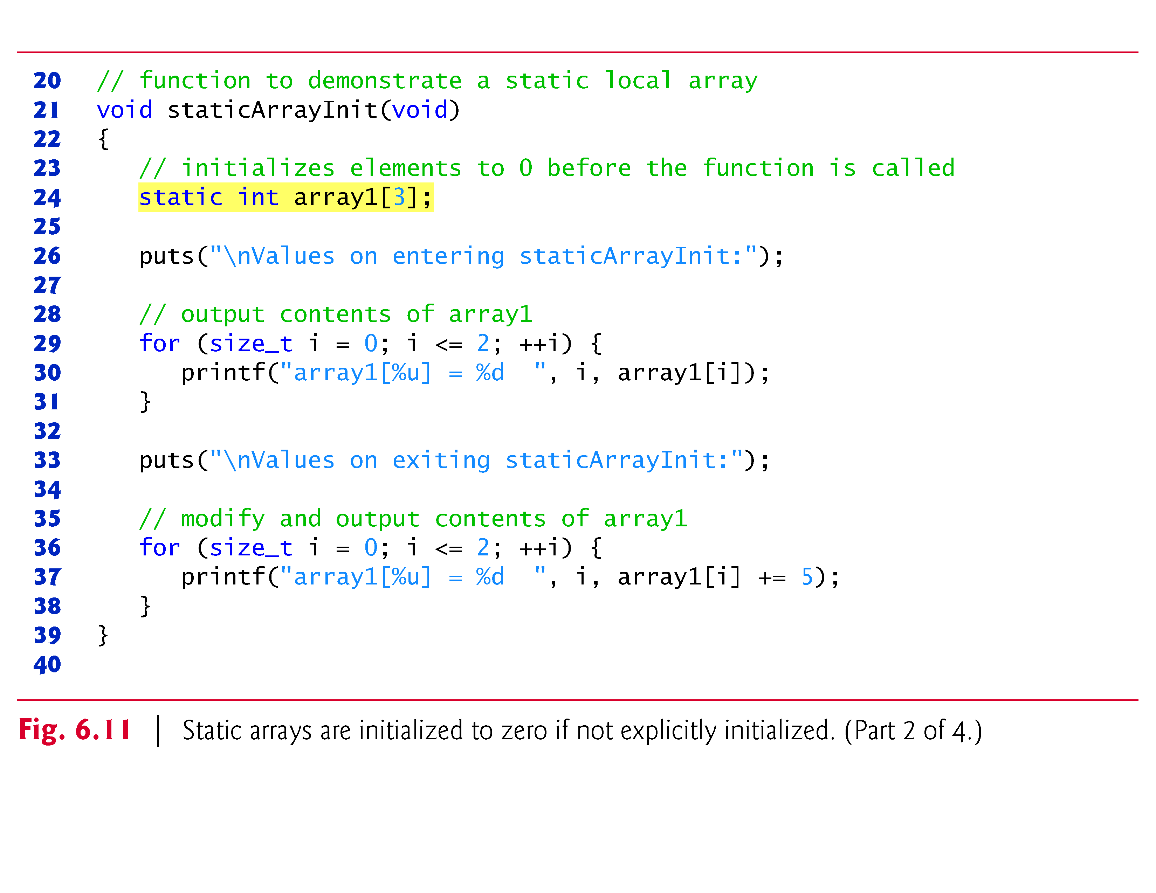

Slide 77
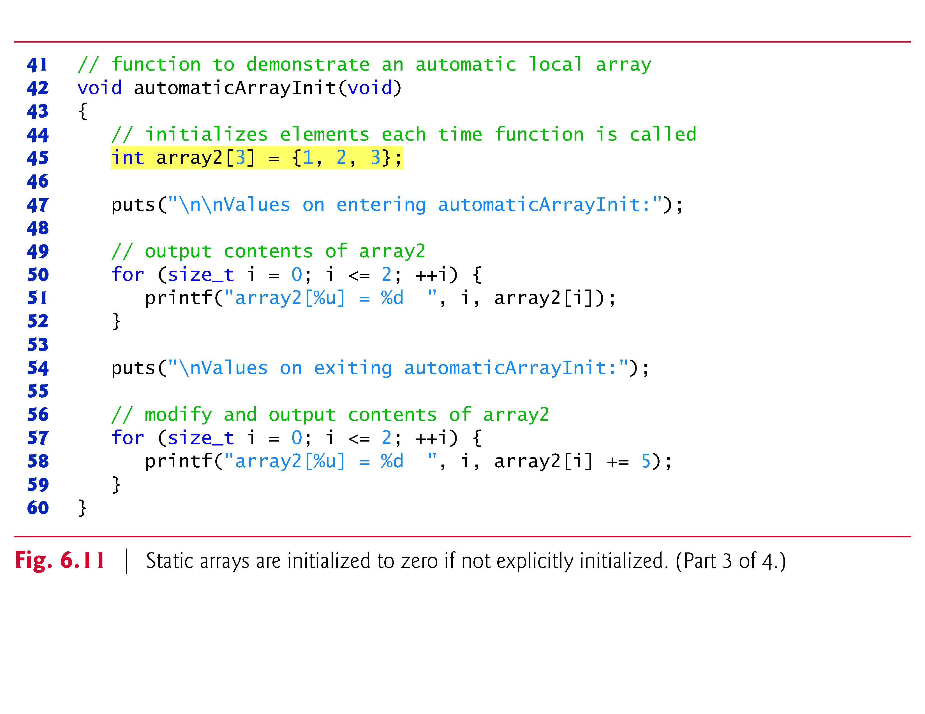

Slide 78
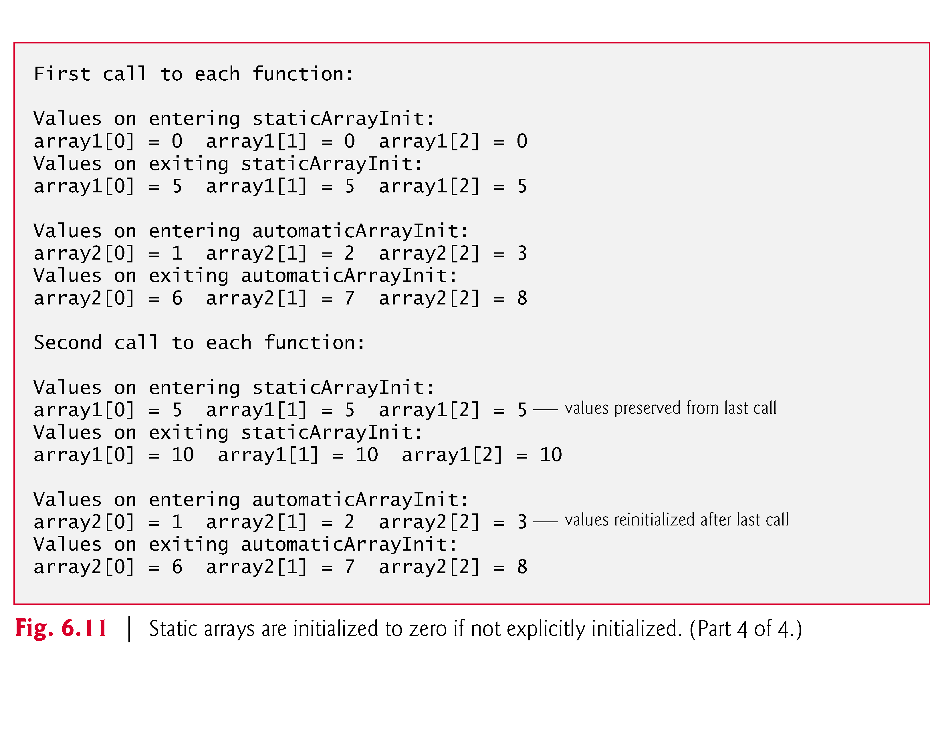

Slide 79
6.7 Passing Arrays to Functions
To pass an array argument to a function, specify the array’s name without any brackets.
For example, if array hourlyTemperatures has been defined as
int hourlyTemperatures[HOURS_IN_A_DAY];
the function call
modifyArray(hourlyTemperatures, HOURS_IN_A_DAY)
passes array hourlyTemperatures and its size to function modifyArray.

Slide 80
6.7 Passing Arrays to Functions (Cont.)
C automatically passes arrays to functions by reference (again, we’ll see in Chapter 7 that this is not a contradiction)—the called functions can modify the element values in the callers’ original arrays.
The name of the array evaluates to the address of the first element of the array.
Because the starting address of the array is passed, the called function knows precisely where the array is stored.

Slide 81
6.7 Passing Arrays to Functions (Cont.)
Therefore, when the called function modifies array elements in its function body, it’s modifying the actual elements of the array in their original memory locations.
Figure 6.12 demonstrates that an array name is really the address of the first element of the array by printing array, &array[0] and &array using the %p conversion specifier—a special conversion specifier for printing addresses.
The %p conversion specifier normally outputs addresses as hexadecimal numbers, but this is compiler dependent.

Slide 82
6.7 Passing Arrays to Functions (Cont.)
Hexadecimal (base 16) numbers consist of the digits 0 through 9 and the letters A through F (these letters are the hexadecimal equivalents of the numbers 10–15).
Appendix C, Number Systems, provides an in-depth discussion of the relationships among binary (base 2), octal (base 8), decimal (base 10; standard integers) and hexadecimal integers.
The output shows that array, &array and &array[0] have the same value, namely 0012FF78.

Slide 83
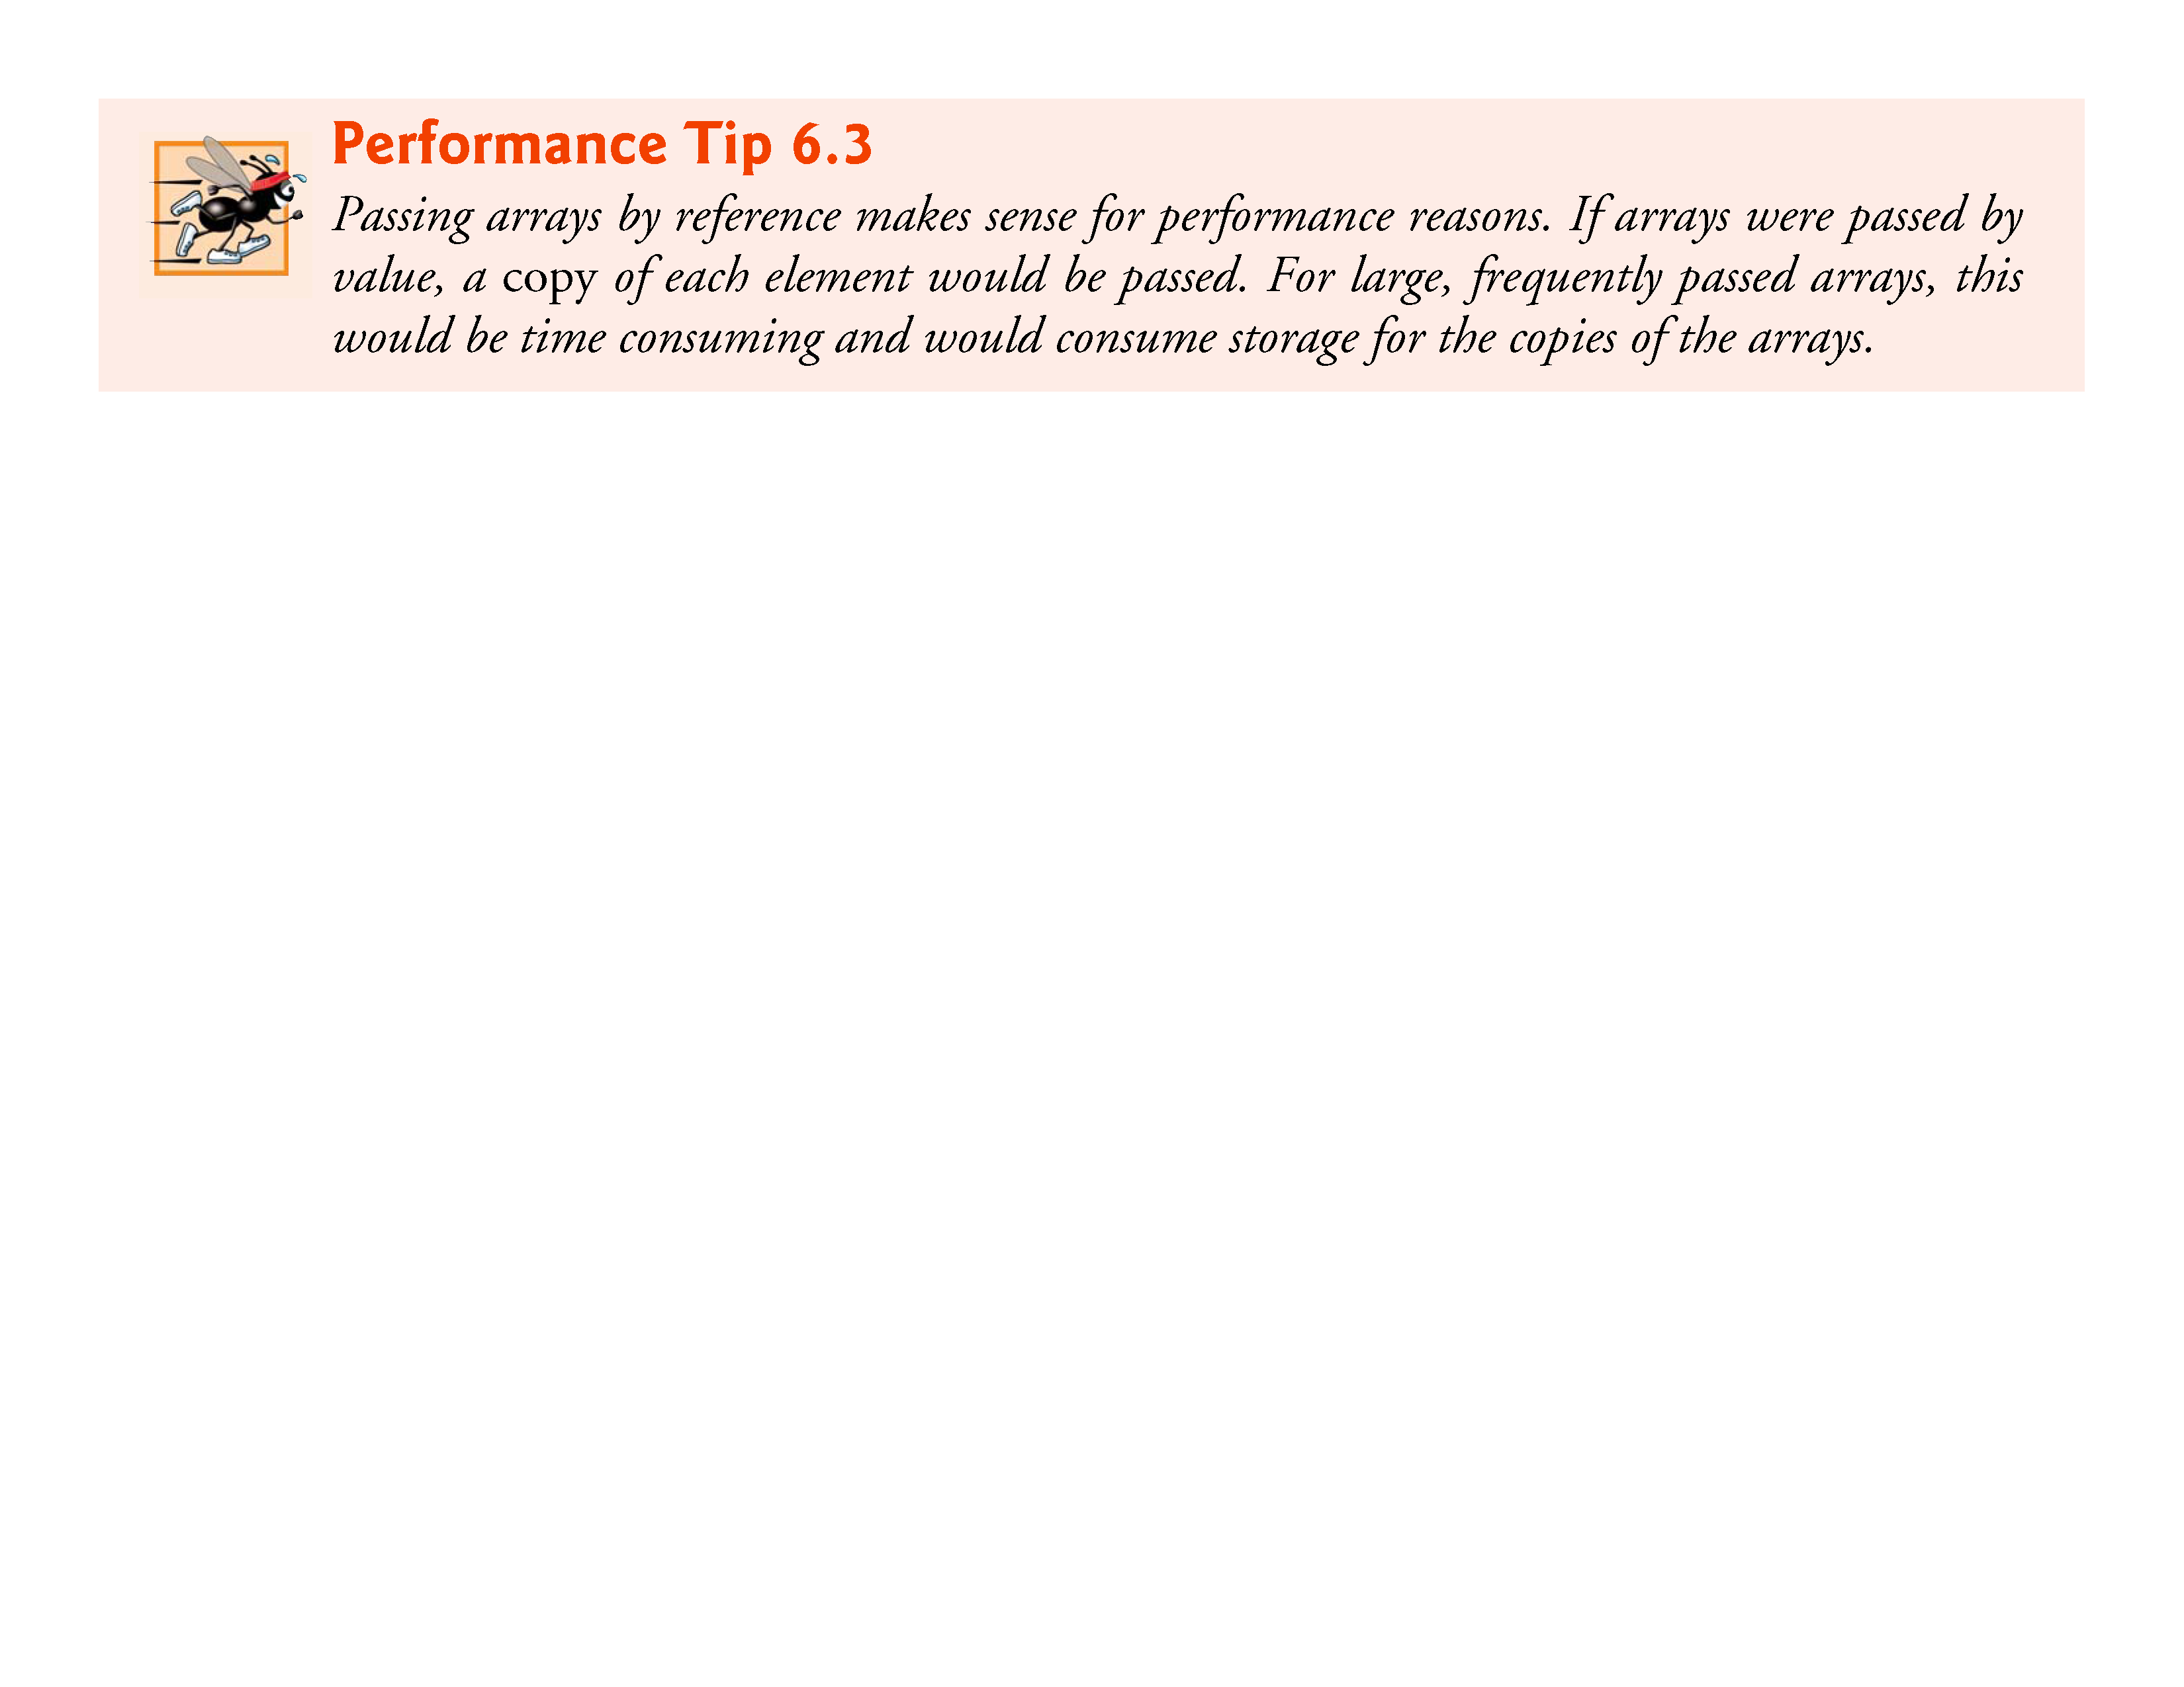

Slide 84
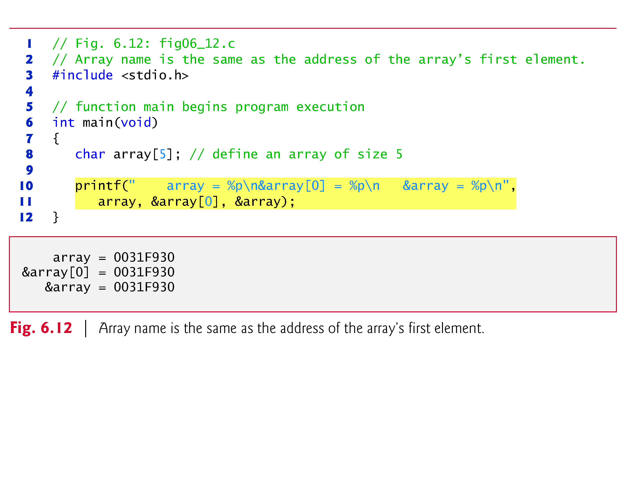

Slide 85
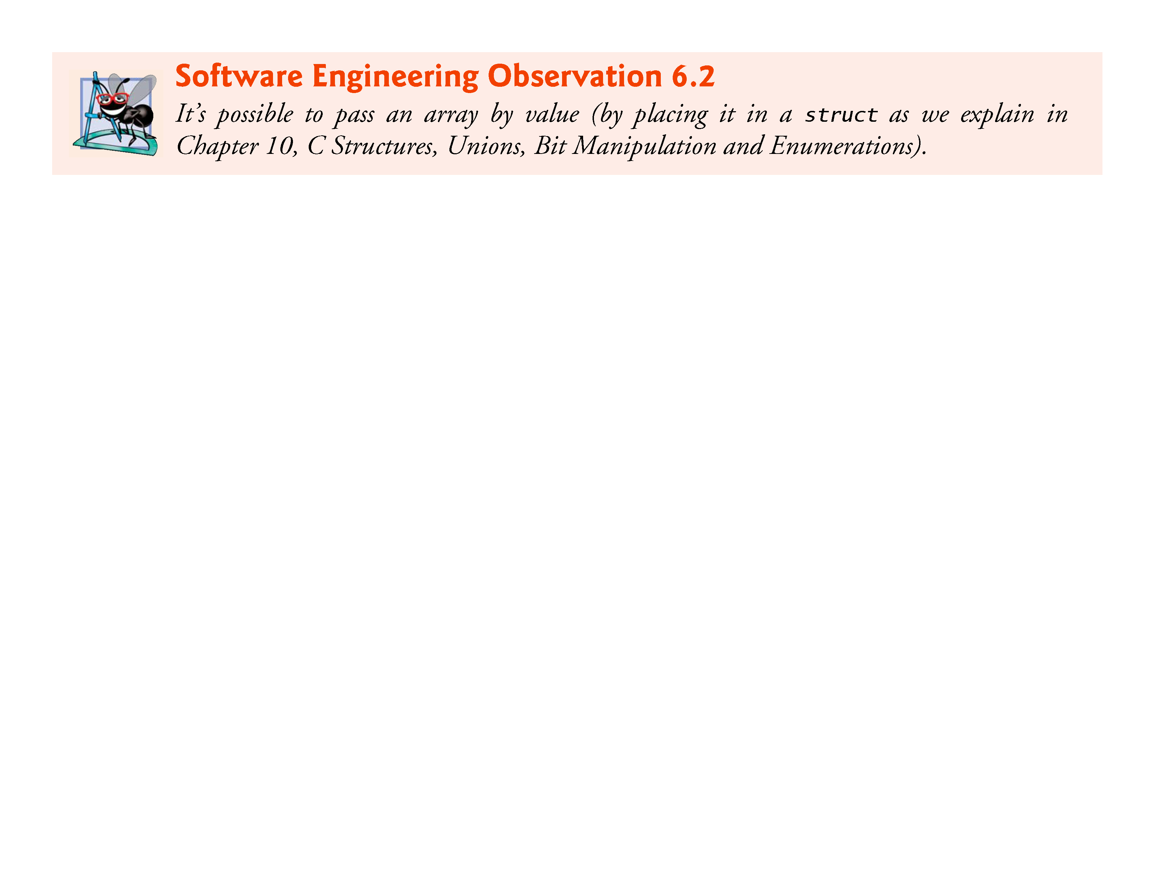

Slide 86
6.7 Passing Arrays to Functions (Cont.)
Although entire arrays are passed by reference, individual array elements are passed by value exactly as simple variables are.
Such simple single pieces of data (such as individual ints, floats and chars) are called scalars.
To pass an element of an array to a function, use the indexed name of the array element as an argument in the function call.
In Chapter 7, we show how to pass scalars (i.e., individual variables and array elements) to functions by reference.

Slide 87
6.7 Passing Arrays to Functions (Cont.)
For a function to receive an array through a function call, the function’s parameter list must specify that an array will be received.
For example, the function header for function modifyArray (that we called earlier in this section) might be written as
void modifyArray(int b[], int size)
indicating that modifyArray expects to receive an array of integers in parameter b and the number of array elements in parameter size.
The size of the array is not required between the array brackets.

Slide 88
6.7 Passing Arrays to Functions (Cont.)
If it’s included, the compiler checks that it’s greater than zero, then ignores it.
Specifying a negative size is a compilation error.
Because arrays are automatically passed by reference, when the called function uses the array name b, it will be referring to the array in the caller (array hourlyTemperatures in the preceding call).

Slide 89
6.7 Passing Arrays to Functions (Cont.)
Difference Between Passing an Entire Array and Passing an Array Element
Figure 6.13 demonstrates the difference between passing an entire array and passing an array element.
The program first prints the five elements of integer array a.
Next, a and its size are passed to function modifyArray, where each of a’s elements is multiplied by 2.
Then a is reprinted in main.

Slide 90
6.7 Passing Arrays to Functions (Cont.)
As the output shows, the elements of a are indeed modified by modifyArray.
Now the program prints the value of a[3] and passes it to function modifyElement.
Function modifyElement multiplies its argument by 2 and prints the new value.
When a[3] is reprinted in main, it has not been modified, because individual array elements are passed by value.

Slide 91
6.7 Passing Arrays to Functions (Cont.)
There may be situations in your programs in which a function should not be allowed to modify array elements.
C provides the type qualifier const (for “constant”) that can be used to prevent modification of array values in a function.
When an array parameter is preceded by the const qualifier, the array elements become constant in the function body, and any attempt to modify an element of the array in the function body results in a compile-time error.
This enables you to correct a program so it does not attempt to modify array elements.

Slide 92
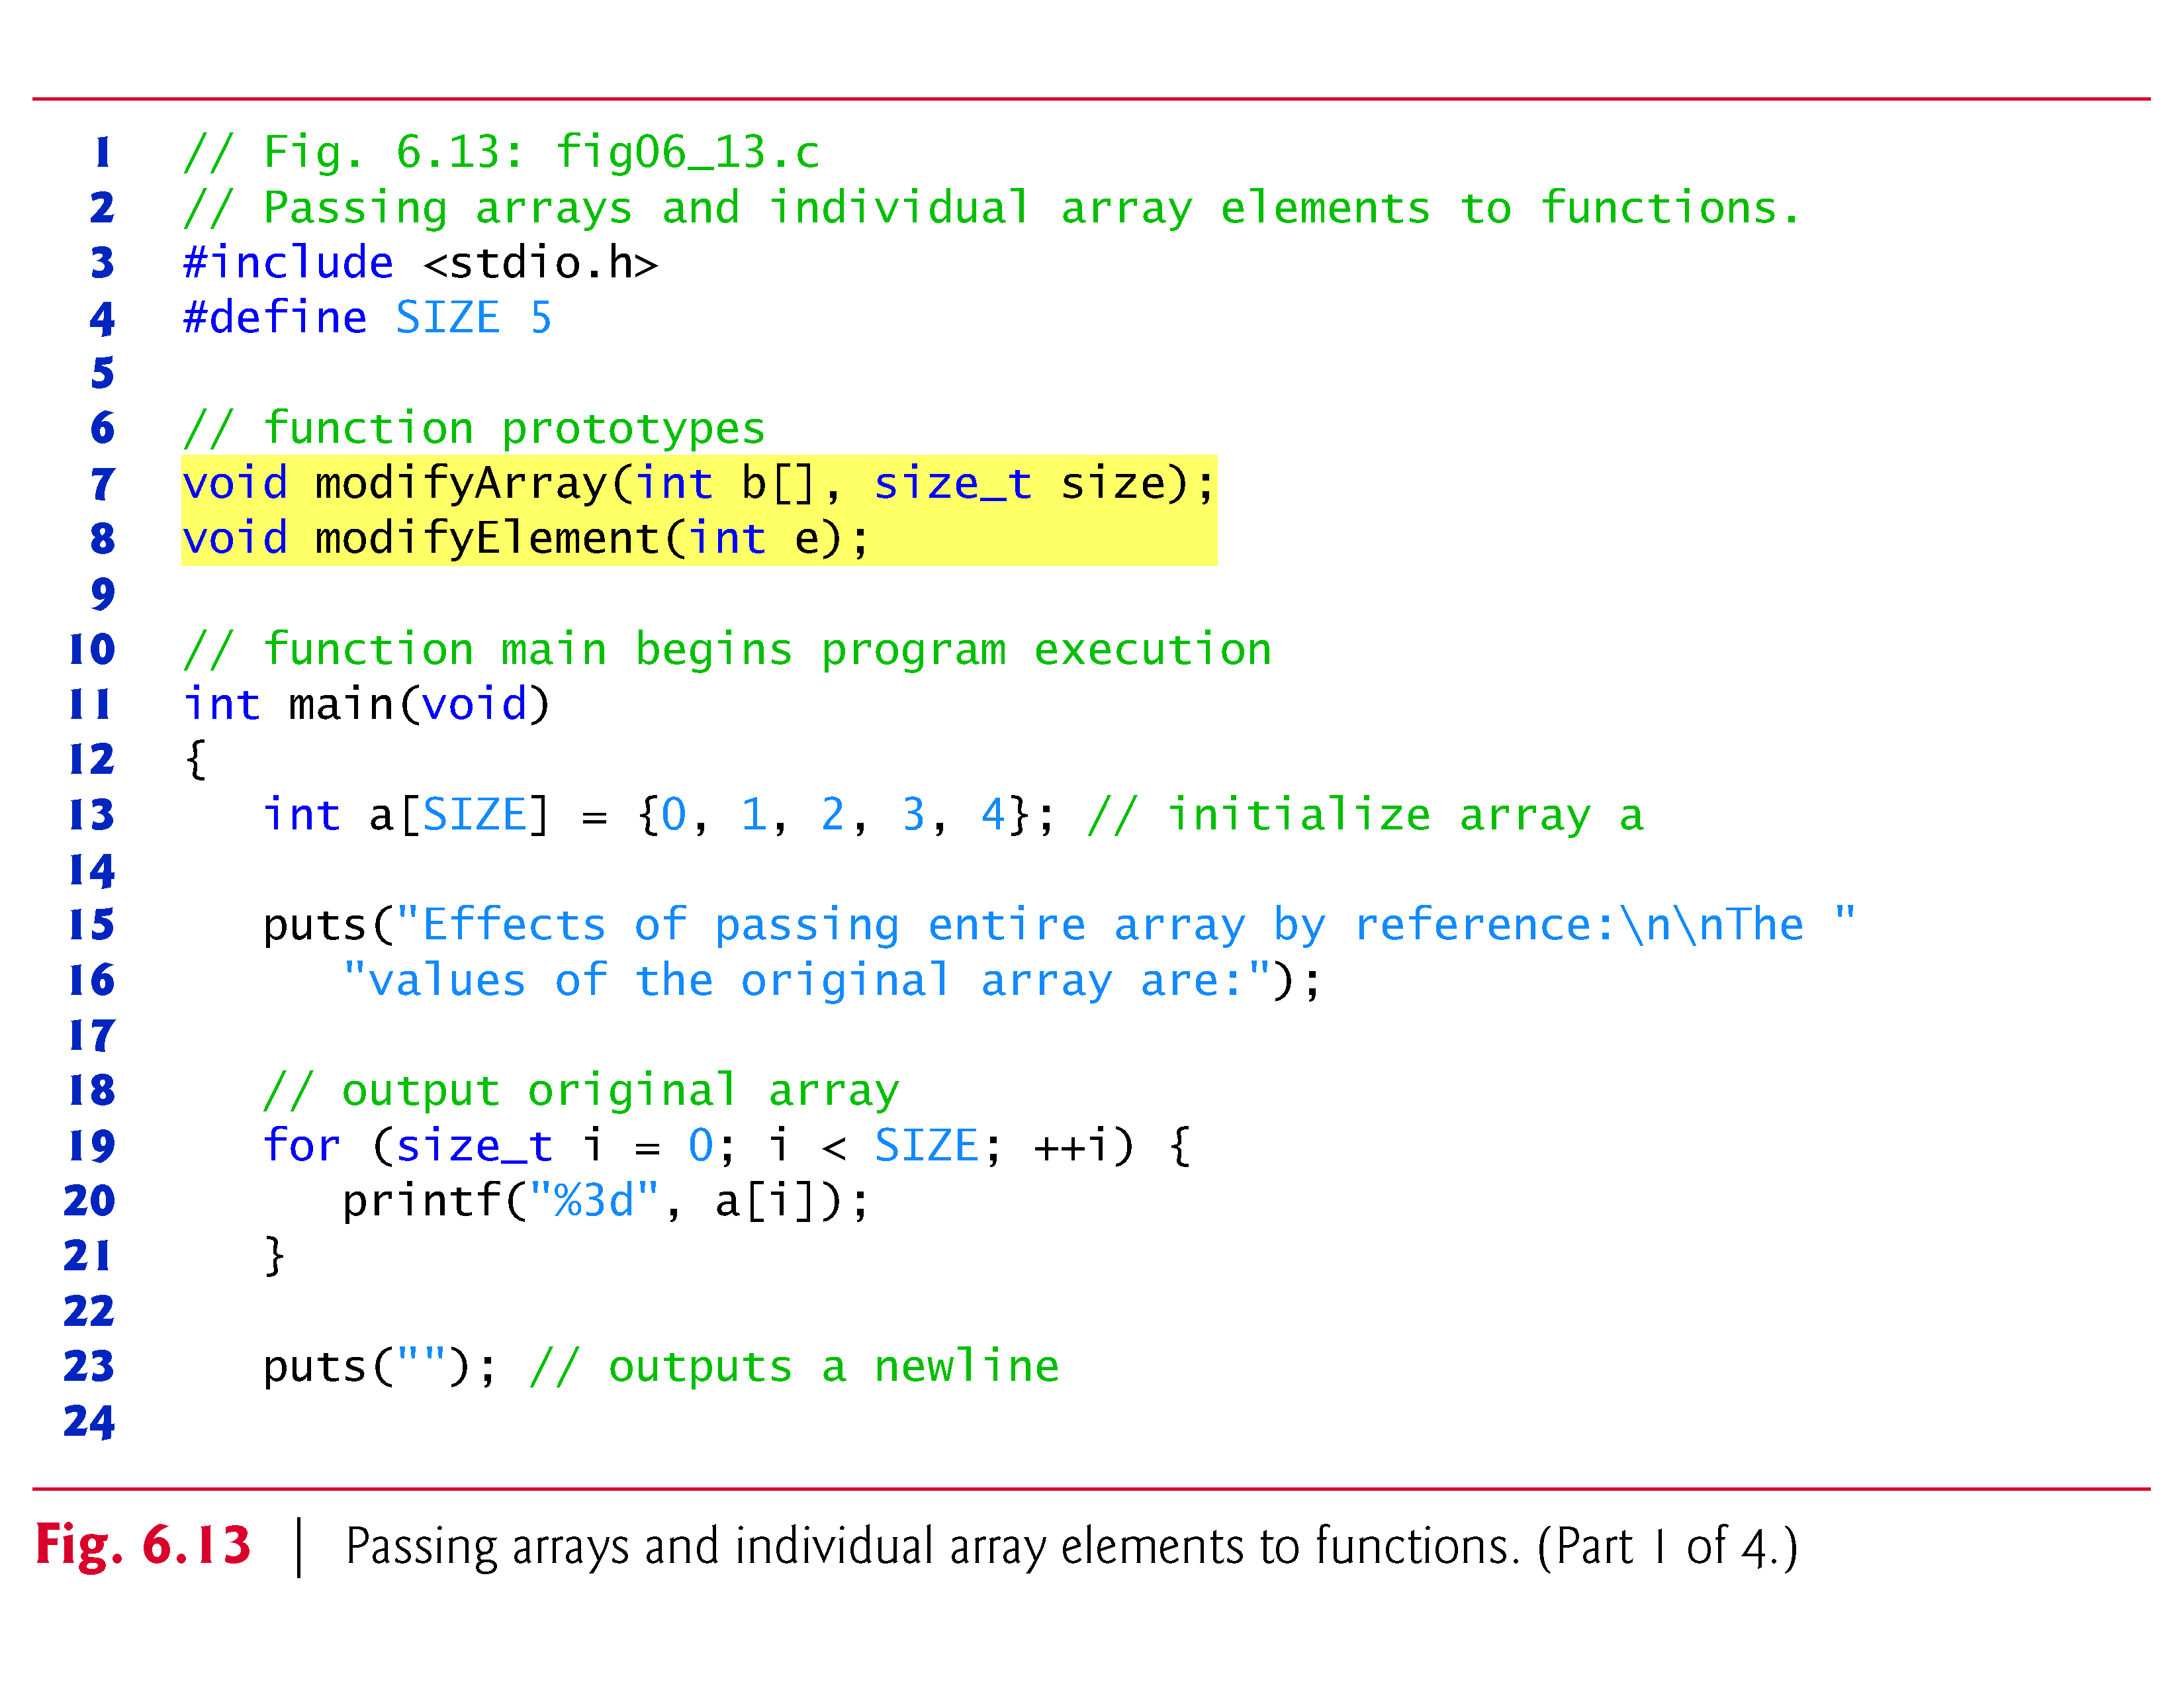

Slide 93
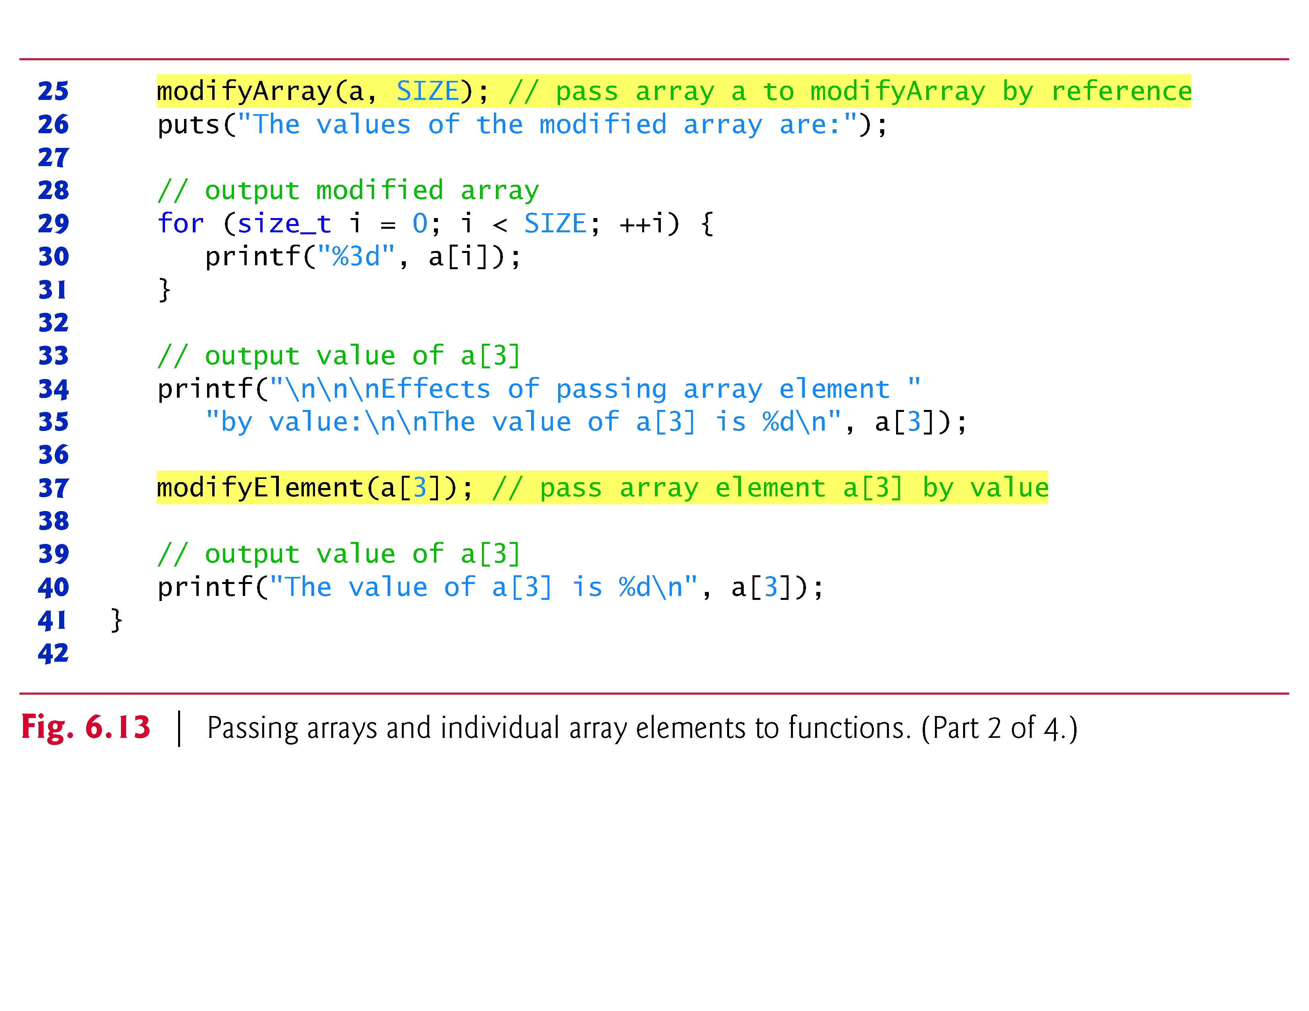

Slide 94
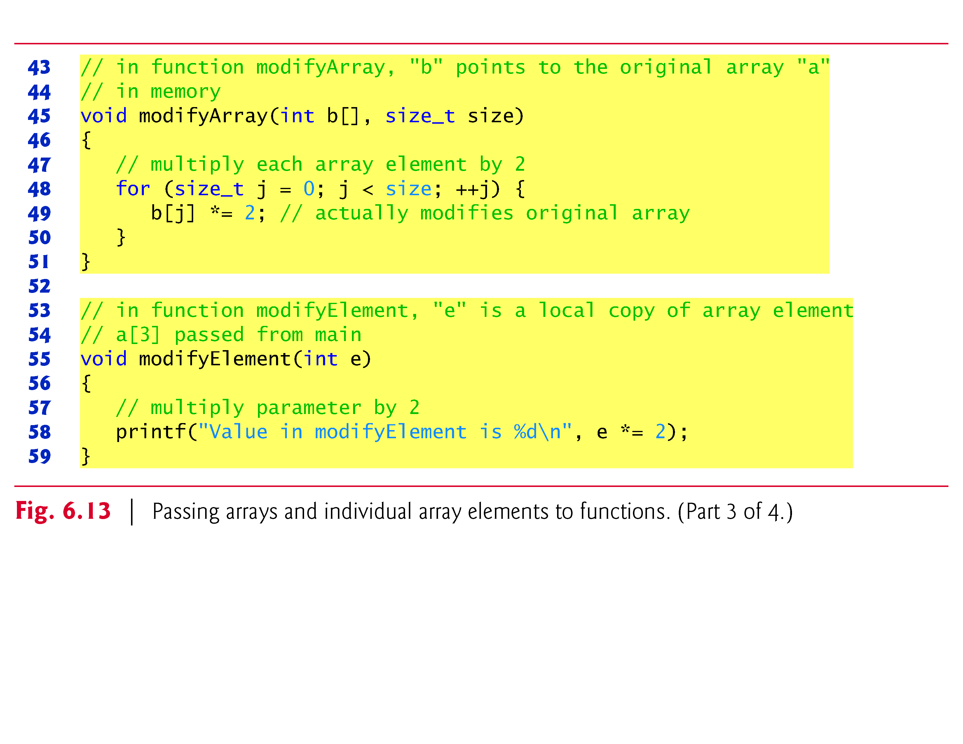

Slide 95
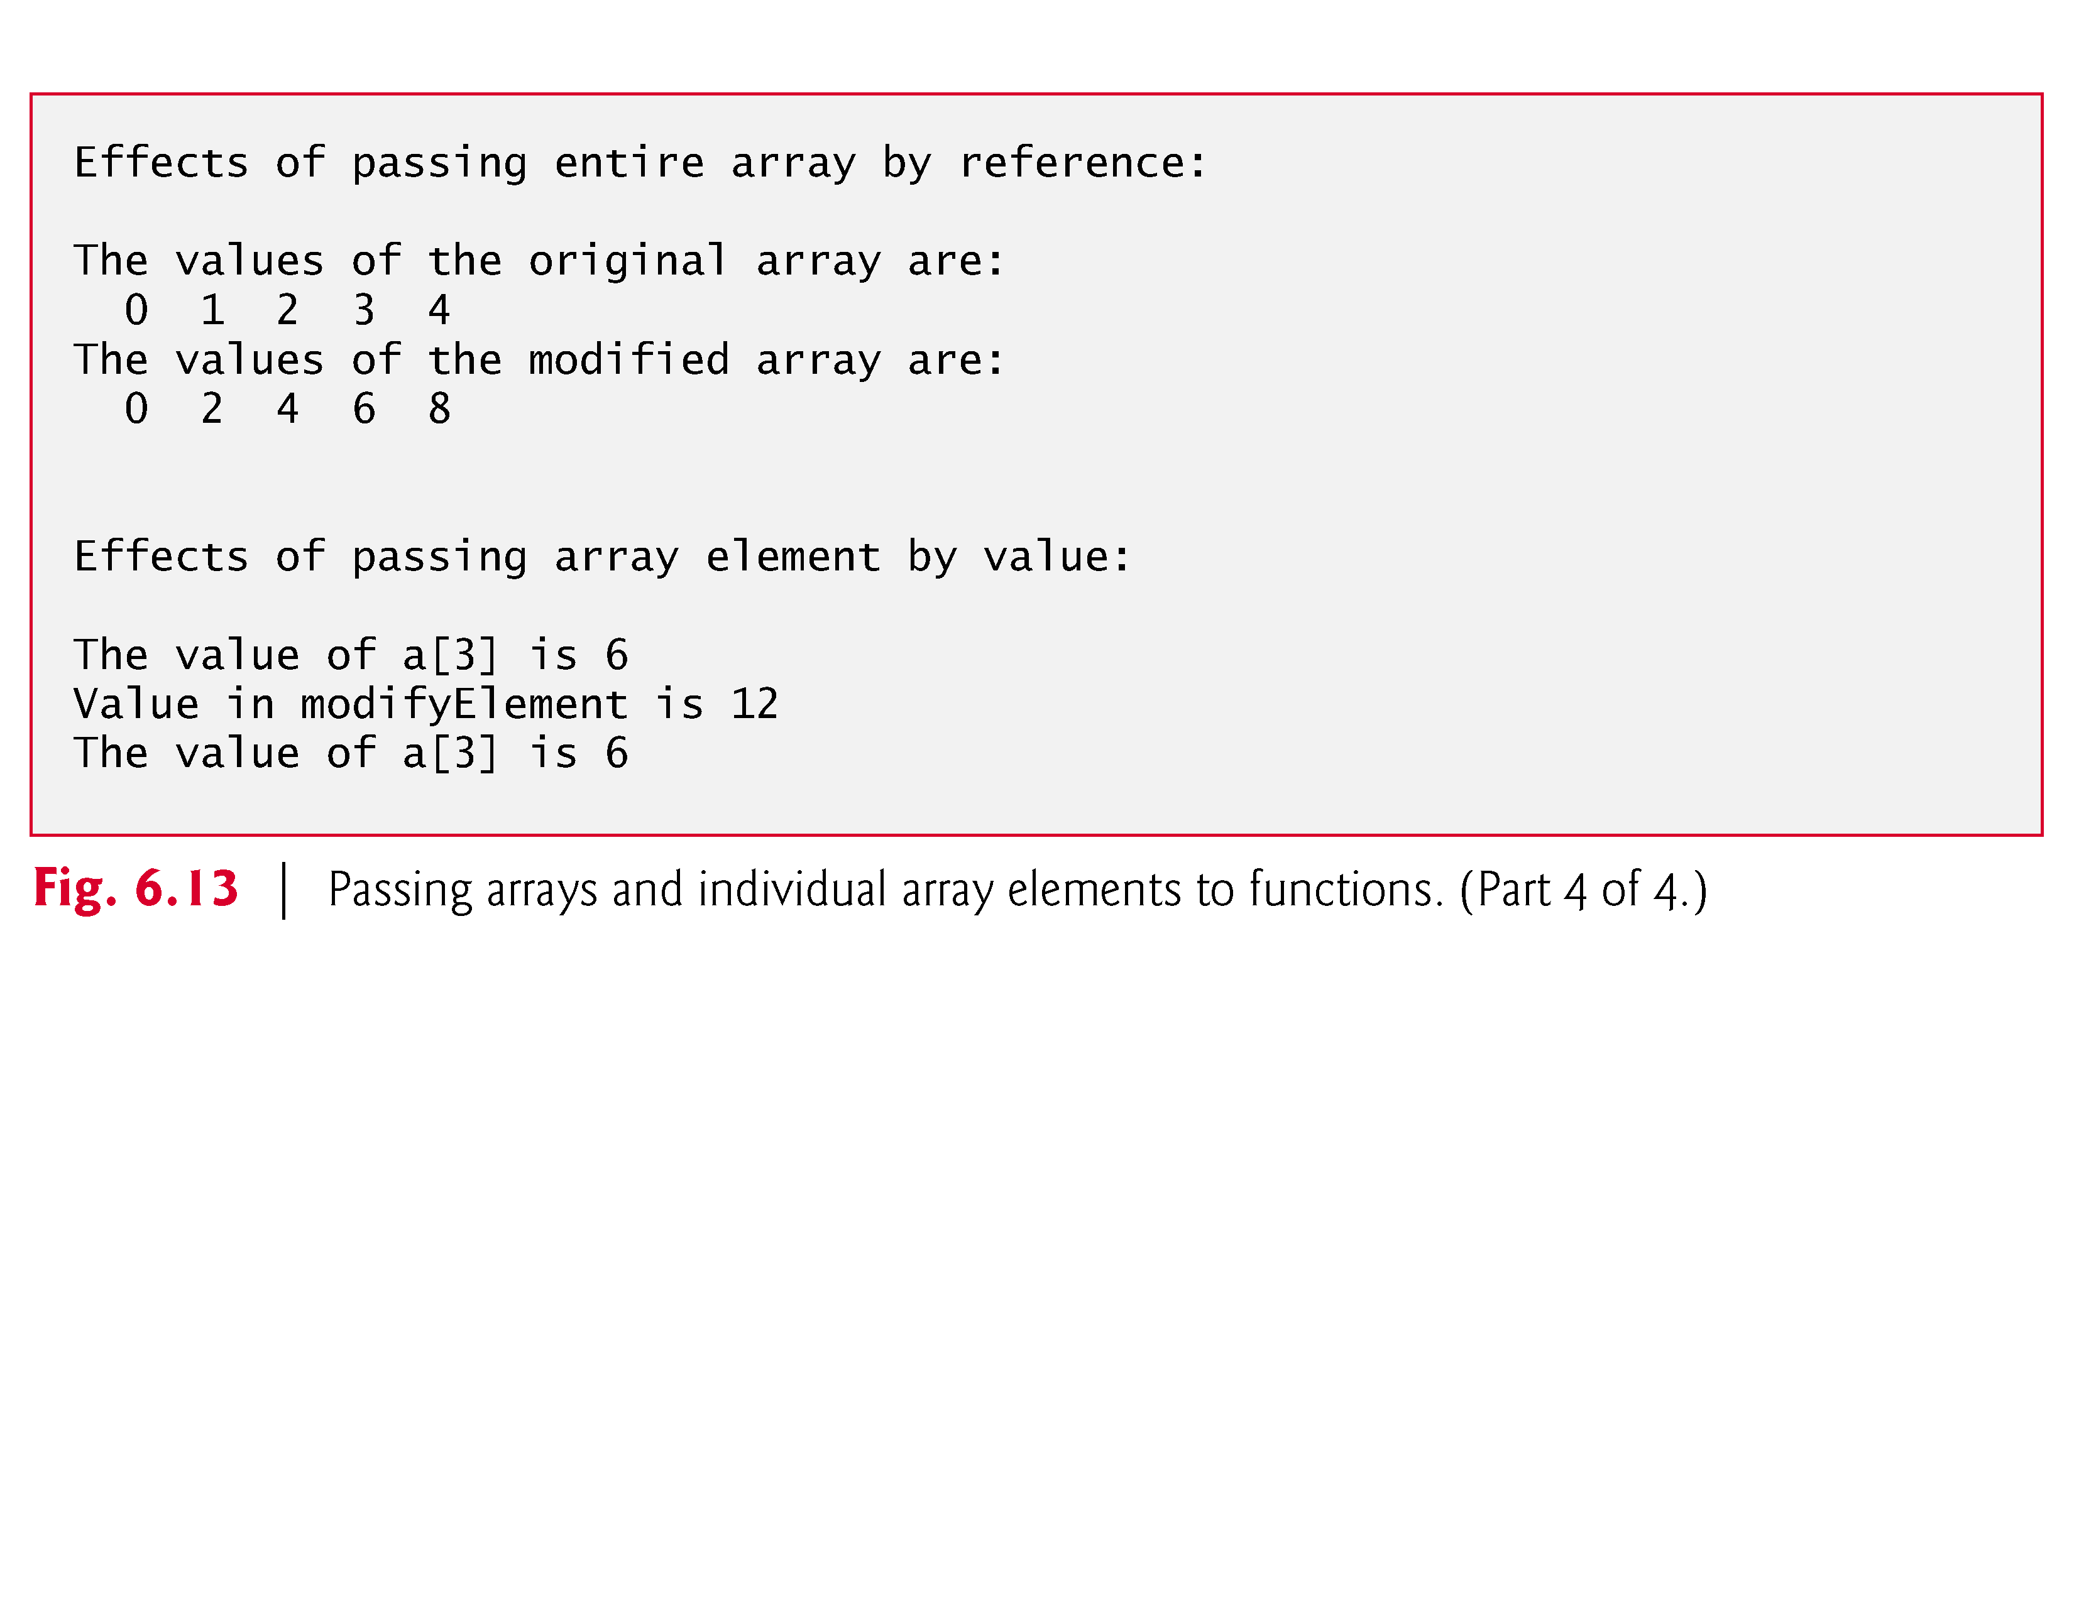

Slide 96
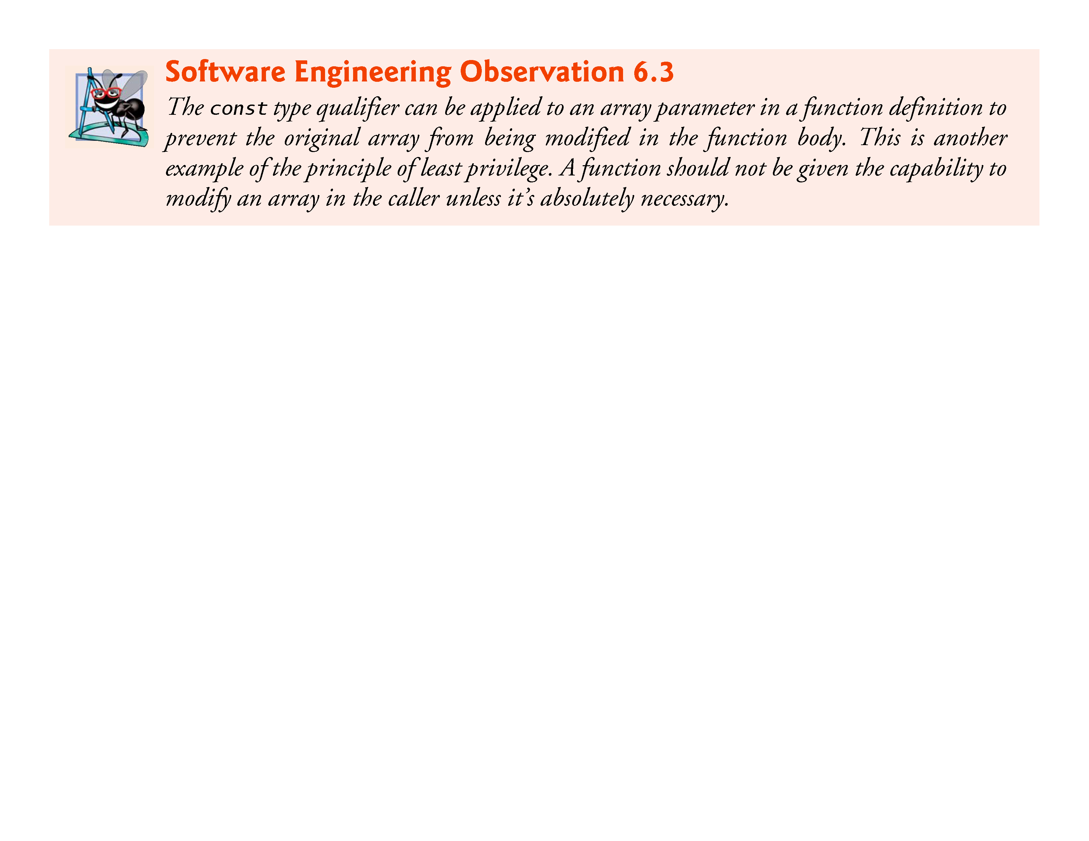

Slide 97
6.7 Passing Arrays to Functions (Cont.)
Using the const Qualifier with Array Parameters
Figure 6.14 demonstrates the const qualifier.
Function tryToModifyArray is defined with parameter const int b[], which specifies that array b is constant and cannot be modified.
The output shows the error messages produced by the compiler—the errors may be different for your compiler.
Each of the function’s three attempts to modify array elements results in the compiler error “l-value specifies a const object.” .

Slide 98
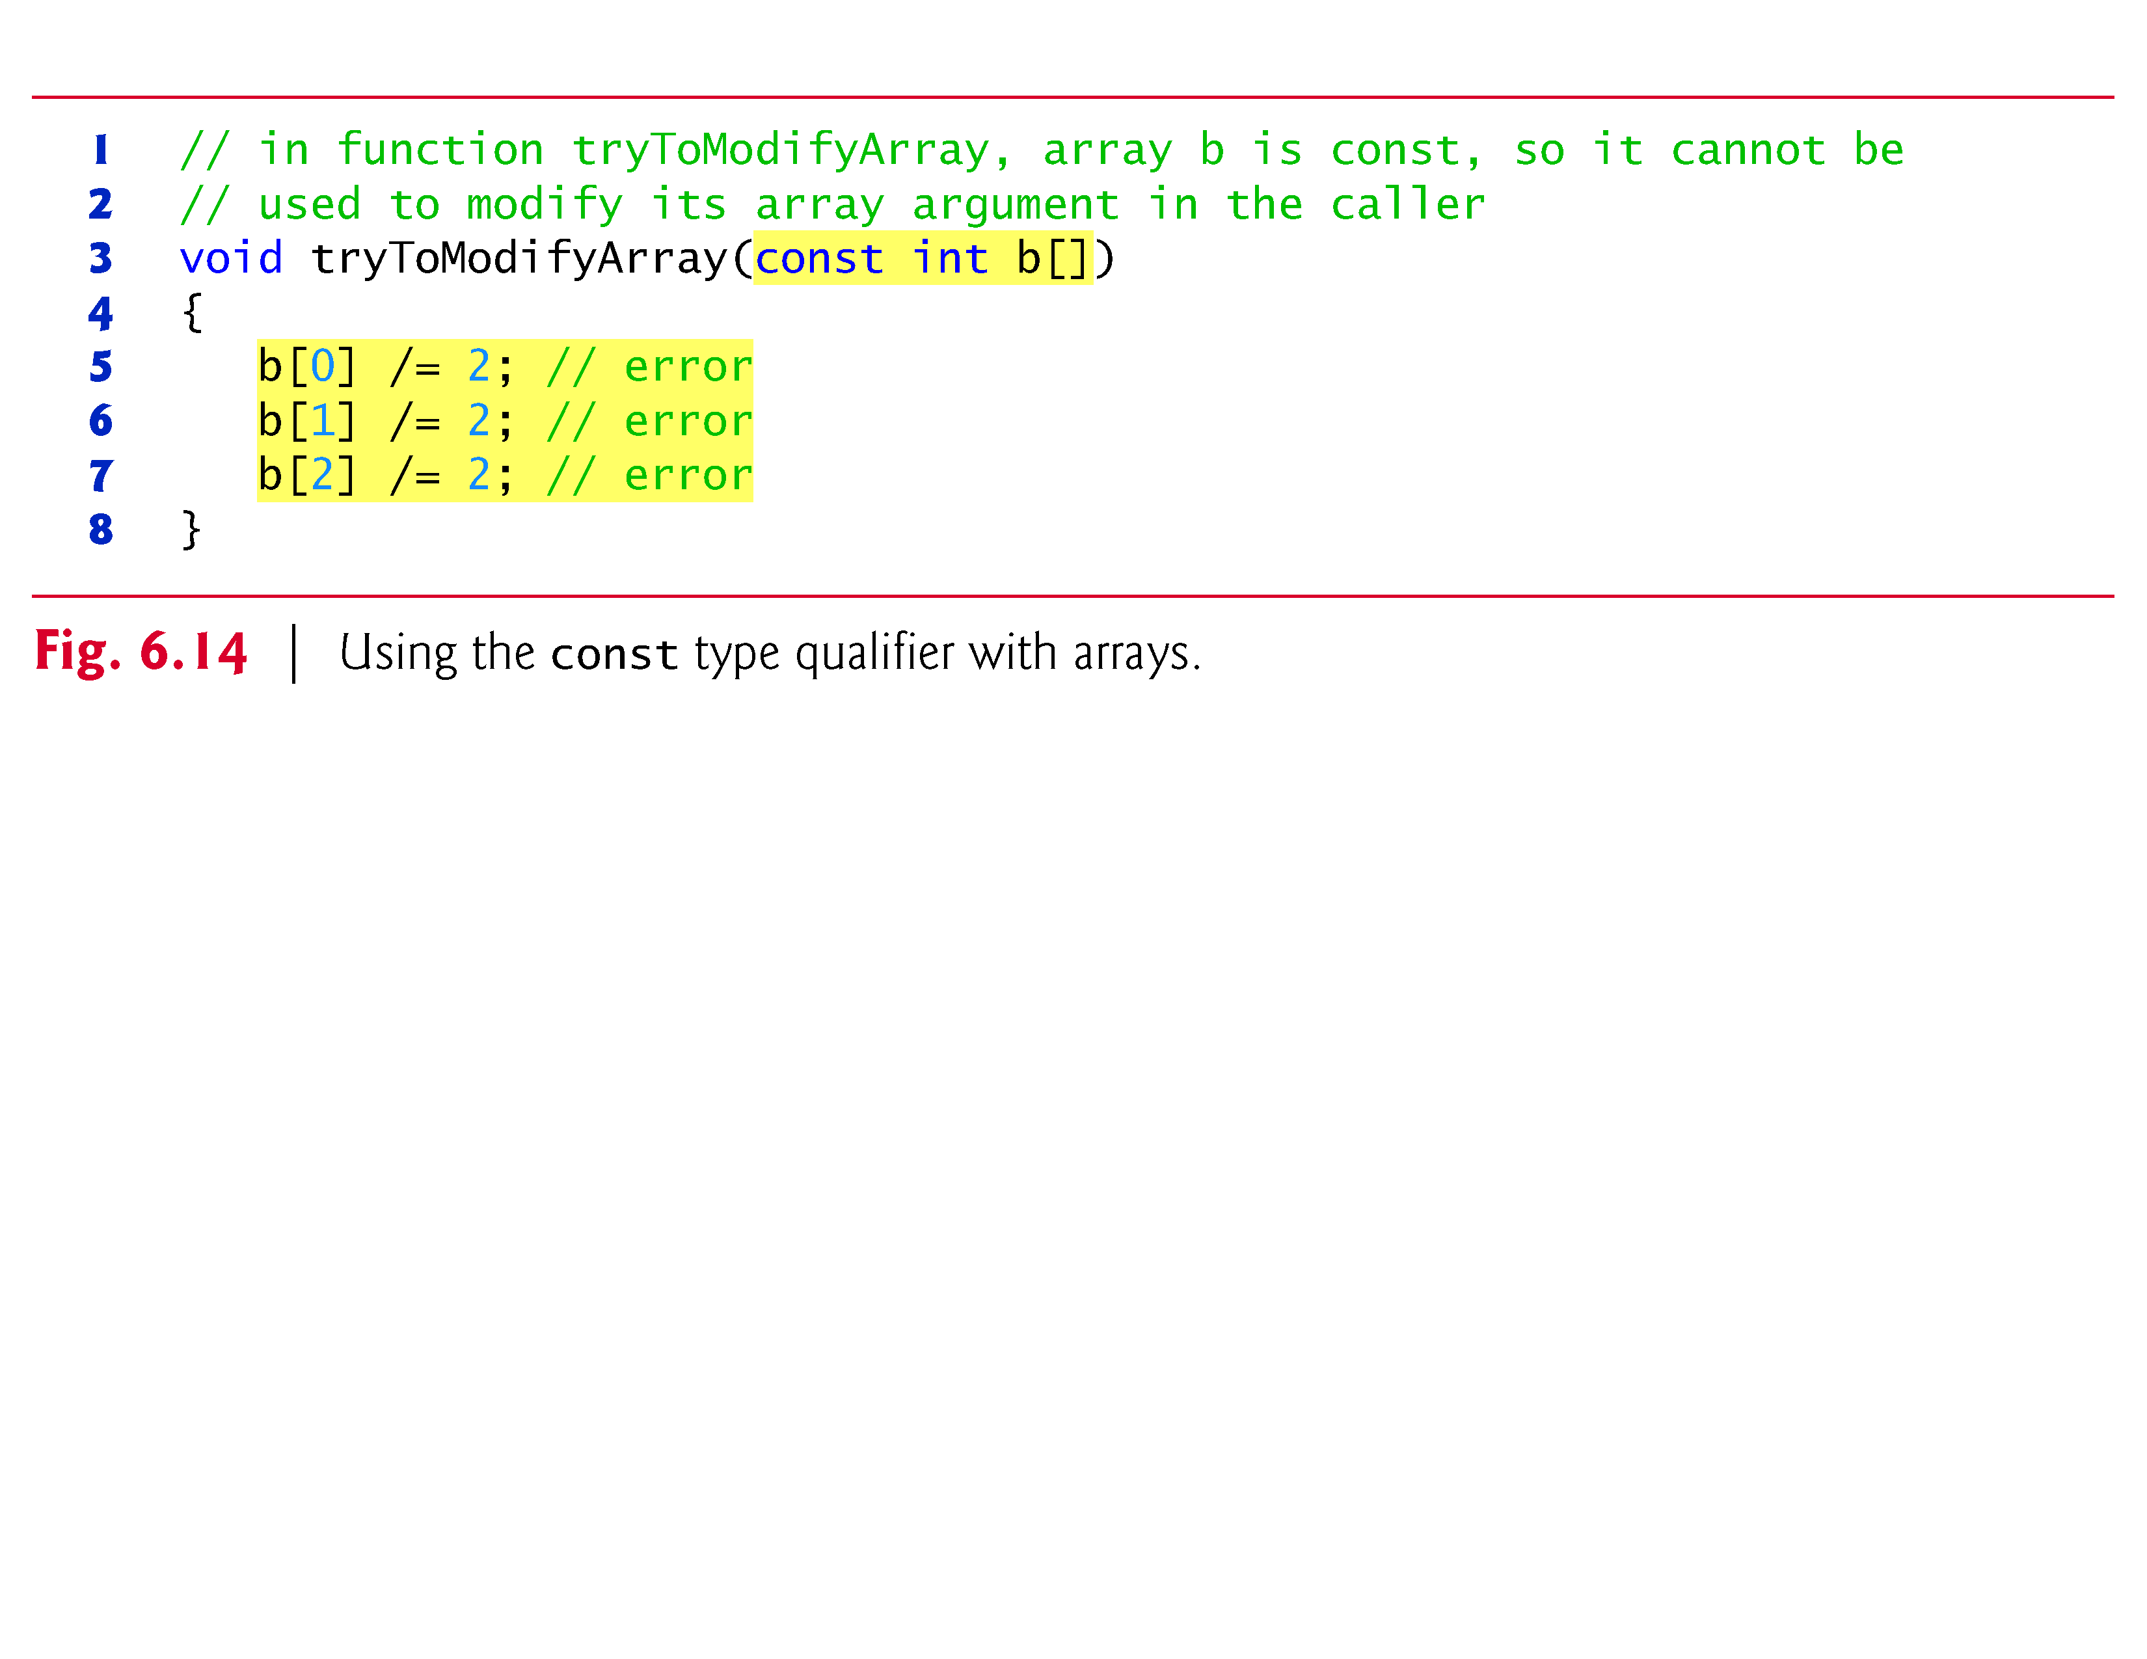

Slide 99
6.8 Sorting Arrays
Sorting data (i.e., placing the data into a particular order such as ascending or descending) is one of the most important computing applications.
In this chapter we discuss what is perhaps the simplest known sorting scheme.
In Chapter 12 and Appendix E, we investigate more complex schemes that yield better performance.

Slide 100
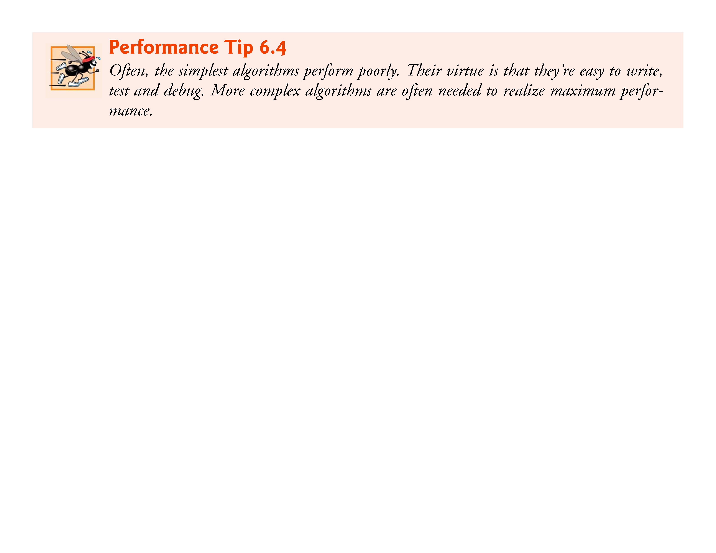

Slide 101
6.8 Sorting Arrays
Figure 6.15 sorts the values in the elements of the 10-element array a into ascending order.
The technique we use is called the bubble sort or the sinking sort because the smaller values gradually “bubble” their way upward to the top of the array like air bubbles rising in water, while the larger values sink to the bottom of the array.
The technique is to make several passes through the array.

Slide 102
6.8 Sorting Arrays
On each pass, successive pairs of elements (element 0 and element 1, then element 1 and element 2, etc.) are compared.
If a pair is in increasing order (or if the values are identical), we leave the values as they are.
If a pair is in decreasing order, their values are swapped in the array.

Slide 103
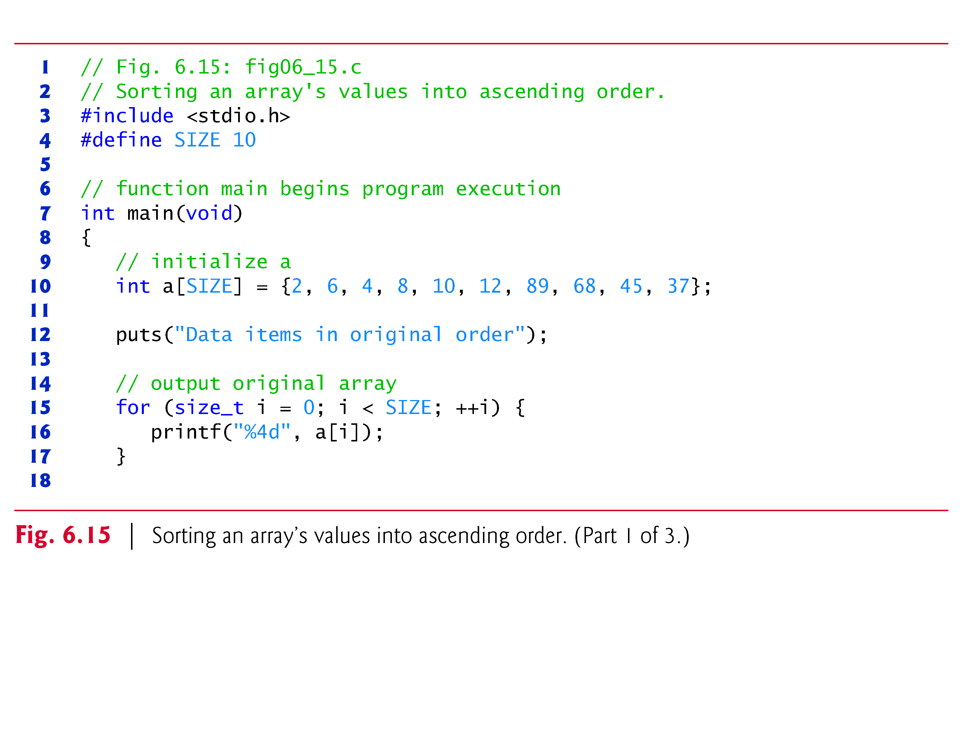

Slide 104
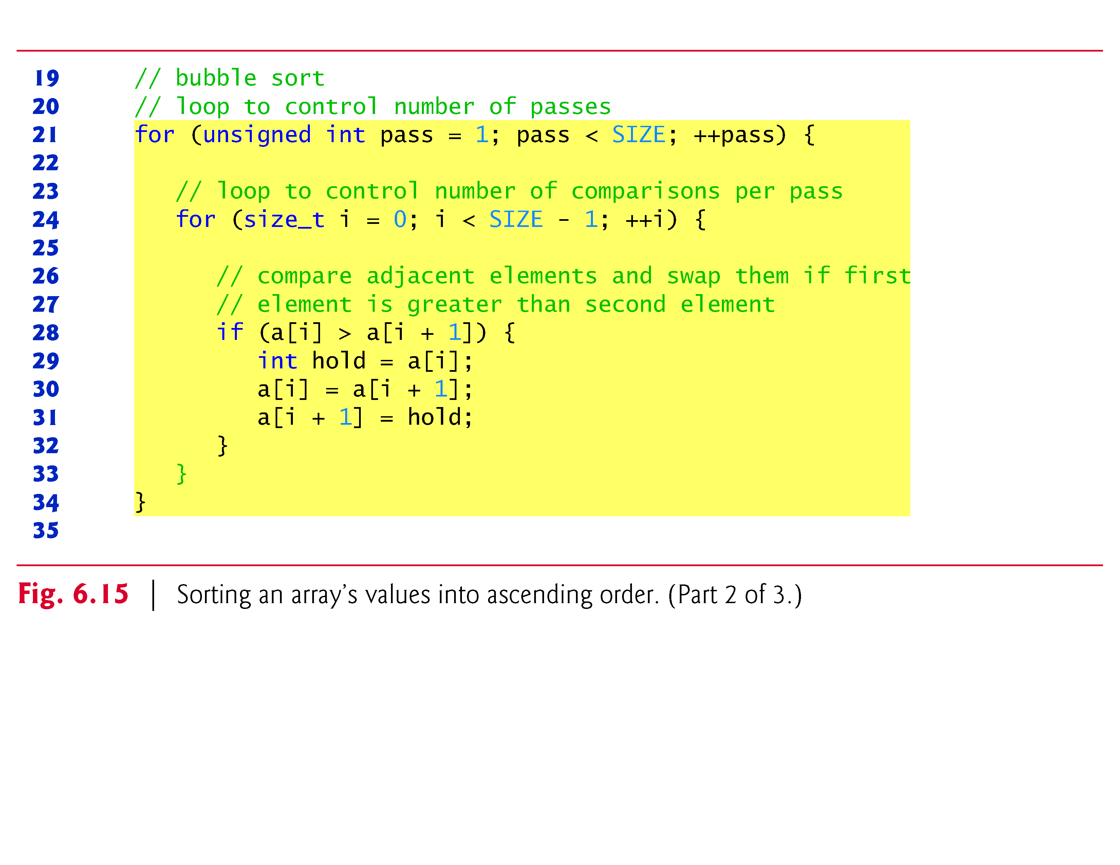

Slide 105
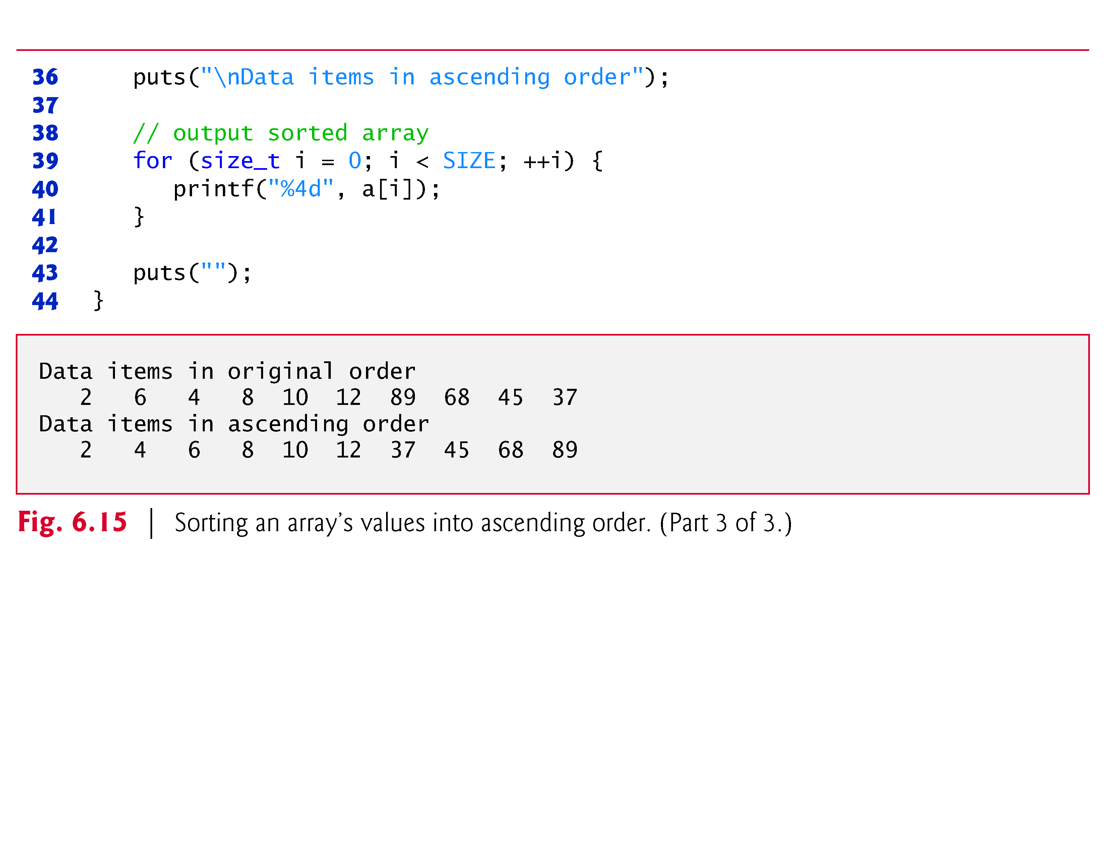

Slide 106
6.8 Sorting Arrays
First the program compares a[0] to a[1], then a[1] to a[2], then a[2] to a[3], and so on until it completes the pass by comparing a[8] to a[9].
Although there are 10 elements, only nine comparisons are performed.
Because of the way the successive comparisons are made, a large value may move down the array many positions on a single pass, but a small value may move up only one position.
On the first pass, the largest value is guaranteed to sink to the bottom element of the array, a[9].

Slide 107
6.8 Sorting Arrays
On the second pass, the second-largest value is guaranteed to sink to a[8].
On the ninth pass, the ninth-largest value sinks to a[1].
This leaves the smallest value in a[0], so only nine passes of the array are needed to sort the array, even though there are ten elements.
The sorting is performed by the nested for loops.

Slide 108
6.8 Sorting Arrays
If a swap is necessary, it’s performed by the three assignments
hold = a[i]; a[i] = a[i + 1]; a[i + 1] = hold;
where the extra variable hold temporarily stores one of the two values being swapped.
The swap cannot be performed with only the two assignments
a[i] = a[i + 1]; a[i + 1] = a[i];

Slide 109
6.8 Sorting Arrays
If, for example, a[i] is 7 and a[i + 1] is 5, after the first assignment both values will be 5 and the value 7 will be lost—hence the need for the extra variable hold.
The chief virtue of the bubble sort is that it’s easy to program.
However, it runs slowly because every exchange moves an element only one position closer to its final destination.
This becomes apparent when sorting large arrays.
In the exercises, we’ll develop more efficient versions of the bubble sort.
Far more efficient sorts than the bubble sort have been developed.

Slide 110
6.9 Case Study: Computing Mean, Median and Mode Using Arrays
Computers are commonly used for survey data analysis to compile and analyze the results of surveys and opinion polls.
Figure 6.16 uses array response initialized with 99 responses to a survey.
Each response is a number from 1 to 9.
The program computes the mean, median and mode of the 99 values.
Figure 6.17 contains a sample run of this program.
This example includes most of the common manipulations usually required in array problems, including passing arrays to functions.

Slide 111


Slide 112


Slide 113


Slide 114


Slide 115


Slide 116


Slide 117


Slide 118


Slide 119


Slide 120


Slide 121


Slide 122
6.9 Case Study: Computing Mean, Median and Mode Using Arrays
Mean
The mean is the arithmetic average of the 99 values.
Function mean (Fig. 6.16) computes the mean by totaling the 99 elements and dividing the result by 99.
Median
The median is the “middle value.”
Function median determines the median by calling function bubbleSort to sort the array of responses into ascending order, then picking answer[SIZE / 2] (the middle element) of the sorted array.

Slide 123
6.9 Case Study: Computing Mean, Median and Mode Using Arrays (Cont.)
When the number of elements is even, the median should be calculated as the mean of the two middle elements.
Function median does not currently provide this capability.
Function printArray is called to output the response array.

Slide 124
6.9 Case Study: Computing Mean, Median and Mode Using Arrays (Cont.)
Mode
The mode is the value that occurs most frequently among the 99 responses.
Function mode determines the mode by counting the number of responses of each type, then selecting the value with the greatest count.
This version of function mode does not handle a tie (see Exercise 7.14).
Function mode also produces a histogram to aid in determining the mode graphically.

Slide 125
6.10 Searching Arrays
It may be necessary to determine whether an array contains a value that matches a certain key value.
The process of finding a particular element of an array is called searching.
In this section we discuss two searching techniques—the simple linear search technique and the more efficient (but more complex) binary search technique.

Slide 126
6.10 Searching Arrays (Cont.)
Searching an Array with Linear Search
The linear search (Fig. 6.18) compares each element of the array with the search key.
Because the array is not in any particular order, it’s just as likely that the value will be found in the first element as in the last.
On average, therefore, the program will have to compare the search key with half the elements of the array.

Slide 127


Slide 128


Slide 129


Slide 130
6.10 Searching Arrays (Cont.)
Searching an Array with Binary Search
The linear searching method works well for small or unsorted arrays.
However, for large arrays linear searching is inefficient.
If the array is sorted, the high-speed binary search technique can be used.
The binary search algorithm eliminates from consideration one-half of the elements in a sorted array after each comparison.
The algorithm locates the middle element of the array and compares it to the search key.

Slide 131
6.10 Searching Arrays (Cont.)
If they’re equal, the search key is found and the index of that element is returned.
If they’re not equal, the problem is reduced to searching one-half of the array.
If the search key is less than the middle element of the array, the first half of the array is searched, otherwise the second half of the array is searched.
If the search key is not found in the specified subarray (piece of the original array), the algorithm is repeated on one-quarter of the original array.

Slide 132
6.10 Searching Arrays (Cont.)
The search continues until the search key is equal to the middle element of a subarray, or until the subarray consists of one element that is not equal to the search key (i.e., the search key is not found).
In a worst case-scenario, searching an array of 1023 elements takes only 10 comparisons using a binary search.
Repeatedly dividing 1,024 by 2 yields the values 512, 256, 128, 64, 32, 16, 8, 4, 2 and 1.
The number 1,024 (2¹⁰) is divided by 2 only 10 times to get the value 1.
Dividing by 2 is equivalent to one comparison in the binary search algorithm.

Slide 133
6.10 Searching Arrays (Cont.)
An array of 1,048,576 (2²⁰) elements takes a maximum of only 20 comparisons to find the search key.
An array of one billion elements takes a maximum of only 30 comparisons to find the search key.
This is a tremendous increase in performance over the linear search that required comparing the search key to an average of half of the array elements.
For a one-billion-element array, this is a difference between an average of 500 million comparisons and a maximum of 30 comparisons!

Slide 134
6.10 Searching Arrays (Cont.)
The maximum comparisons for any array can be determined by finding the first power of 2 greater than the number of array elements.
Figure 6.19 presents the iterative version of function binarySearch
The function receives four arguments—an integer array b to be searched, an integer searchKey, the low array index and the high array index (these define the portion of the array to be searched).
If the search key does not match the middle element of a subarray, the low index or high index is modified so that a smaller subarray can be searched.

Slide 135
6.10 Searching Arrays (Cont.)
If the search key is less than the middle element, the high index is set to middle - 1 and the search is continued on the elements from low to middle - 1.
If the search key is greater than the middle element, the low index is set to middle + 1 and the search is continued on the elements from middle + 1 to high.
The program uses an array of 15 elements.
The first power of 2 greater than the number of elements in this array is 16 (2⁴), so no more than 4 comparisons are required to find the search key.

Slide 136
6.10 Searching Arrays (Cont.)
The program uses function printHeader to output the array indices and function printRow to output each subarray during the binary search process.
The middle element in each subarray is marked with an asterisk (*) to indicate the element to which the search key is compared.

Slide 137


Slide 138


Slide 139


Slide 140


Slide 141


Slide 142


Slide 143


Slide 144
6.11 Multidimensional Arrays
Arrays in C can have multiple indices.
A common use of multidimensional arrays is to represent tables of values consisting of information arranged in rows and columns.
To identify a particular table element, we must specify two indices: The first (by convention) identifies the element’s row and the second (by convention) identifies the element’s column.
Tables or arrays that require two indices to identify a particular element are called two-dimensional arrays.

Slide 145
6.11 Multidimensional Arrays (Cont.)
Multidimensional arrays can have more than two indices.
Figure 6.20 illustrates a two-dimensional array, a.
The array contains three rows and four columns, so it’s said to be a 3-by-4 array.
In general, an array with m rows and n columns is called an m-by-n array

Slide 146


Slide 147
6.11 Multidimensional Arrays (Cont.)
Every element in array a is identified in Fig. 6.20 by an element name of the form a[i][j]; a is the name of the array, and i and j are the indices that uniquely identify each element in a.
The names of the elements in row 0 all have a first index of 0; the names of the elements in column 3 all have a second index of 3.

Slide 148


Slide 149
6.11 Multidimensional Arrays (Cont.)
A multidimensional array can be initialized when it’s defined, much like a one-dimensional array.
For example, a two-dimensional array int b[2][2] could be defined and initialized with
int b[2][2] = {{1, 2}, {3, 4}};
The values are grouped by row in braces.
The values in the first set of braces initialize row 0 and the values in the second set of braces initialize row 1.
So, the values 1 and 2 initialize elements b[0][0] and b[0][1], respectively, and the values 3 and 4 initialize elements b[1][0] and b[1][1], respectively.

Slide 150
6.11 Multidimensional Arrays (Cont.)
If there are not enough initializers for a given row, the remaining elements of that row are initialized to 0.
Thus,
int b[2][2] = {{1}, {3, 4}};
would initialize b[0][0] to 1, b[0][1] to 0, b[1][0] to 3 and b[1][1] to 4.
Figure 6.21 demonstrates defining and initializing two-dimensional arrays.

Slide 151


Slide 152


Slide 153
6.11 Multidimensional Arrays (Cont.)
The program defines three arrays of two rows and three columns (six elements each).
The definition of array1 provides six initializers in two sublists.
The first sublist initializes row 0 of the array to the values 1, 2 and 3; and the second sublist initializes row 1 of the array to the values 4, 5 and 6.

Slide 154
6.11 Multidimensional Arrays (Cont.)
If the braces around each sublist are removed from the array1 initializer list, the compiler initializes the elements of the first row followed by the elements of the second row.
The definition of array2 provides five initializers.
The initializers are assigned to the first row, then the second row.
Any elements that do not have an explicit initializer are initialized to zero automatically, so array2[1][2] is initialized to 0.
The definition of array3 provides three initializers in two sublists.

Slide 155
6.11 Multidimensional Arrays (Cont.)
The sublist for the first row explicitly initializes the first two elements of the first row to 1 and 2.
The third element is initialized to zero.
The sublist for the second row explicitly initializes the first element to 4.
The last two elements are initialized to zero.
The program calls printArray to output each array’s elements.
The function definition specifies the array parameter as const int a[][3].
When we receive a one-dimensional array as a parameter, the array brackets are empty in the function’s parameter list.

Slide 156
6.11 Multidimensional Arrays (Cont.)
The first index of a multidimensional array is not required either, but all subsequent indices are required.
The compiler uses these indices to determine the locations in memory of elements in multidimensional arrays.
All array elements are stored consecutively in memory regardless of the number of indices.
In a two-dimensional array, the first row is stored in memory followed by the second row.
Providing the index values in a parameter declaration enables the compiler to tell the function how to locate an element in the array.

Slide 157
6.11 Multidimensional Arrays (Cont.)
In a two-dimensional array, each row is basically a one-dimensional array.
To locate an element in a particular row, the compiler must know how many elements are in each row so that it can skip the proper number of memory locations when accessing the array.
Thus, when accessing a[1][2] in our example, the compiler knows to skip the three elements of the first row to get to the second row (row 1).
Then, the compiler accesses element 2 of that row.

Slide 158
6.11 Multidimensional Arrays (Cont.)
Many common array manipulations use for iteration statements.
For example, the following statement sets all the elements in row 2 of array a in Fig. 6.20 to zero:
for (size_t column = 0; column <= 3; ++column) { a[2][column] = 0; }
We specified row 2, so the first index is always 2.

Slide 159
6.11 Multidimensional Arrays (Cont.)
The loop varies only the second index.
The preceding for statement is equivalent to the assignment statements:
a[2][0] = 0; a[2][1] = 0; a[2][2] = 0; a[2][3] = 0;

Slide 160
6.11 Multidimensional Arrays (Cont.)
The following nested for statement determines the total of all the elements in array a.
total = 0;
for (size_t row = 0; row <= 2; ++row) { for (size_t column = 0; column <= 3; ++column) { total += a[row][column]; } }
The for statement totals the elements of the array one row at a time.

Slide 161
6.11 Multidimensional Arrays (Cont.)
The outer for statement begins by setting row (i.e., the row index) to 0 so that the elements of that row may be totaled by the inner for statement.
The outer for statement then increments row to 1, so the elements of that row can be totaled.
Then, the outer for statement increments row to 2, so the elements of the third row can be totaled.
When the nested for statement terminates, total contains the sum of all the elements in the array a.

Slide 162
6.11 Multidimensional Arrays (Cont.)
Two-Dimensonal Array Manipulations
Figure 6.22 performs several other common array manipulations on 3-by-4 array studentGrades using for statements.
Each row of the array represents a student and each column represents a grade on one of the four exams the students took during the semester.
The array manipulations are performed by four functions.
Function minimum determines the lowest grade of any student for the semester.

Slide 163
6.11 Multidimensional Arrays (Cont.)
Function maximum determines the highest grade of any student for the semester.
Function average determines a particular student’s semester average.
Function printArray outputs the two-dimensional array in a neat, tabular format.

Slide 164


Slide 165


Slide 166


Slide 167


Slide 168


Slide 169


Slide 170


Slide 171
6.11 Multidimensional Arrays (Cont.)
Functions minimum, maximum and printArray each receive three arguments—the studentGrades array (called grades in each function), the number of students (rows of the array) and the number of exams (columns of the array).
Each function loops through array grades using nested for statements.

Slide 172
6.11 Multidimensional Arrays (Cont.)
The following nested for statement is from the function minimum definition:
// loop through rows of grades for (size_t i = 0; i < pupils; ++i) { // loop through columns of grades for (size_t j = 0; j < tests; ++j) { if (grades[i][j] < lowGrade) { lowGrade = grades[i][j]; } } }

Slide 173
6.11 Multidimensional Arrays (Cont.)
The outer for statement begins by setting i (i.e., the row index) to 0 so that the elements of that row (i.e., the grades of the first student) can be compared to variable lowGrade in the body of the inner for statement.
The inner for statement loops through the four grades of a particular row and compares each grade to lowGrade.
If a grade is less than lowGrade, lowGrade is set to that grade.
The outer for statement then increments the row index to 1.
The elements of that row are compared to variable lowGrade.

Slide 174
6.11 Multidimensional Arrays (Cont.)
The outer for statement then increments the row index to 2.
The elements of that row are compared to variable lowGrade.
When execution of the nested statement is complete, lowGrade contains the smallest grade in the two-dimensional array.
Function maximum works similarly to function minimum.
Function average takes two arguments—a one-dimensional array of test results for a particular student called setOfGrades and the number of test results in the array.

Slide 175
6.11 Multidimensional Arrays (Cont.)
When average is called, the first argument studentGrades[student] is passed.
This causes the address of one row of the two-dimensional array to be passed to average.
The argument studentGrades[1] is the starting address of row 1 of the array.
Remember that a two-dimensional array is basically an array of one-dimensional arrays and that the name of a one-dimensional array is the address of the array in memory.
Function average calculates the sum of the array elements, divides the total by the number of test results and returns the floating-point result.

Slide 176
6.12 Variable-Length Arrays
In early versions of C, all arrays had constant size.
But what if you don’t know an array’s size at compilation time?
To handle this, you’d have to use dynamic memory allocation with malloc and related functions.
The C standard allows you to handle arrays of unknown size using variable-length arrays (VLAs).
These are not arrays whose size can change—that would compromise the integrity of nearby locations in memory.

Slide 177
6.12 Variable-Length Arrays (Cont.)
A variable-length array is an array whose length, or size, is defined in terms of an expression evaluated at execution time.
The program of Fig. 6.23 declares and prints several VLAs.
[Note: This feature is not supported in Microsoft Visual C++.]

Slide 178


Slide 179


Slide 180


Slide 181


Slide 182


Slide 183
6.12 Variable-Length Arrays (Cont.)
First, we prompt the user for the desired sizes for a one-dimensional array and two two-dimensional arrays .
Next we declare VLAs of the appropriate size.
This is valid as long as the variables representing the array sizes are of an integral type.
After declaring the arrays, we use the sizeof operator to make sure that our VLA is of the proper length.
In early versions of C sizeof was always a compile-time operation, but when applied to a VLA, sizeof operates at runtime.

Slide 184
6.12 Variable-Length Arrays (Cont.)
The output window shows that the sizeof operator returns a size of 24 bytes—four times that of the number we entered because the size of an int on our machine is 4 bytes.
Next we assign values to the elements of our VLAs.
We use i < arraySize as our loop-continuation condition when filling the one-dimensional array.
As with fixed-length arrays, there is no protection against stepping outside the array bounds.
Function print1DArray takes a one-dimensional VLA.

Slide 185
6.12 Variable-Length Arrays (Cont.)
The syntax for passing VLAs as parameters to functions is the same as with a normal, fixed-length array.
We use the variable size in the declaration of the array parameter, but no checking is performed other than the variable being defined and of integral type—it’s purely documentation for the programmer.
Function print2DArray takes a variable-length two-dimensional array and displays it to the screen.
Recall from Section 6.9 that, all but the first index of a multidimensional array must be specified when declaring a function parameter.

Slide 186
6.12 Variable-Length Arrays (Cont.)
The same restriction holds true for VLAs, except that the sizes can be specified by variables.
The initial value of col passed to the function is used to convert from two-dimensional indices to offsets into the contiguous memory the array is stored in, just as with a fixed-size array.
Changing the value of col inside the function will not cause any changes to the indexing, but passing an incorrect value to the function will.

Slide 187
6.13 Secure C Programming
Bounds Checking for Array Indices
It’s important to ensure that every index you use to access an array element is within the array’s bounds—that is, greater than or equal to 0 and less than the number of array elements.
A two-dimensional array’s row and column indices must be greater than or equal to 0 and less than the numbers of rows and columns, respectively.
Allowing programs to read from or write to array elements outside the bounds of arrays are common security flaws.
Reading from out-of-bounds array elements can cause a program to crash or even appear to execute correctly while using bad data.

Slide 188
6.13 Secure C Programming (Cont.)
Writing to an out-of-bounds element (known as a buffer overflow) can corrupt a program’s data in memory, crash a program and allow attackers to exploit the system and execute their own code.
As we stated in the chapter, C provides no automatic bounds checking for arrays, so you must provide your own.
For techniques that help you prevent such problems, see CERT guideline ARR30-C at www.securecoding.cert.org.

Slide 189
6.13 Secure C Programming (Cont.)
scanf_s
Bounds checking is also important in string processing.
When reading a string into a char array, scanf does not prevent buffer overflows.
If the number of characters input is greater than or equal to the array’s length, scanf will write characters—including the string’s terminating null character ('\0')—beyond the end of the array.
This might overwrite other variables’ values, and eventually the program might overwrite the string’s '\0' if it writes to those other variables.

Slide 190
6.13 Secure C Programming (Cont.)
Functions determine where strings end by looking for their terminating '\0' character.
For example, function printf outputs a string by reading characters from the beginning of the string in memory and continuing until the string’s '\0' is encountered.
If the '\0' is missing, printf might read far beyond the end of the string until it encounters some other '\0' in memory.

Slide 191
6.13 Secure C Programming (Cont.)
The C standard’s optional Annex K provides new, more secure, versions of many string-processing and input/output functions, including scanf_s—a version of scanf that performs additional checks to ensure that it does not write beyond the end of a character array used to store a string.
Assuming that myString is a 20-character array, the statement
scanf_s("%19s", myString, 20);
reads a string into myString. Function scanf_s requires two arguments for each %s in the format string—a character array in which to place the input string and the number of array elements.

Slide 192
6.13 Secure C Programming (Cont.)
The second of these arguments is used by scanf_s to prevent buffer overflows.
For example, it’s possible to supply a field width for %s that’s too long for the underlying character array, or to simply omit the field width entirely.
If the number of characters input plus the terminating null character is larger than the number of array elements, the %s conversion would fail.
Because the preceding statement contains only one conversion specifier, scanf_s would return 0 indicating that no conversions were performed, and myString would be unaltered.
In general, if your compiler supports the functions from the C standard’s optional Annex K, you should use them.

Slide 193
6.13 Secure C Programming (Cont.)
Don’t Use Strings Read from the User as Format-Control Strings
You might have noticed that throughout this book, we never use single-argument printfs. Instead we use one of the following forms:
When we need to output a '\n' after the string, we use function puts (which automatically outputs a '\n' after its single string argument), as in
puts("Welcome to C!");
When we need the cursor to remain on the same line as the string, we use function printf, as in
printf("%s", "Enter first integer: ");

Slide 194
6.13 Secure C Programming (Cont.)
Because we were displaying string literals, we certainly could have used the one-argument form of printf, as in
printf("Welcome to C!\n");
printf("Enter first integer: ");
When printf evaluates the format-control string in its first (and possibly its only) argument, the function performs tasks based on the conversion specifier(s) in that string.
If the format-control string were obtained from the user, an attacker could supply malicious conversion specifiers that would be “executed” by the formatted output function.

Slide 195
6.13 Secure C Programming (Cont.)
Now that you know how to read strings into character arrays, it’s important to note that you should never use as a printf’s format-control string a character array that might contain user input.
For more information, see CERT guideline FIO30-C at www.securecoding.cert.org.

Slide 196


